Slide 1
Unit 4 Weekend
He often plays football.
WWW.PPT818.COM

Slide 2
Read them!

Slide 3
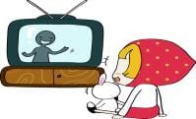
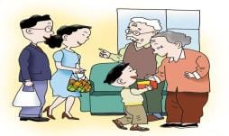
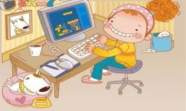
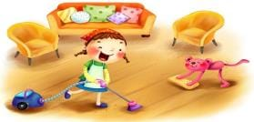
visit my grandparents
watch TV
play computer games
do housework
read books

Slide 4
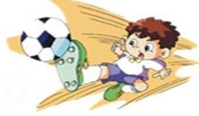
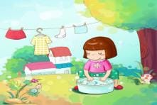
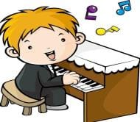
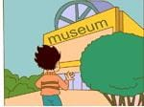
play football
wash clothes
go swimming
go to the museum
play the piano

Slide 5
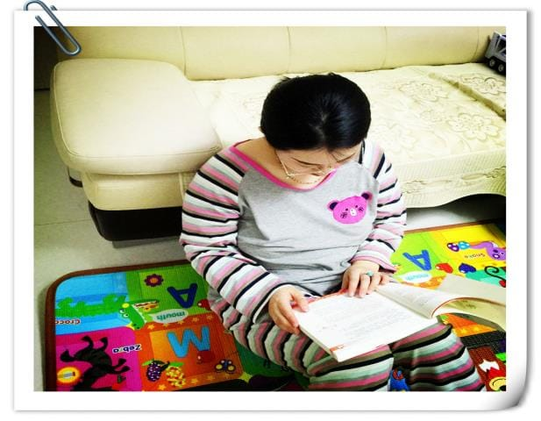

Slide 6
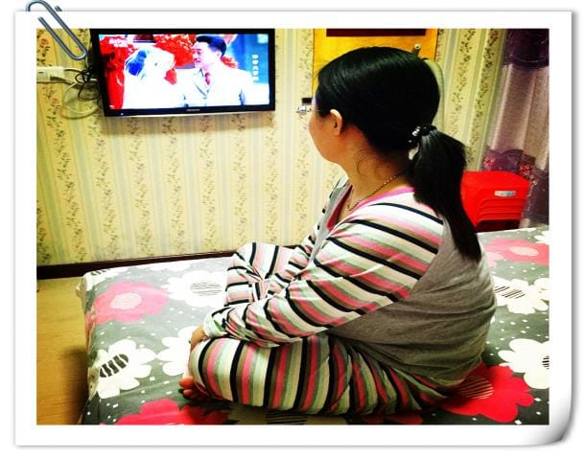

Slide 7
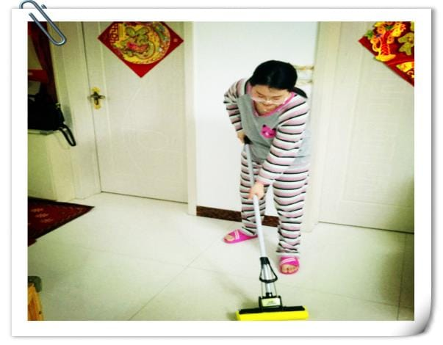

Slide 8
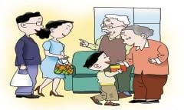
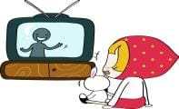
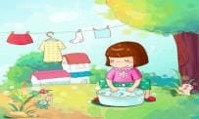
What do you do at the weekend?
...
I often...
Sometimes I...

Slide 9
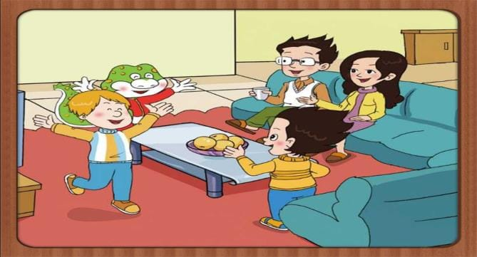
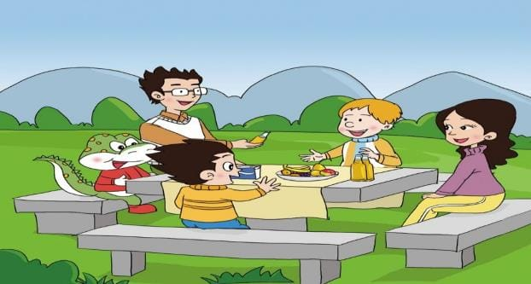
have a picnic
They __________ on Saturday.
A. climb the hill
B. have a picnic

Slide 10
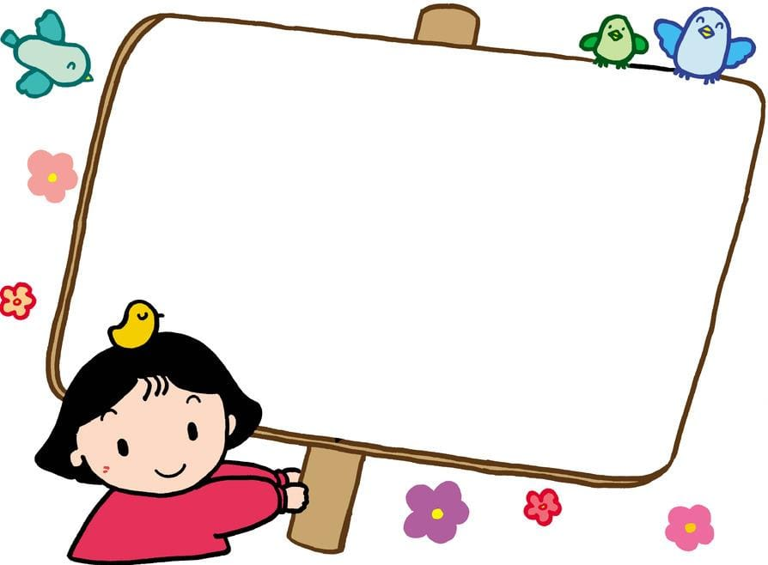
What does your mother do at the weekend?
Watch TV ?
Go shopping ?
Do housework ?
Go to the cinema ?

Slide 11
China
Canada
Ottawa
cinema

Slide 12
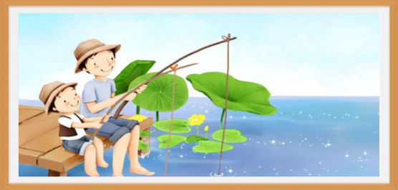
What does your father do at the weekend?
goes fishing
He often _____________.
goes fishing
goes swimming

Slide 13
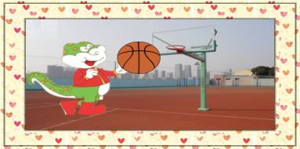
What does Danny usually do at the weekend?
He usually _____________.
plays football

Slide 14
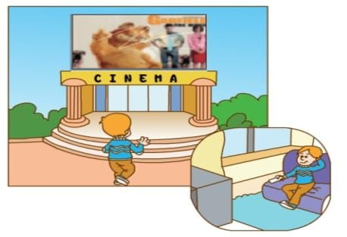
What does Peter do at the weekend?
goes to the cinema
He often _______________.
Sometimes he _________.
watches TV

Slide 15
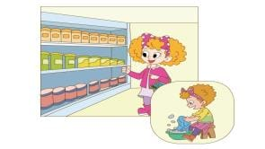
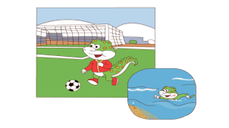
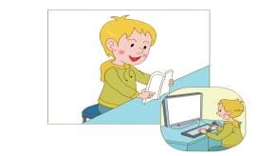
Talk about the pictures with your partners.(同桌交谈)
A: What does...do at the weekend?
B: He/She often...
Sometimes he/she...

Slide 16
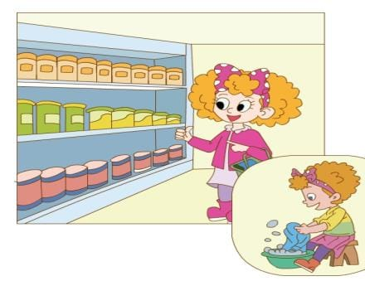
What does Jenny do at the weekend?
She often ___________.
goes shopping
Sometimes she ____________.
washes clothes

Slide 17
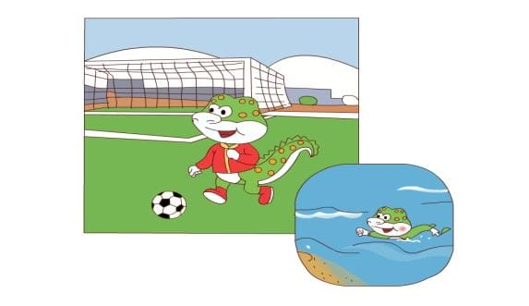
What does Danny do at the weekend?
He often ___________.
plays football
Sometimes he ____________.
goes swimming

Slide 18
What does Tom do at the weekend?
He often ___________.
reads books
Sometimes he _________________.
plays computer games

Slide 19
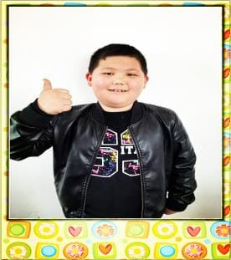
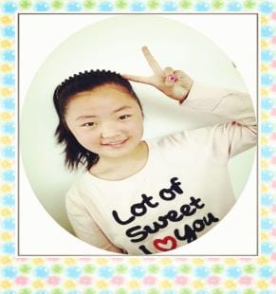
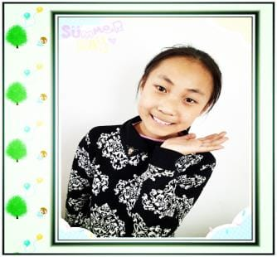
What do they do at the weekend?

Slide 20
Guessing game!

Slide 21
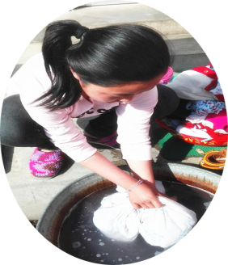
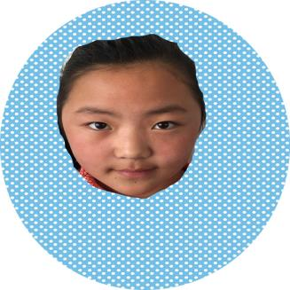
What does Liu Xinying do at the weekend?
She often _____________.
washes clothes

Slide 22
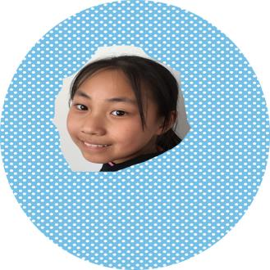
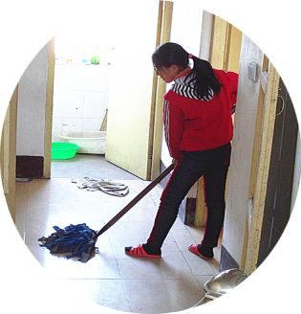
What does Cui Kejin do at the weekend?
cleans the floor
Sometimes she _____________.

Slide 23
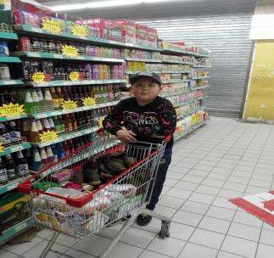
What does Song Dezheng do at the weekend?
What does Song Dezheng do at the weekend?
He often _____________.
goes shopping

Slide 24
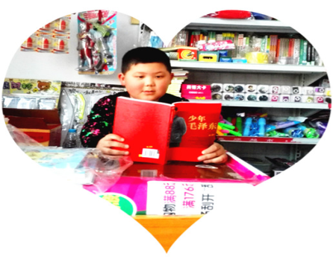
reads books
Sometimes he __________.

Slide 25
What does Song Dezheng do at the weekend?
He often goes shopping.
Sometimes he reads books.

Slide 26
Make a poster(海报)：
Weekend Fun

Slide 27
Steps(步骤):
1.Stick the pictures on and introduce your weekend.(粘贴图片并介绍自己的周末生活)
2.Talk about group members' weekend with each other.(询问并介绍组内成员的周末生活)

Slide 28
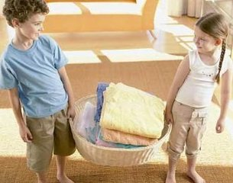
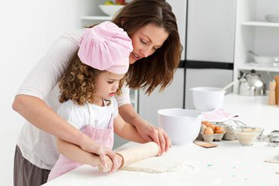

Slide 29
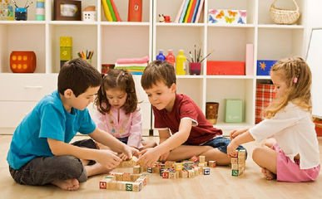
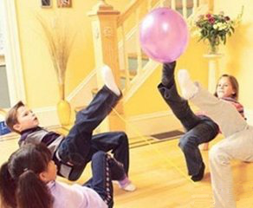

Slide 30
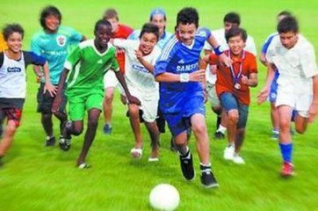
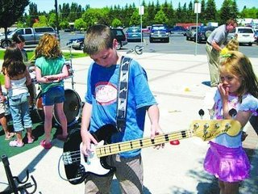

Slide 31
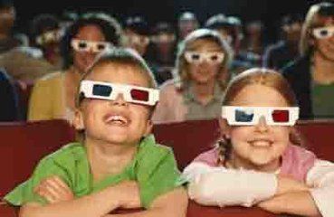
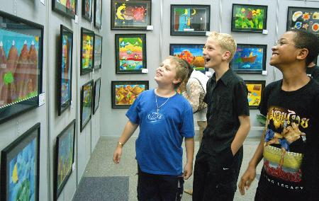

Slide 32
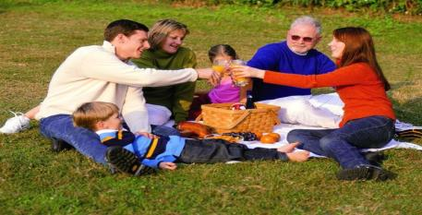
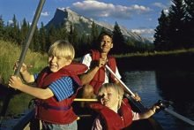

Slide 33
A better life lies in its rich and colorful, to make life more interesting, we must continue to rich it and plan your study well.
生活的美好就在于它的丰富多彩，要使生活变得有趣，就要不断地充实它,做好学习计划。

Slide 34
Summary!

Slide 35
1.Read the text three times.（读课文三遍）
2.Make a suvey: Talk about your family members' weekend and finish the table.（调查家人的周末生活并完成表格）
 | Often | Sometimes
Mum
Dad
...

