Slide 1
Unit 8
It must belong to Carla.
Section A (第2课时)
WWW.PPT818.COM

Slide 2
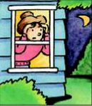
Warming up
1.How do you feel when you hear
strange noises at night?
2.Do you think it might be an animal?

Slide 3
Read the article and decide which might be the best title.
3a
A.A small and Quiet Town
B.Strange Happenings in My Town
C.Animals in Our Neighborhood
We live in a small town and almost everyone knows each other.It used to be very quiet.Nothing much ever happened around here.However, these days,something unusual is happening in our town.Victor,a teacher at my school,is really nervous.When he was interviewed by the town newspaper,he said,“Every night we hear strange noises outside our window.My wife thinks that it could be an animal,but my friends and I think it must be teenagers having fun.My parents called the policemen,but they couldn’t find anything strange. They think it might be the wind.I don’t think so!”

Slide 4
Victor’s next-door neighbor Helen is worried,too.“At first,I thought that it might be a dog,but I couldn’t see a dog or anything else,either. So I guess it can't be a dog.But then,what could it be?”One woman in the area saw something running away,but it was dark so she is not sure. “I think it was too big to be a dog,”she said.“Maybe it was a bear or a wolf.”
Everyone in our town is feeling uneasy,and everyone has his or her own ideas.There must be something visiting the homes in our neighborhood,but what is it? We have no idea.Most people hope that this animal or person will simply go away,but I do not think that is going to happen.The noise-maker is having too much fun creating fear in the neighborhood.

Slide 5
3b
Read the article again and find words to match the meanings.
nervous or worried area where people live
______________ ______________
young people animal like a very large dog
______________ ______________
person in the next house person who makes noise
______________ ______________
uneasy
neighborhood
teenagers
wolf
neighbor
noise-maker

Slide 6
3c
Read the article carefully and write what people think about the strange noises.
Who gave opinions? | What are the opinions?
Victor's wife | She thinks that it could be an animal.
Victor and his friends
The policemen
Helen
One woman in the area
The writer himself
They think it must be teenagers having fun.
They think it might be the wind.
She thinks it can't be a dog.
She thinks it might be a bear or a wolf.
He/She doesn't think that is going to happen.

Slide 7
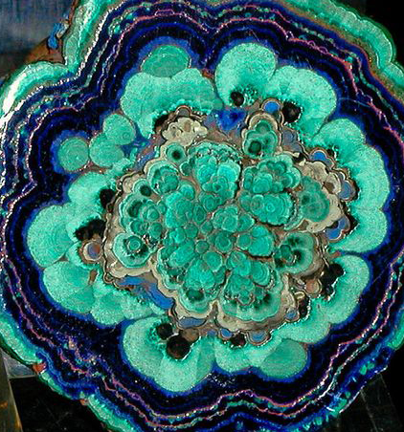
Language Points
1.At first,I thought that it might be a dog,but I couldn't see a dog or anything else,either.起初，我认为它可能是一只狗，但我没看到狗，也没看到其他任何东西。（教材P59）
either作副词，意为：“也”。
e.g.:I don't know,either.
【辨析】either,too,also与as well
(1) either用于否定句，放于句尾，意为"（后者）也（不）"其前常有逗号。
e.g.:If he doesn't go,I won't go,either.
(2) too用于肯定句，且一般放于句末，意为“(后者)也”，其前常有逗号。
e.g.:Jim likes red.I like red,too.

Slide 8
(3) also用于肯定句，且放于连系动词、助动词或情态动词之后，实义动词之前，意为“也”。
e.g.:They also agree with me .
(4) as well常用于肯定句句末，意为“也；还”，其前无逗号。
e.g.:He speaks English,and he knows French as well.

Slide 9
2.Maybe it was a bear or a wolf.也许它是一只熊或一只狼。（教材 P59）
maybe此处作副词，意为“也许，可能”，相当于perhaps,常位于句首。
e.g.:Maybe she'll come this afternoon.
Maybe you put the letter in your pockets.
【辨析】may be与maybe
(1) may be意为“也许是，可能是”，may是情态动词，be是动词原形，两者构成完整的谓语形式，与主语形成系表结构。
e.g.:He may be a soldier.
(2) maybe和may be可相互转换。
e.g.:Maybe you are right.=You may be right.

Slide 10
3.There must be something visiting the homes in the
neighborhood,...一定有什么东西闯入了我们社区的住户家中，......（教材P59）
there must be是there be与情态动词must连用的结构，表示对现在情况的肯定推测，意为“一定有......”。
e.g.:There must be someone in the room.
“There be+名词+doing sth.”句型表示“有......在做某事”。
e.g.:There is someone knocking at the door.
There are some boys standing on the playground.

Slide 11
4.The noise-maker is having too much fun creating fear in the neighborhood.噪音制造者非常乐于在社区里制造恐惧。（教材P59）
have fun意为“玩得高兴；过得愉快”，其同义短语为have a great/good/wonderful time和enjoy oneself。
e.g.:Did you have fun at the party?
It’s a good place to have fun.
have fun (in) doing sth.意为“做某事很开心”。
e.g.:The kids are having fun playing in the park now.
Did you have fun visiting that museum?

Slide 12
Exercise
一、用所给单词的正确形式填空。
1.There is an_______________(usual) thing happening in our neighborhood.
2.I think it must be teenagers_______________(have) fun.
3.These days,strange things________________(happen).
4.There are two_______________(wolf) fighting.
5.These_____________(policeman) are runing after the thief.
unusual
having
are happening
wolves
policemen

Slide 13
二、单项选择。
( )1.There must_______somebody_______after me.
A.have;run B.be;run
C.have;to run D.be;running
( )2.We had fun_______apples on the farm with the farmers last week.
A.to pick B.picking
C.pick D.picked
D
B

Slide 14
( )3.Nothing________to me.
A.strange happens B.strange is happened
C.else happens with D.else is happened
( )4.We can't find________in the house,________.
A.something strange;too
B.anything strange;either
C.strange something;as well
D.strange anything;as well as
A
B

Slide 15
Homework
1.Learn the new words and expressions by heart.
2.Retell the story.

Slide 16
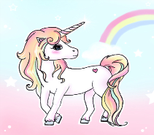
Thank you!

