Slide 1
Unit 8
Is there a post office near here?
WWW.PPT818.COM

Slide 2
学 习 重 点
单词: road, air, money, spend, climb, enjoy, free, easily, often, monkey
短语: spend time, enjoy reading.
句型: 1. I like to spend time there on weekends.
2. I love to watch the monkeys climbing around.
3. The best things in life are free.
4. It’s very quiet and I enjoy reading there.

Slide 3
预 习 检 测
一、请根据中文意思写出下列单词。（这些都是黑体单词，要好好记住哦。）
1. ________ v. 花费
2. _________ v. 爬
3. _________ v. 享受；喜爱
4. _________ n. 路
5. _________ adv. 时常
6. _________ n. 空气
7. _________ adv. 容易地
8. _________ n. 钱
9. ________ adj. 免费的
spend
climb
enjoy
road
often
air
easily
money
free
Notes:
3

Slide 4
预 习 检 测
二、请认真阅读课本，找出以下短语。
10. 在我的街区 _________________
11. 花时间 _______________
12. 喜欢阅读 _______________
13. 看起来像 _______________
14. 走出去 _______________
15. 沿着……走 _____________
16. 免费的 _________________
17. 在生活中 _____________
18. 在周末 _________________
in my neighborhood
spend time
enjoy reading
look like
walk out
go along
be free
in life
on weekends/on the weekend
Notes:
4

Slide 5
预 习 检 测
三、阅读2b短文，完成下列信息填空。
19. Anna likes to __________there on weekends.
20. Anna loves to watch the monkey __________
_________.
21. John often exercises at the park because he loves ___________________________.
22. The best things in life ____________.
23. Lisa lives in ________________________. There is a post office _____________________
______________.
24. When Lisa reads books, ________________.
spend time
climbing
around
the clean air and sunshine
are free
a noisy neighborhood
between my house and
a clothes store
time goes quickly
Notes:
5

Slide 6
思 考 探 究
★ neighborhood 是名词，意为“街区、街坊”。 neighbor 是名词，意为“邻居”.
in the neighborhood意为“在附近”。指位置相近的人或事物。
1) Is there a hospital around here? = Is there a hospital ______ _________ _______________?
2) He has many good _______________ (邻居).
★ 3) spend是 __________ (词性)，意为“度过；花费 (时间、金钱等) ”。
spend time with sb. “与某人一起度过时间”
4) I like to spend time _______ my friends on weekends.
in the neighborhood
neighbors
动词
with
Notes:
6

Slide 7
spend 常用短语有 ( 注意与pay 的区别，pay 只表示花费金钱 )
spend time /money on sth.花费时间/金钱在某事（物）上，
spend time /money (in) doing sth 花费时间/金钱做某事。
5) I often spend half an hour on my homework. = I often _______ half an hour _____________my homework.
★ 6) enjoy 的用法。enjoy是 _________ (词性)，意为“享受…的乐趣，喜欢，欣赏”。其用法：
“enjoy+名词”, eg：I enjoy music a lot.
“enjoy+v-ing”, eg：I enjoy listening to music a lot.
spend
on/ (in) doing
动词

Slide 8
7) enjoy oneself 意为“玩得开心，过得愉快”= ________________/________________
8) My father enjoys ___________ (watch) football games on TV after supper.
9) We have fun in the zoo.
= We _______________________ in the zoo.
★ I love to watch the monkeys climbing around.
10) watch 在此句中是 _____ (词性)，意为“看，观看”。
watch sb doing sth, 意为“观看、看着某人正在做某事”。(强调动作正在进行)
watch sb do sth, 意为“看到某人做过某事”。 (强调动作已经完成或曾经发生)
have a good time
have fun
watching
enjoy ourselves
动词

Slide 9
11) 我看见他走过了马路。
I watch him __________________ (walk) across the street.
12) 我看见他正在打篮球。
I watch him ____________ (play) basketball.
walk
playing

Slide 10
Period 3训练案 (Reading P47)
成效追踪
一、根据2b内容完成短文填空，每空一词。（先合上课本试着填空，再对答案）
Anna,
There 1. ____ a zoo in my neighborhood. I like to 2. ________ time there 3. _____ weekends. I love to watch the monkeys 4. _________ around. The monkeys sometimes fight. They 5. _______ like my friends and me 6._______ we fight. To get 7. ______ , I usually walk out and 8. _____ right on Bridge Road. Then I walk 9. ________ Bridge Road. The zoo is 10. ____ the right.
is
spend
on
jumping
look
when
there
turn
along
on
Notes:
10

Slide 11
Period 3训练案 (Reading P47)
成效追踪
John,
I live 11. _________ a supermarket. My parents usually 12. _________ there. There is a big park 13. _________ from the supermarket. I often 14. _________ at the park because I love the clean 15. _________ and sunshine. The best things in life are 16. _________! To 17. ________ to the park, you just have to 18. _________ Center Street.
near
shop
across
exercise
air
free
get
cross
Notes:
11

Slide 12
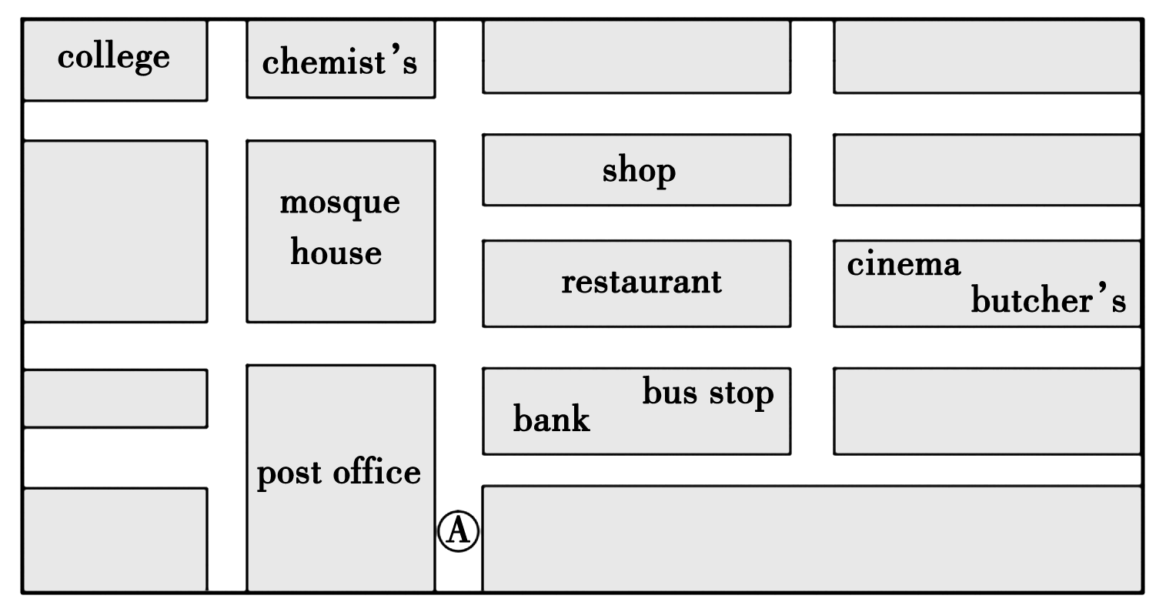
能 力 阶 梯
二、根据下面的地图寻找正确路线和目的地，完成选择题。( 注意每次都以A处作为出发点 )
Notes:
12

Slide 13
能 力 阶 梯
( ) 19. Walk up the street and turn left at the first crossing. Then turn left again at the next crossing. The _____ is a few meters on your left.
A. bank B. college
C. post office D. shop
( ) 20. Walk up the street only a few meters. Take the first turning on the right. The ____ is on your left.
A. post office B. bank
C. house D. restaurant
C
B

Slide 14
能 力 阶 梯
B
( ) 21. Walk up the street and take the second turning on the right. The____is on your right half-way down this street.
A. cinema B. bus stop
C. mosque house D. chemist’s
( ) 22. Take the first turning on the right. Then turn left at the first crossing and walk up the street. The _____ is on the right just after the second crossing.
A. house B. bank
C. butcher’s D. cinema
D

Slide 15
能 力 阶 梯
A
( ) 23. Turn right first. Then turn left. Walk up this street and turn left at the third crossing. The _______ is half-way down the street on the left.
A. shop B. bank
C. cinema D. house

Slide 16
三、重点词汇积累 ( 从上面题目中找出以下短语 )
24. 沿着这条街往上走_________________
25. 在你的左边______________________
26. 在第一个转弯处向右转___________________________
27. 先向右转________________________
28. 然后向左转______________________
walk up the street
on your left
take the first turning on the right
turn right first
then turn left

