Slide 1
Unit8 Topic 3
Let’s celebrate!
Section C
WWW.PPT818.COM

Slide 2
Retell the passage according to the key words.
…the most important… ,…on Dec.25th,…. Before….,….preparing for….,…go shopping, clean…, give…to…and decorate…with…. .
…Eve,..night …,…go to church and…,…put up…by…..or at the end of….before …bed.
On the morning of….., ….get up …and open…in the…., …think…must be from…! Then ….gives …to…..Later…. Families…get-together with…,…greet….and say,“……….!”

Slide 3
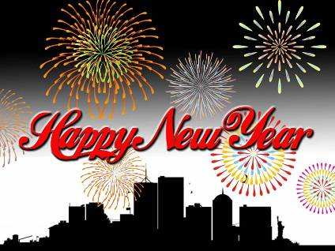
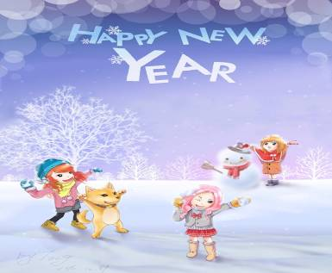
the Spring Festival
The Spring Festival is the most important festival in China.
In China, the Spring Festival is a big event.
事件

Slide 4
Work in groups and discuss the following question. Write some key words here.
What do you usually do in the Spring Festival ?
1._____________________ 2._____________________
3._____________________ 4._____________________

Slide 5
Before the Spring Festival
2013
1月16日
十二月一日
Many people start preparing for the Spring Festival one month before it comes.
start doing sth.开始做某事

Slide 6
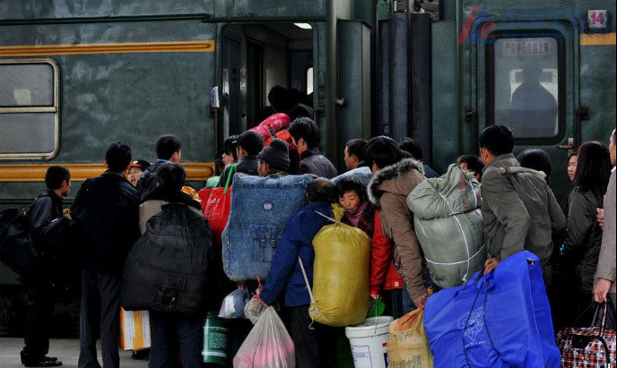
Before the Spring Festival
go home

Slide 7
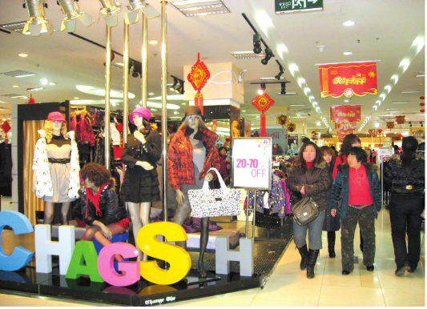
buy some new clothes

Slide 8
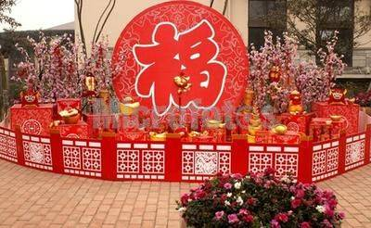
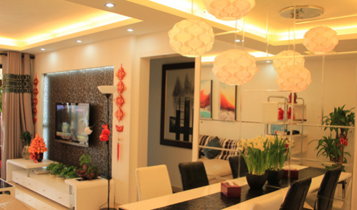
decorate their homes

Slide 9
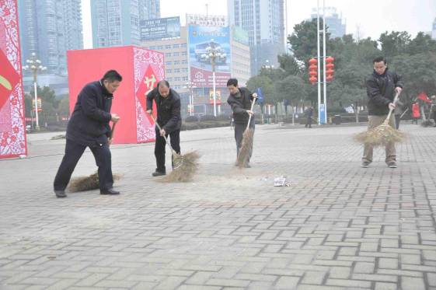
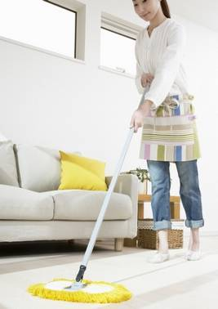
do some cleaning

Slide 10
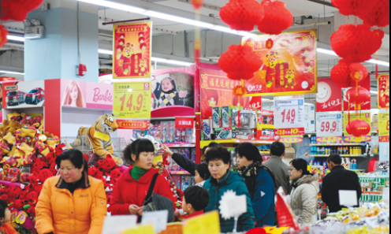
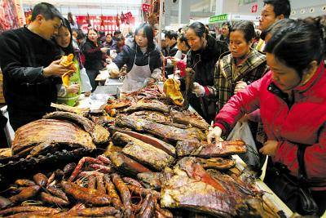
prepare delicious food

Slide 11
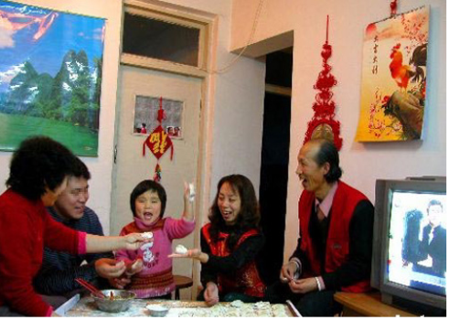
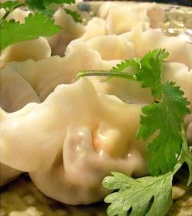
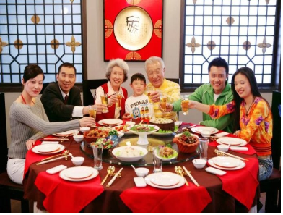
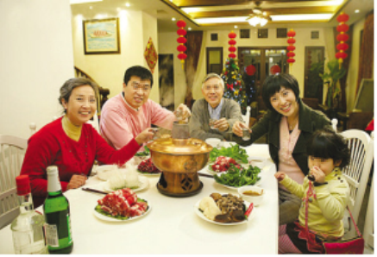
On the eve of the Spring Festival
The family all get together for a big dinner.
enjoy dumplings at midnight

Slide 12
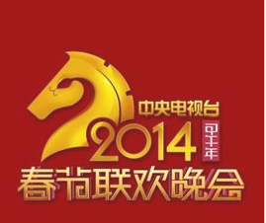
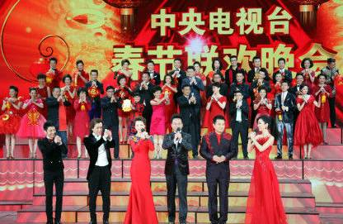
stay up and watch the Spring Party on TV

Slide 13
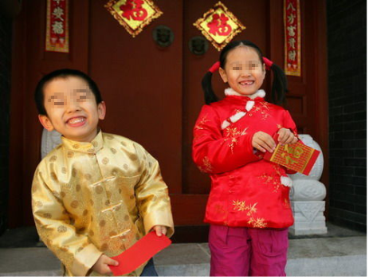
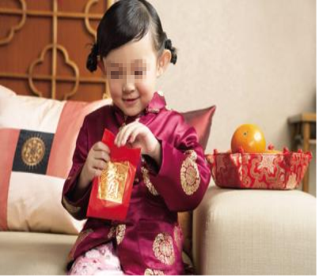
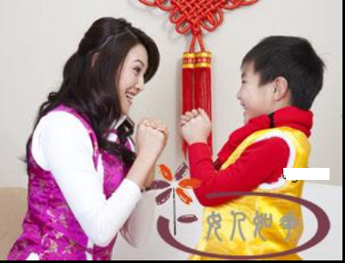
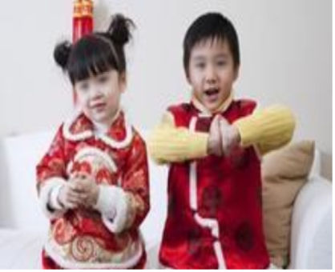
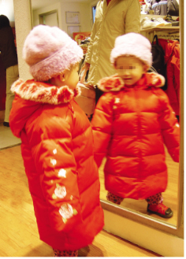
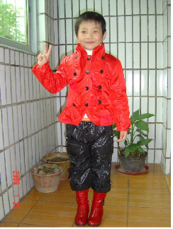
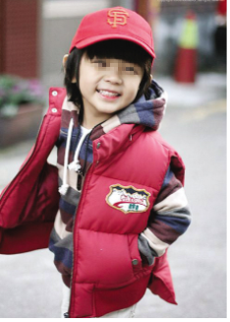
On the first day of the Spring Festival
put on their new clothes
greet their parents
get lucky money

Slide 14
Read 1a and complete the table. You can add more.
Time | Before the Spring Festival | On the Eve of the Spring Festival | On the First Day of the Spring Festival
Activity
prepare delicious food，clean and decorate homes,
buy some new clothes
the family all get together to have dinner, stay up and enjoy dumplings
children put on new clothes and greet their parents and they can get lucky money from their parents

Slide 15
Suppose you have an American friend. Tell him/her about what the Chinese people usually do to celebrate the Spring Festival.
A: Hello,...!
A:..., Can you tell me something
about the Spring Festival?
A:It's very interesting.
B:Hello,...!
B:Sure. Before the Spring
Festival...
B:...

Slide 16
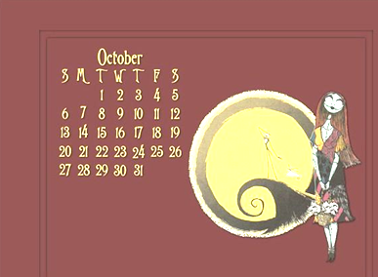
* The night of Oct. 31st
Which festival is it?
It's Halloween.

Slide 17
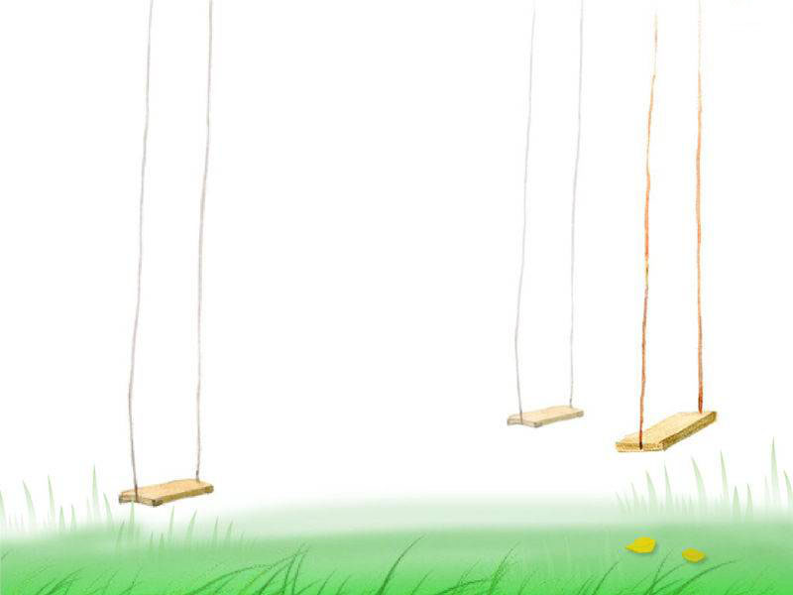
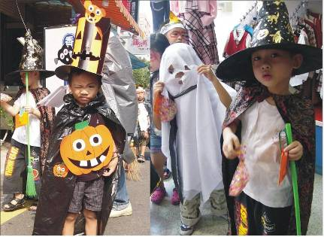
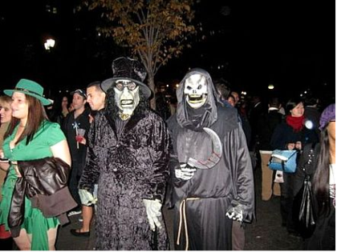
Have a special party.
wear scary clothes with big hats
color faces white and mouths black like ghosts

Slide 18
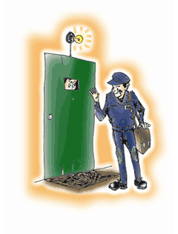
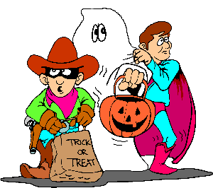
knock on/at
trick or treat

Slide 19
Read and complete the letter with the correct form of each verb in the box.
have be give wear tell not play
November 1st, 2011
Dear Kangkang,
Thank you for your beautiful card. Last night ____ Halloween. I ____ a wonderful time with my friends. We all _____ scary clothes, and colored our faces white and mouths black like ghosts. Then we knocked on our neighbors’ doors and shouted, “Trick or treat!” Our neighbors ____ us treats. Of course, we __________ tricks on them. It was very interesting!
Could you ____ me something about your favorite festival?
Please give my best wishes to your parents!
Yours，
Julia
was
had
wore
gave
Didn’t play
tell

Slide 20
Read 2a again and put in the correct order the activities Julia did on Halloween. Then tell your partner.
_______knocked on neighbors' doors
_______colored faces white and mouths black
_______shouted "Trick or treat !"
2
1
3

Slide 21
What is your favorite holiday or festival? What do people usually do on that day? Write a passage.

Slide 22
Summary
1. Learn some new words and phrases:
start doing sth., stay up, lucky money,
knock on/at, shout (at), trick or treat .
2. Talk about customs and culture.
3. Learn some important festivals and their main celebrating activities.

Slide 23
Homework
1.Read 1a and retell it.
2.Please write a letter or send an E-mail to your foreign friends. Tell him/her a Chinese traditional(传统的) festival.
3.Finish Section C in your workbook.

