Slide 1
Unit2 Spring is Coming!
第2课时
WWW.PPT818.COM

Slide 2
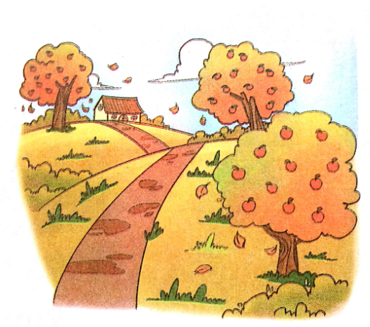
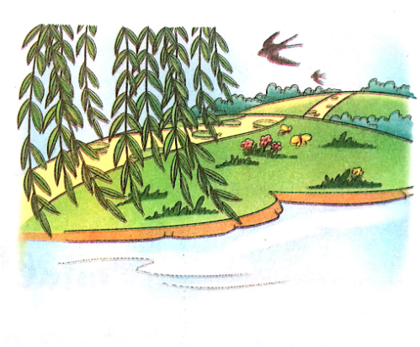
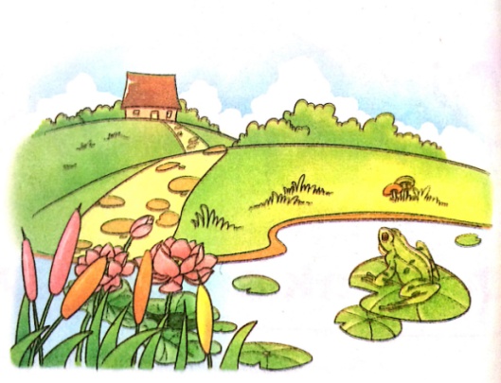
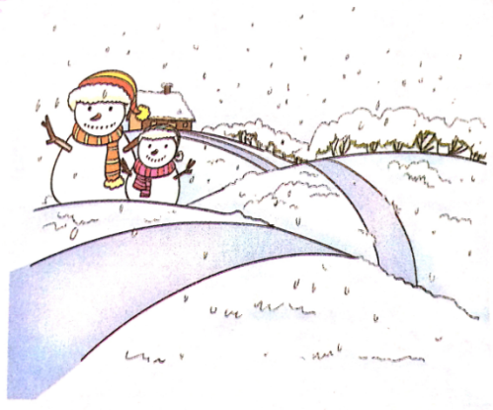
>>Review
Quick response

Slide 3
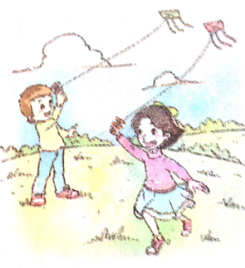
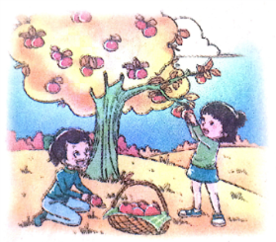
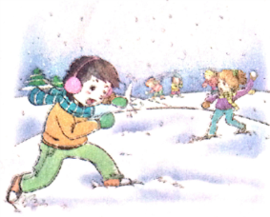
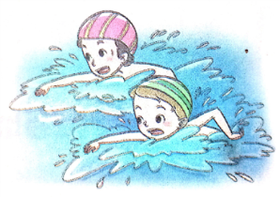
>>Warming-up
Look, tick and say
Which is your favourite season? Why?

Slide 4
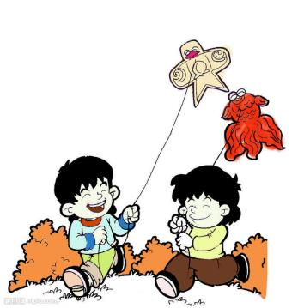
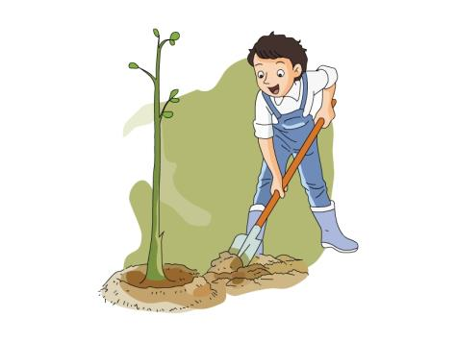
>>Presentation
Look and say
What do you do in…?
I often …with my friends.
Sometime we …

Slide 5
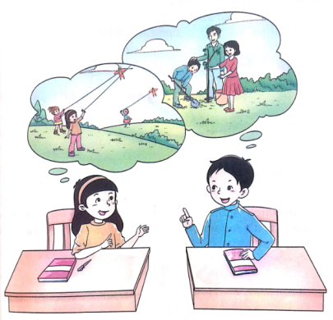
>>Presentation
Listen and answer
Is spring coming?
Yes. Spring is coming.
2. Are they happy?
Yes, they are.

Slide 6
>>Presentation
Listen and answer
3. What does Li Shan do in spring?
She often flies kites with her friends. Sometimes they climb the mountains.
4. What does Su Nan do in spring?
He plants trees with his parents every year on Tree Planting Day.
Sometimes they ride bikes.

Slide 7
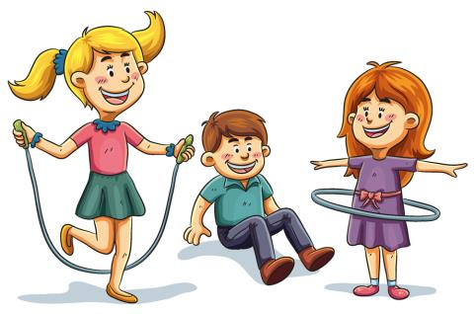
>>Presentation
Let’s learn
How happy we are!
How interesting!

Slide 8
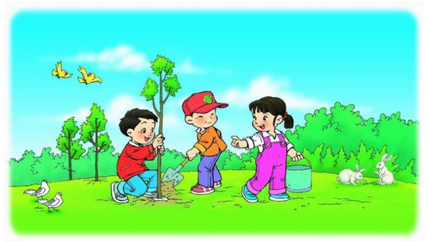
>>Presentation
Let’s learn
Tree Planting Day
on Tree Planting Day

Slide 9
>>Presentation
Let’s learn
Li Shan: Spring is coming! How happy we are!
Su Nan: Yeah! What do you do in spring?
Li Shan: I often fly kites with my friends. Sometimes we climb the mountains. How about you?

Slide 10
>>Presentation
Let’s learn
Su Nan: I plant trees with my parents every year on Tree Planting Day. Sometimes we ride bikes.
Li Shan: How interesting!

Slide 11
>>Practice
Role-play

Slide 12
>>Practice
活动
编创新对话

Slide 13
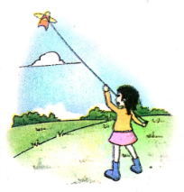
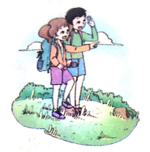
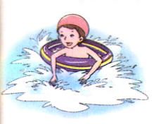
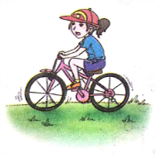
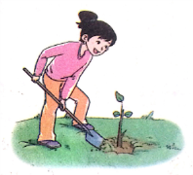
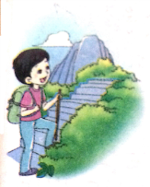
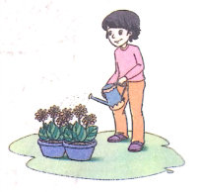
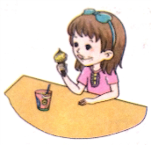
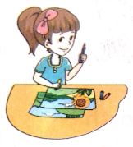
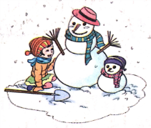
>>Presentation
Tick, then ask and answer
What do you do in spring?
In spring, I often … Sometimes I …

Slide 14
>>Summary
句子：
What do you do in spring?
I often… Sometimes I …

Slide 15
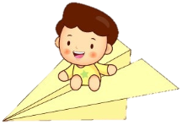
>>Homework
1.观看课文动画，按照正确的语音、语调朗读课文对话。
2.熟读课文“Let’s talk ”部分。
3.预习“Let’s learn”。
close

