Slide 1
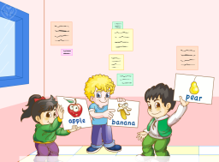
Unit1 I went to Sanya for my holidays.
人教精通版六年级下册
Lesson 3
WWW.PPT818.COM

Slide 2
>>Warm-up
Let’s review
（单击图片可播放动画）

Slide 3
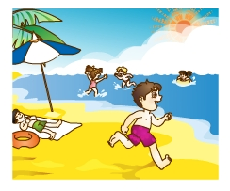
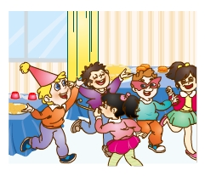
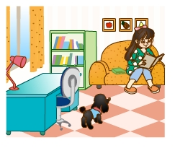
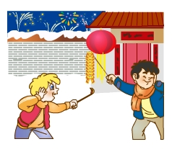
>>Warm-up
Let’s review
Which is missing?

Slide 4
>>Lead-in
Free talk
Talk about your English learning.
Free talk
When did you begin to learn English?
Free talk
What are you interested in?
Free talk
What did you often do in your English classes?

Slide 5
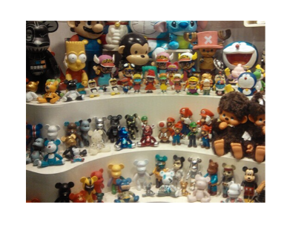
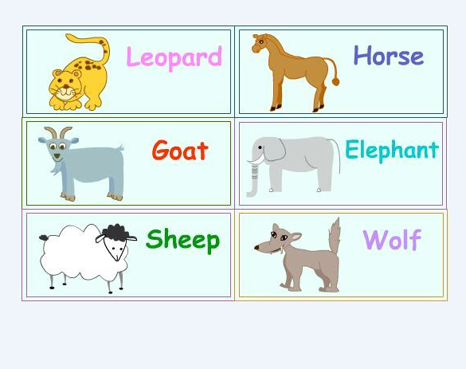
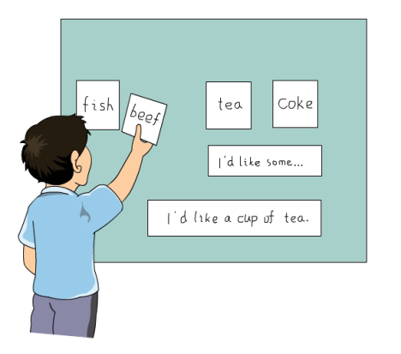
>>Presentation
Play a game
抢读单词
blackboard
learn
word
a lot of

Slide 6
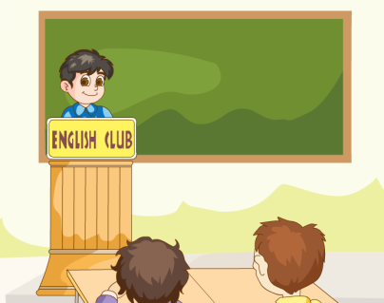
>>Presentation
Let’s watch
What’s the topic of this passage?
It’s about our English learning.
（单击图片可播放动画）

Slide 7
>>Presentation
Listen and answer
When did they begin to learn English?
They began to learn English three years ago.
They began to learn English three years ago.
What have they learned?
They have learned a lot of words
and sentences.
They have learned a lot of words
and sentences.

Slide 8
>>Presentation
Read and answer
1. What topics are they interested in?
They are very interested in topics like school life, daily life, family, sports, holidays and animals.
They are very interested in topics like school life, daily life, family, sports, holidays and animals.

Slide 9
>>Presentation
Read and answer
2. What did your English teacher often
ask you?
Our English teacher often asked us to practice listening, speaking, reading and writing.
Our English teacher often asked us to practice listening, speaking, reading and writing.
3. What can they do in English now?
Now they can play games and do tasks in English.

Slide 10
>>Presentation
Look and find
We began to learn English three years ago.
We have learned a lot of words and sentences.
Our English teacher often asked us to practice
listening, speaking, reading and writing.

Slide 11
>>Presentation
Let’s read
begin
began
learn
learned
ask
asked

Slide 12
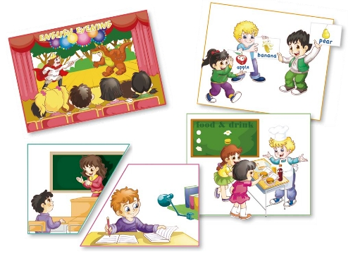
>>Practice
活动1
配音表演

Slide 13
>>Practice
活动2
我是小记者
S1: When did you begin to
learn English?
S1: What are you interested in?
S1: What did you often do in
your English classes?
S1: What can you do in English
now?
S2: …

Slide 14
>>Summary
We are very interested in English.
We have learned…

Slide 15
>>Homework
1.观看课文动画，按照正确的语音、语调朗读课文对话。
2.参考本课Just read and talk部分，写一段关于自己英语学习经历的小短文（不少于6句）。

