Slide 1
How many monkeys can you see?
Animals
WWW.PPT818.COM

Slide 2
教学目标
1．能正确认读和书写字母R-T。
2．能能听懂、会说、认读单词can, see;认读数字11～20。
3．能听懂、会说、认读谈论动物的句型: “How many monkeys can you see?”，“Nineteen monkeys.”。

Slide 3
Let’s sing
Let’s all go to the zoo tomorrow
Let’s all go to the zoo tomorrow,
zoo tomorrow, zoo tomorrow,
Let’s all go to see the lions(elephants), and see the monkeys(pandas), too

Slide 4
Look and say
How many tigers?

Slide 5
Listen and say
Jenny : Look! How many monkeys can you see?
Li Ming: Let’s count! One, two,…,ten, eleven, twelve, thirteen.

Slide 6
Jenny : Fourteen, fifteen, sixteen, seventeen.
Li Ming: Eighteen, nineteen. Nineteen monkeys.

Slide 7
Danny : No. Twenty monkeys!
Li Ming：Ha-ha……

Slide 8
Look and say
12
13
16
14
17
18
11
15
19

Slide 9
Try to act.
让我们一起表演对话吧。
ips:
看看哪位同学演的发音又准、演的又棒！

Slide 10
Read in roles together.
让我们一起分角色朗读课文吧。
ips:
同学们要读出每个角色的不同语气哦！

Slide 11
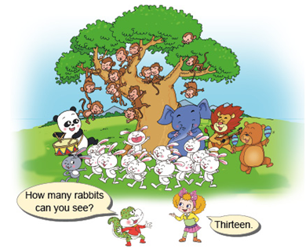
Pratice

Slide 12
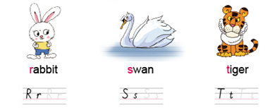
Let’s copy.

Slide 13
Homework:
1、听本课录音，模仿跟读
2、用英语数数自己的文具、衣服等物品的数量。
3、与朋友说说自己喜欢的动物，并收集其图片或画下来。

