Slide 1
Unit 4
What's the best movie theater?
Section B Period 1 (1a-2e)
WWW.PPT818.COM

Slide 2
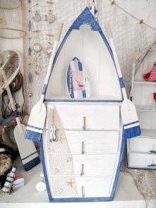
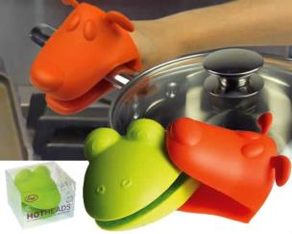
creative
more creative
most creative
… is creative.
… is more creative.
… is the most creative of the three.

Slide 3
quiet
good
quieter
better
quietest
best

Slide 4
1a
Write these words and phrases next to their opposites in the chart.
funniest most creative
quietest best

Slide 5
most boring | most creative
loudest
worst
most serious
quietest
best
funniest

Slide 6
Who knows the most?
Mount Qomolangma (珠穆朗玛峰)
is the __________ mountain in the world.
highest
longest
2. Changjiang River is the _________ river in China.
largest
3. Pacific Ocean (太平洋) is the ___________
ocean in the world.

Slide 7
4. The falls of Jiuzhaigou (九寨沟瀑布) are
the _________ falls in the world.
cleanest
biggest
5. Blue Whale (蓝鲸) is the ________ animal
in the world.
6. Giraffe is the _________ animal in the world.
tallest

Slide 8
7. Hummer (蜂鸟) is the ___________
bird in the world.
8. The Great Wall is the _________
wall in the world.
9. Humans(人类) are the _________ animal
in the world.
10. China has the ____________
people in the world.
11. Paris is one of the _______________
cities in the world.
smallest
longest
smartest
most
most beautiful

Slide 9
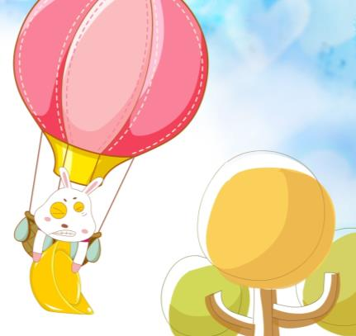
1b
Tell your partner about people you know. Use the words in 1a.

Slide 10
PAIRWORK
My sister Isabel is the funniest person I know.
Notes:
10

Slide 11
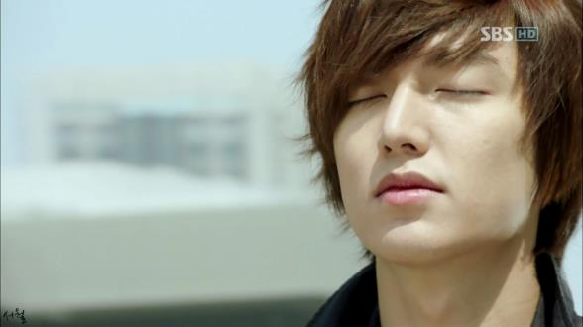
Jeff Green is the quietest person I know.

Slide 12
Do you know what a talent show is?
Did you have a talent show in your school/class? When? Did you enjoy it?
If not, do you want to have a talent show in our school?

Slide 13
1c
Listen to people talking about a school talent show. Match the pictures with the performers.
Eliza __________ Vera ____________
Steve ___________ Dennis __________
The Math Teachers __________
d
a
e
c
b

Slide 14
Listen again. What do the people say about the performers? Fill in the chart with the adjectives you hear.
1d
Names | What people say
Eliza | best,
Steve
Vera
Dennis
The Math Teachers
excellent, great
funniest
creative, the most creative
worst, terrible
loudest

Slide 15
Look at the information in 1d and make a conversation.
1e
A: Who was the best performer?
B: Eliza was the best performer.

Slide 16
Who was the best performer?
… was the best performer.

