Slide 1
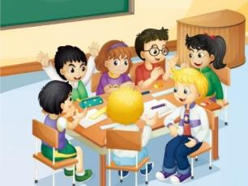
人教版精通版英语五年级下册
Unit 3 We should obey the rules.
WWW.PPT818.COM

Slide 2
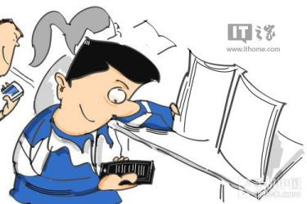
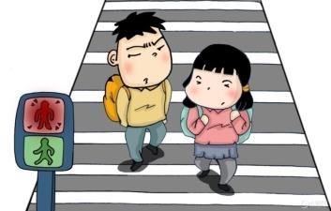
>>Warm-up
Discuss
Look at the photos.
What do you think of them?

Slide 3
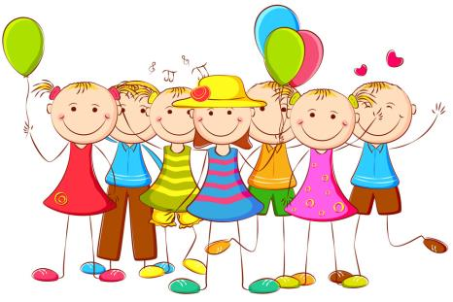
>>Lead-in
What class rules do you have?
What do you think of the class rules?

Slide 4
>>Presentation
Just talk
Gao Wei is a good boy. He knows the school rules very well. He comes to school early. He listens carefully and talks actively. He never makes noise in class. He’s a group leader. His group is making a list of class rules.

Slide 5
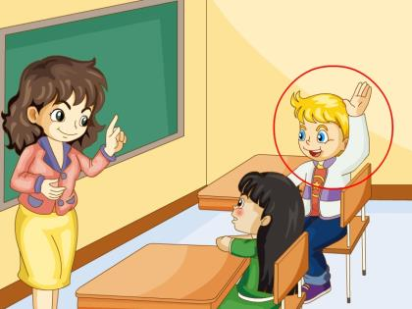
>>Presentation
actively
He talks actively in class.

Slide 6
>>Presentation
make noise
Please don’t make noise in class.

Slide 7
>>Practice
Just talk
He knows the school ________ very well.
He comes to school ________.
He listens carefully and talks ________.
He never makes ________ in class.
His group is making a list of ________ rules.
rules
early
actively
noise
class

Slide 8
>>Presentation
Class Rules
Listen carefully and talk actively.
Hand in your homework on time.
Don’t be late for school.
Don’t make noise in class.

Slide 9
>>Practice
Right or Wrong?
Hand in your homework on time.
Be late for school.
Make noise in class.
Listen carefully and talk actively.

Slide 10
>>Practice
Group Work
Class Rules
Let’s make a list of class rules together!

Slide 11
>>Summary
怎样制定和表达我们的班规？
例如：
Listen carefully and talk actively.
Hand in your homework on time.
Don’t be late for school.
Don’t make noise in class.

Slide 12
>>Homework
1. 观看课文动画，按照正确的语音、语调朗读课文。
2 . 准备个小卡片，写下大家一起制定的班规。
3 . 预习Lesson14。
close

