Slide 1
Unit2 What’s your hobby?
人教精通版六年级上册
WWW.PPT818.COM

Slide 2
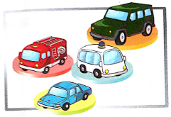
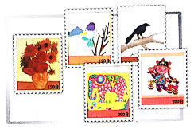
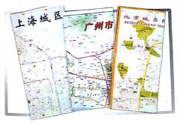
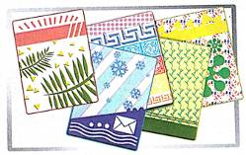
>>Warm-up
Let’s review
—What’s your hobby?
—My hobby is …
collecting toy cars
collecting stamps
collecting maps
collecting picture cards

Slide 3
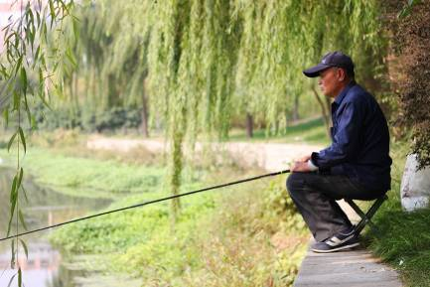
>>Lead-in
Look and say
This is a photo of my father.
Can you guess his hobby?
His hobby is fishing. He likes fishing.
What’s your father’s hobby?

Slide 4
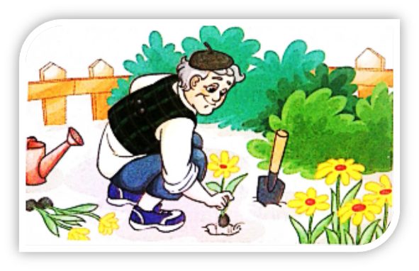
>>Presentation
Look and guess
planting flowers
He likes flowers. So his hobby is ______________.

Slide 5
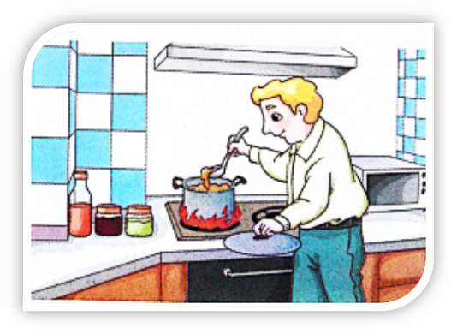
>>Presentation
Look and guess
cooking meals
He likes eating. So his hobby is ______________.

Slide 6
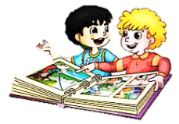
>>Presentation
Just read and talk
Listen and say
Gao Wei and Jim are looking at the photos. What are
they talking about?
They are talking about Jim’s family’s hobbies.

Slide 7
>>Presentation
Just read and talk
Listen and circle
How many people are mentioned in the conversation?
Who are they?
Five people. They’re Jim’s grandpa, grandma, father, mother and Gao Wei’s grandpa.

Slide 8
>>Presentation
Just read and talk
Read and fill
What are their hobbies?
Jim’s grandpa
fishing
Gao Wei’s grandpa
planting flowers
Jim’s grandma
likes
drinking Chinese tea
Jim’s father
cooking
Jim’s mother
singing

Slide 9
>>Presentation
Just read and talk
Listen and imitate
Jim: Hi, Gao Wei! Do you want to look at my
family photos?
Gao Wei: Sure! Wow! What’s he doing?
Jim: My grandpa is fishing.
Gao Wei: Is that his hobby?
Jim: Yes. What’s your grandpa’s hobby?
Gao Wei: His hobby is planting flowers.

Slide 10
>>Presentation
Just read and talk
Listen and imitate
Jim: Look here at my grandma. Her hobby is
drinking Chinese tea.
Gao Wei: That’s great! What’s your dad’s hobby?
Jim: Look at this photo! His hobby is cooking.
Gao Wei: That’s interesting! And what’s your mum’s
hobby?
Jim: Her hobby is singing. In this photo, she’s
singing at her birthday party.
Gao Wei: That’s wonderful!

Slide 11
>>Practice
Read it by yourself for one minute .
自读对话一分钟。
一分钟倒计时
60
Learning tip :
10
10
50
当你自己朗读时，遇到不会读或不明白意思的单词或句子，可以把它圈起来，请教同学或老师！
20
20
40
30
30

Slide 12
>>Practice
Show time
小组合作，练习对话并表演，其他同学评价。
Pronunciation (语音) |  | Fluency (流利) | Cooperation (合作)
OK!
Great!
Super!

Slide 13
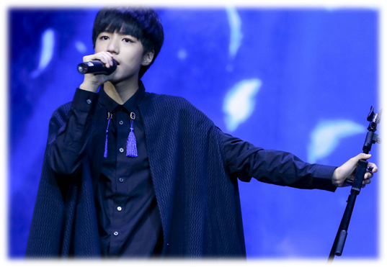
>>Practice
Ask and answer
What’s his hobby?
His hobby is singing.

Slide 14
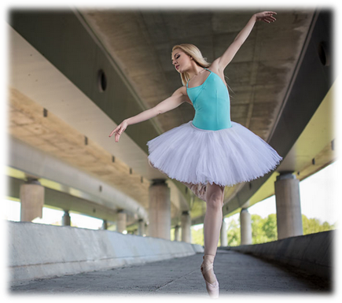
>>Practice
Ask and answer
What’s her hobby?
Her hobby is dancing.

Slide 15
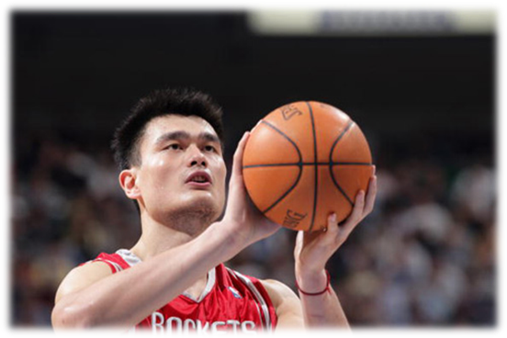
>>Practice
Ask and answer
What’s his hobby?
His hobby is playing basketball.

Slide 16
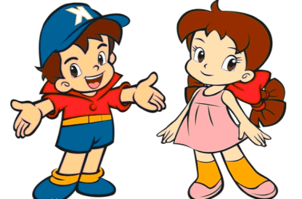
>>Practice
Pair work
What’s your father’s hobby?
His hobby is …
What’s your mother’s hobby?
Her hobby is …

Slide 17
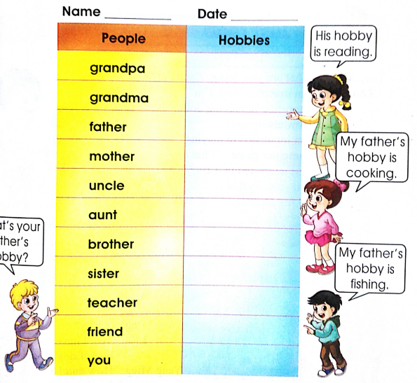
>>Practice
Let’s do a survey
Name ____ Date ____
His hobby is reading.
活动要求：
1.活动时间：5分钟
2.活动内容：调查家人、老师或朋友的兴趣爱好。
3.活动形式：学生4人一组，由一名学生扮演采访者，其他3名
学生为被采访者，仿照图片提示进行活动。
4. 展示方式：小组集体展示,每人至少说一句话。
My father’s hobby is cooking.
What’s your father’s hobby?
My father’s hobby is fishing.

Slide 18
>>Summary
如何询问别人的兴趣爱好并做相应回答呢？
—What’s your grandpa’s hobby?
—His hobby is ….
例句
—What’s your grandpa’s hobby?
—His hobby is planting flowers.

Slide 19
>>Homework
1.跟读课文录音，按照正确的语音、语调朗读课文对话。 2.调查你的父母或身边的朋友他们的兴趣爱好，并制成一张表格，要求用英文填写。
3.预习 Lesson10。

