Slide 1
Module
12
Help
Unit 2 Stay away from windows and heavy furniture.
WWW.PPT818.COM

Slide 2
1 Work in pairs. Look at the pictures and
ask and answer the questions.
1 Where are the people?
2 What are they doing? Why?

Slide 3
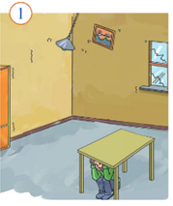
Inside the room
hiding under a table

Slide 4
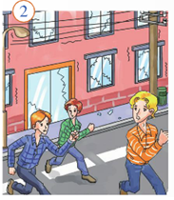
Outside the building
Moving away from building

Slide 5
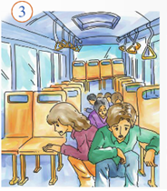
In the bus
Staying in the bus

Slide 6
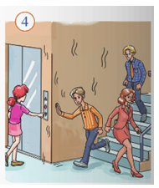
In the building
Leaving the building but don’t use the lift.

Slide 7
4 Read the sentences. Decide if the
following actions are right (√) or
wrong (×).
When the earthquake started…
1 …I hid under a table.
2 …Sam sat on his desk.
3 …Alice ran out of the building.
4 …Peter and Helen stayed in their car.
5 …my family and I moved away from the beach.
√
×
×
√
√

Slide 8
5 Answer the questions. Use the words
and expressions in the box.
brave inside keep calm power lines
street lights warn
1 What is difficult to do before an earthquake?
2 Where should you stay before the ground stops
shaking?
3 What should you do when you are with other people?
4 What shouldn’t you stand near or under in the
street?

Slide 9
1 What is difficult to do before an earthquake?
2 Where should you stay before the ground stops shaking?
3 What should you do when you are with other people?
4 What shouldn’t you stand near or under in the street?
It’s difficult to warn people before an earthquake.
We should stay inside.
We should keep calm and be brave.
We shouldn’t stand near power lines or under street lights in the street.

Slide 10
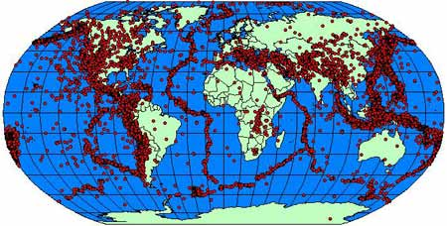
seismic belts (地震带) in the world

Slide 11
Can we stop earthquakes?
We can’t stop earthquakes, but we can try to reduce the losses caused by earthquakes.
To build houses as strong as possible.
To build houses on rock rather than on sand.

Slide 12
What can we do after earthquakes?
Try to rescue people.
Try to rebuild families.
Try to forget sad experiences and live with
strong belief.

