Slide 1
Natural Disasters
Section C Discovering Useful Structures & Listening and Talking
WWW.PPT818.COM

Slide 2
Ⅰ
Ⅱ
Ⅲ
Ⅳ
Ⅰ.知识体系图解
volcano
erupt
supply
hurricane
power
tap
whistle
emergency
calm
aid

Slide 3
Ⅰ
Ⅱ
Ⅲ
Ⅳ
现有(尤其指帮助)
志愿做
醒来;唤醒
搭起;搭建
在户外
阻止……做……
用……覆盖……
与……保持距离
紧紧握住
首先
保持镇静
处于危险中

Slide 4
Ⅰ
Ⅱ
Ⅲ
Ⅳ

Slide 5
Ⅰ
Ⅱ
Ⅲ
Ⅳ
Ⅱ.选词填空
1.It is known to all that an active volcano can at any time.
2.The government has declared a state of following the earthquake.
3.So,do we dance in order to make ourselves feel better, ,healthier?(2018·全国卷Ⅲ)
4.You can plant a tree,make a meal with locally grown vegetables,or save —the possibilities are endless.(2019·北京卷)
5.Caffeine,a chemical typically found in coffee,has caused a lot of concern because it is one of the few drugs that show up regularly in our food .(2018·浙江卷)
erupt
emergency
calmer
power
supply

Slide 6
Ⅰ
Ⅱ
Ⅲ
Ⅳ
Ⅲ.完成句子
1.Can you tell me who (阻止你去) to the cinema last night?
2.The boy was completely lost and didn’t know________________ (去哪里).
3.Hearing the words,the girl was so shy that she
(用……捂着脸) her hands.
4.The weather was so fine that they decided to have a packed lunch
(在户外).
5.Soon after the flood,many countries (为他们提供)food and clothing.
prevented you from going
where to go
covered her face with
in the open air
provided them with

Slide 7
Ⅰ
Ⅱ
Ⅲ
Ⅳ
Ⅳ.听说导学
听教材P53的Conversation,回答第1至3小题。
1.Where does the conversation most probably take place?
A.In the teacher’s office.
B.In the classroom.
C.At the police station.
2.What is Lucky?
A.An expert.
B.A student.
C.A rescue dog.
答案:B
答案:C

Slide 8
Ⅰ
Ⅱ
Ⅲ
Ⅳ
3.What are the speakers talking about?
A.What to do in an earthquake.
B.How to prevent disasters.
C.How to predict disasters.
答案:A

Slide 9
重点词汇
重点句式
重点语法
随堂练习
1.supply n. [pl.] 补给品;供应(量);补给 vt. 供应;供给
【课文原句】The supplies which were provided to the disaster area were collected from around the country.
向灾区提供的物资是从全国各地收集的。
【词汇精讲】句中的supply意为“补给品”,要用复数形式。
There is a crying need for more medical supplies for the survivors.
幸存者们急需更多医疗药品。
The supply of coal and gas would not last forever.
煤炭和天然气的供应不会永远持续下去。
We supplied them with money and clothes.
我们给他们提供钱和衣服。

Slide 10
重点词汇
重点句式
重点语法
随堂练习
【词汇拓展】

Slide 11
重点词汇
重点句式
重点语法
随堂练习
2.aid n. 援助;帮助;救援物资 vi.& vt.(formal)帮助;援助
【课文原句】first aid kit 急救包
【词汇精讲】上面的aid意为“援助;帮助”,是名词做定语,修饰kit。
There is no doubt that John’s first aid skills he learned at school saved Ms Slade’s life.
毫无疑问,约翰在学校学到的急救技能挽救了斯莱德女士的生命。
The old man gets about with the aid of a walking stick.老人借助于拐棍四处走动。
His classmates aided him in his English study.
他的同学帮他学英语。

Slide 12
重点词汇
重点句式
重点语法
随堂练习
【词汇拓展】

Slide 13
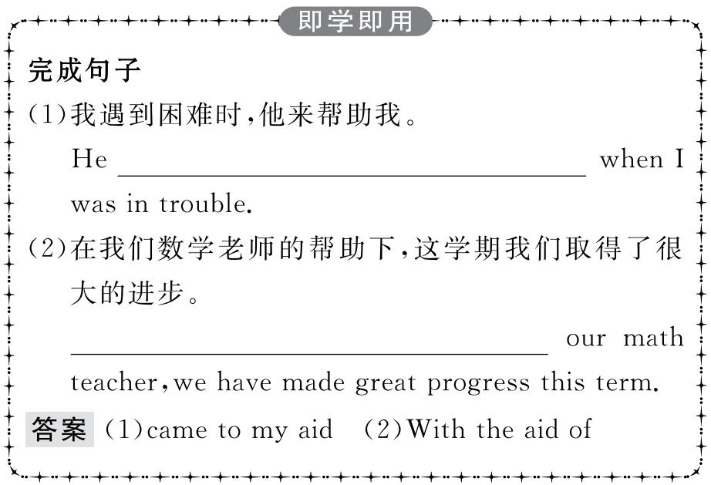
重点词汇
重点句式
重点语法
随堂练习

Slide 14
重点词汇
重点句式
重点语法
随堂练习
3.calm adj.镇静的;沉着的 vt.使平静;使镇静
【课文原句】If you find yourself in danger from a forest fire,first of all,stay calm.
如果你发现自己处于森林火灾的危险之中,首先要保持冷静。
【词汇精讲】句中的calm意为“镇静的;沉着的”,做连系动词stay的表语。
In the face of great danger,it’s important to keep calm.
在危险面前,保持镇静很重要。
They can be trained to remain calm in noisy and crowded places.
通过训练,在喧闹和拥挤的地方他们依然可以保持镇静。

Slide 15
重点词汇
重点句式
重点语法
随堂练习
【词汇拓展】
Though he was very angry,he tried hard to calm himself.
尽管他很气愤,他努力使自己平静下来。
The baby was crying and the mother was trying her best to calm him.
婴儿在哭,妈妈想尽办法使他安静下来。
You’d better calm down,or else you will get into trouble.
你最好冷静一点,不然你就有麻烦了。

Slide 16
重点词汇
重点句式
重点语法
随堂练习
calm,quiet,still,silent

Slide 17
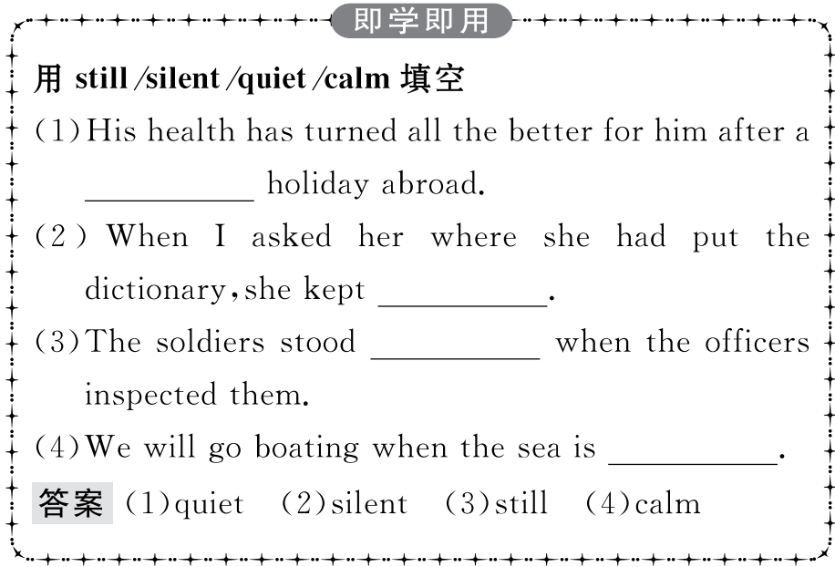
重点词汇
重点句式
重点语法
随堂练习

Slide 18
重点词汇
重点句式
重点语法
随堂练习
4.on hand 现有(尤其指帮助)
【课文原句】Now for our emergency supplies,we would suggest always having on hand enough water and food for three days,a radio,...
对于我们的紧急物资,我们建议随时有足够的水和三天的食物,一台收音机……
【词汇精讲】句中的on hand是介词短语,意为“现有”,在句中做状语。
He has too much work on hand to go picnicking with us.
他手头的工作太多了,不能跟我们去野餐。
We could only study those animals that we happened to have on hand.
我们只能对现有的动物进行研究。

Slide 19
重点词汇
重点句式
重点语法
随堂练习
【词汇拓展】

Slide 20
重点词汇
重点句式
重点语法
随堂练习

Slide 21
重点词汇
重点句式
重点语法
随堂练习
Now for our emergency supplies,we would suggest always having on hand enough water and food for three days,a radio,...
对于我们的紧急物资,我们建议随时有足够的水和三天的食物,一台收音机……
【句式剖析】本句是一个简单句。Now for our emergency supplies是介词短语做状语,would suggest是谓语动词,having...是动词-ing形式的短语做宾语。

Slide 22
重点词汇
重点句式
重点语法
随堂练习
【句式拓展】suggest表示“建议”时,后接名词、代词、动词-ing做宾语,也可接that从句。suggest表示“建议”,后接宾语从句时,从句的谓语动词要用should do,should可省略。
I suggested climbing Mount Tai next Sunday.
我建议下周日爬泰山。
Our English teacher suggested our handing in the homework tomorrow.
我们的英语老师建议我们明天交作业。
I suggest that you (should) stay here as if nothing had happened.
我建议你待在这里,就像什么也没发生一样。
The doctor suggested that I (should) come again next day.医生建议我第二天再来。

Slide 23
重点词汇
重点句式
重点语法
随堂练习
suggest表示“暗示;表明”时,后面的宾语从句不用虚拟语气。
His expression suggests that he didn’t sleep well last night.他的表情说明他昨晚没睡好。

Slide 24
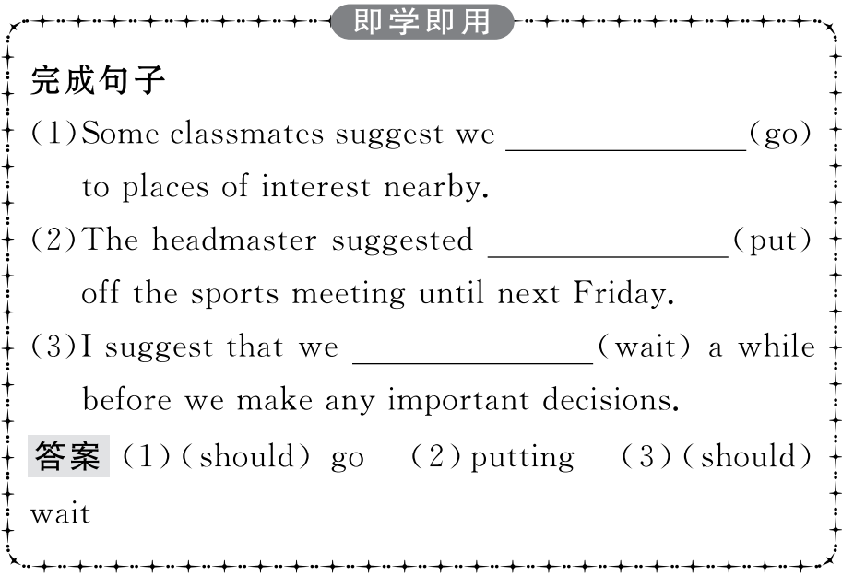
重点词汇
重点句式
重点语法
随堂练习

Slide 25
重点词汇
重点句式
重点语法
随堂练习
限制性定语从句(I)(which,that,who,whom,whose)
定语从句是用来充当句中定语的从句,它主要用于修饰句子中的名词、代词,其位置位于被修饰的名词、代词之后。在被修饰的名词、代词与定语从句之间往往有一个关系词将其前后两部分联系成一个整体,关系词可分为两种:关系代词和关系副词。常见的关系代词有:that,which,who,whom和whose。
一、关系代词的用法
1.who指人,在定语从句中做主语或宾语。
There’s a man at the front door who wants to see you.
前门口有个人想见你。
Those who want to go outing must be at the school gate at 7 tomorrow morning.
想去郊游的人必须在明晨7点到大门口集合。

Slide 26
重点词汇
重点句式
重点语法
随堂练习
2.whom指人,在定语从句中做宾语,常可省略。
Mr.Smith is the man (whom) you talked about on the bus.
史密斯先生就是你们在公共汽车上谈论的那个人。
The monitor is just the student (whom) I want to see.
班长正是我想要见的那个学生。
注意:关系代词whom 在口语或非正式文体中常可用who 来代替,也可省略。
The man (whom/who) you met just now is my brother.
你刚才遇到的那个人是我哥哥。
3.which指物,在定语从句中做主语或宾语,做宾语时常可省略。
Basketball is a game which is liked by most people.
篮球是大多数人都喜欢的运动。
The dictionary (which/that) I bought last week is very useful.我上周买的字典很有用。

Slide 27
重点词汇
重点句式
重点语法
随堂练习
4.that指人时,相当于who 或whom;指物时,相当于which。在定语从句中做主语或宾语,做宾语时常可省略。
The number of people that/who come to visit this city each year reaches one million.
每年来参观这座城市的人数达一百万。
The managers discussed the plan that/which will be carried out the next year.
经理们讨论了明年将会执行的计划。

Slide 28
重点词汇
重点句式
重点语法
随堂练习
5.whose通常指人,也可指物,在定语从句中做定语。whose 后必须有一名词。
He has a friend whose father is a doctor.
他有一个爸爸当医生的朋友。
Children who are not active or whose diet is high in fat will gain weight quickly.
不爱运动或者饮食热量偏高的孩子们会很快发胖。

Slide 29
重点词汇
重点句式
重点语法
随堂练习
二、限制性定语从句中只能用that引导定语从句的情况
1.当先行词是everything,anything,nothing,all,none,few,little,some等不定代词时,或当先行词受every,any,all,some,no,little,few,much等代词修饰时。
Have you taken down everything that Mr.Li said?
李老师讲的你都记下来了吗?
There seems to be nothing that is impossible to him in the world.
对他来说似乎世界上没有什么不可能的事。
All that can be done has been done.
所有能做的都做好了。
There is little that I can do for you.我不能为你干什么。
He stayed in the library and looked up any information that they needed.
他待在图书馆查找他们所需的资料。

Slide 30
重点词汇
重点句式
重点语法
随堂练习
2.当先行词被序数词修饰时。
The first place that they visited in London was Big Ben.
在伦敦他们参观的第一个地方是大本钟。
3.当先行词被形容词最高级修饰时。
This is the best film that I have ever seen.
这是我看过的最好的电影。
4.当先行词被the very,the only修饰时。
This is the very dictionary that I want to buy.
这正是我要买的词典。
After the fire in his house,the old car is the only thing that he owns.房子失火后,这辆旧车是他唯一拥有的东西。

Slide 31
重点词汇
重点句式
重点语法
随堂练习
5.当先行词前面有who,which等疑问代词时。
Who is the man that is standing by the gate?
站在门口的那个人是谁?
Which is the T-shirt that fits me most?
哪件T恤衫最合我的身?
6.当先行词为人与动物或人与物时。
They talked about the persons and things that they remembered at school.
他们谈论着他们所能记起的上学时的人和事。
Look at the man and his donkey that are walking up the street.
瞧瞧那个沿街走来的人和他的毛驴。

Slide 32
重点词汇
重点句式
重点语法
随堂练习
Ⅰ.单词拼写
1.If a volcano ,it explodes and sends smoke,fire,and rock into the sky.
答案:erupts
2.In order to catch my attention,the man walked to my car and t on the front glass.
答案:tapped
3.Luckily,he scored the winning goal just seconds before the final w .
答案:whistle

Slide 33
重点词汇
重点句式
重点语法
随堂练习
4.In case of e ,press the alarm button.
答案:emergency
5.More wind p stations will spring up to meet the demand for clean energy.(2019·江苏卷)
答案:power

Slide 34
重点词汇
重点句式
重点语法
随堂练习
Ⅱ.用关系代词引导的定语从句翻译下列句子
1.我的确有几条建议需要你注意。(2018·全国卷Ⅰ)
答案:I do have a few suggestions which you should pay attention to.
2.Growing Together是一部关于我们学校历史的电影短片。(2018·全国卷Ⅱ)
答案:Growing Together is a short film which is about the history of our school.
3.我们学校建了一座新体育馆,它成了我们学校的地标。(2018·全国卷Ⅲ)
答案:Our school has built a new stadium which has become the landmark of our school.

Slide 35
重点词汇
重点句式
重点语法
随堂练习
4.我建议你申请北京大学,它是中国最好的大学之一。(2018·北京卷)
答案:I suggest you apply for Beijing University which is one of the best universities in China.
5.那是一个黑色的皮钱包,里面有大约200美元和我的身份证。(2018·浙江卷)
答案:It is a black leather wallet in which there are 200 dollars and my ID card.

