Slide 1
Unit 12
weather
WWW.PPT818.COM

Slide 2
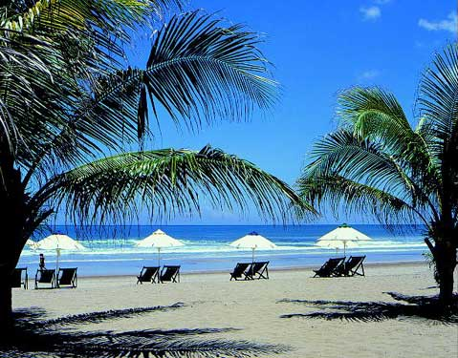

sun
It’s sunny.
sunny

Slide 3

cloud
It’s cloudy.
cloudy

Slide 4

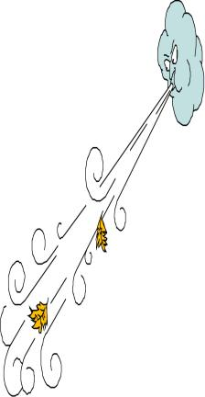



wind
o
w
It’s windy..
windy

Slide 5

It’s rainy.
rain
rainy

Slide 6
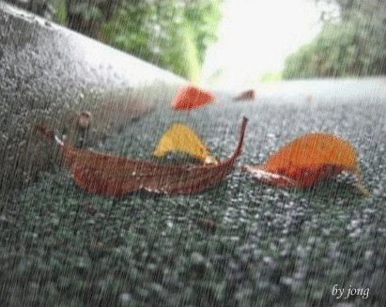
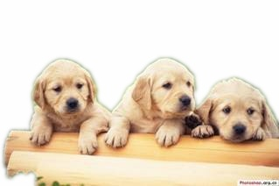
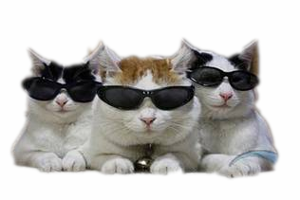
倾盆大雨
It is raining cats and dogs.

Slide 7



Do you know these signs ?
sun
sunny
rain
rainy
cloud
cloudy
wind
windy

Slide 8

How is the weather,Kitty?
It’s rainy.

Slide 9
How is the weather,Kitty?
It’s cloudy and windy.

Slide 10
How is the weather today,Kitty?
It’s warm and sunny .
It’s Sunday.Let’s go to the park.

Slide 11
I can ride my bike in the park.
I can run in the park.

Slide 12
How is the weather today?
It’s rainy.
I don’t like the rain.
I can’t play in the park.
I like the rain.

Slide 13
It’s windy today.
I like the wind.
I can fly my kite.
I don’t like the wind.

Slide 14
It’s hot today.
I don’t like the sun.
I like the sun.

