Slide 1
Unit 5
What were you doing when
the rainstorm came?
Section B 3a—3b（含Self Check ）
WWW.PPT818.COM

Slide 2
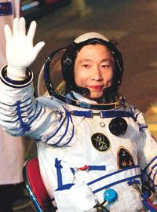
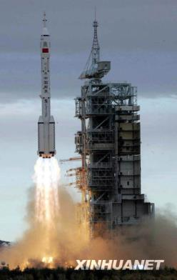
October 15, 2003
Yang Liwei flew around the Earth.

Slide 3
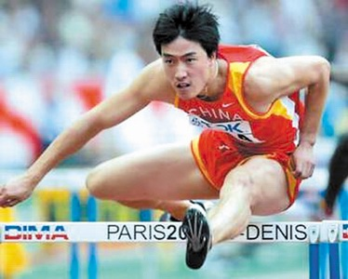
Liu Xiang won the gold medal at
the 2004 Olympics.

Slide 4
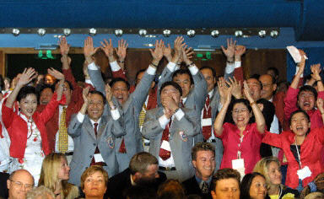
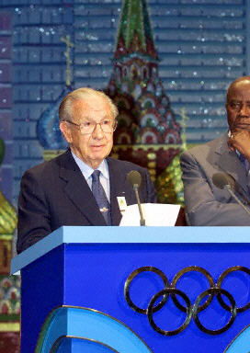
Beijing was made host to the 2008 Olympics.

Slide 5
Look at what the teacher did yesterday. Write
what you were doing at these times.
9:00—9:30 at the doctor’s
10:00—11:00 had English class
12:00—13:00 had lunch
14:00—15: 30 visited a friend in hospital
16:00—17:00 went shopping
While the teacher was at the doctor’s, I was
going to the class. …
at the doctor’s 在诊所(医院)
at the barber’s 在理发店

Slide 6
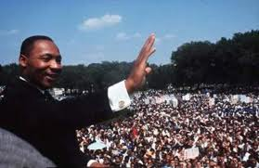
Clue of a story
What was the event?
Where did it happen?
What were people doing?
Why was it important?
Why do you remember this event?

Slide 7
下面五个句子组成一个故事, 用正确时态
填空并排列好顺序。
( )Yasmin (opened/was opening) _______ the window.
( )At 8:00 Yasmin (did/was doing) __________ her
homework when someone knocked on the window.
( )Yasmin quickly (closed/was closing) _______ the
window.
( )While she (was sleeping/went to sleep)
_____________, she dreamed about UFOs.
( )Then some strange looking people (were saying/
said)________, “We are from Planet Red.”
2
opened
1
was doing
4
closed
5
was sleeping
3
said

Slide 8
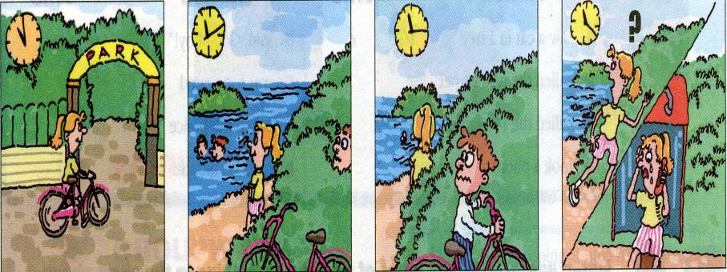
Use these pictures to write a story.

Slide 9
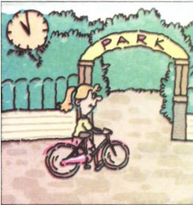
Look
What can you see in the picture?
At 11:00 am, Linda got to the park on her bike.
Notes:
9

Slide 10
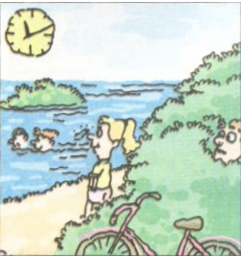
What can you see in the picture?
At 11:10 am, Linda was watching some people swimming in the lake.
Her bike was just behind her.

Slide 11
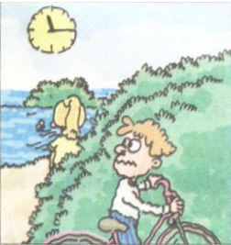
What can you see in the picture?
At 11:15 am, a man wheeled away Linda’s bike.

Slide 12
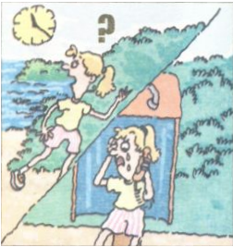
What can you see in the picture?
At 11:25 am, Linda couldn't find her bike. She telephoned the police at once.

Slide 13
Writing
Use these pictures to write a story.
1
2
3
4

Slide 14
Homework
Write about an event that you remember
well. Give dates and say why you remember
it, and what you were doing at the time when
you heard the news.

