Slide 1
Unit 9 Communication
How Embarrassing!
WWW.PPT818.COM

Slide 2
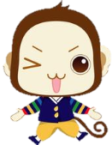
学习目标
1. To learn adjectives like V+ing, V+ed
eg. embarrassing/ embarrassed …
2. To learn about expressions:
run into; return to; hear from; make plans; remind of
3. To learn about talking one’s experience.
4. To realize talking about problems is better than
keeping them as secrets.

Slide 3
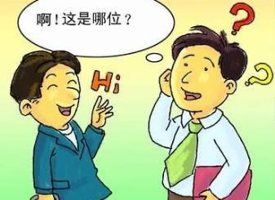
Warming up
How do you feel if you meet an old friend and he or she can’t remember your name?
Have you ever gotten back in touch with an old friend?

Slide 4
Reading
What is Ling Ming’s embarrassing experience?

Slide 5
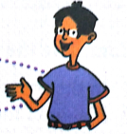
Reading
Read and retell Li Ming’s embarrassing experience using the hints below.
run into… familiar… couldn’t remember…
awful…chat…

Slide 6
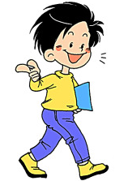
Retelling
Make a dialogue between Wang Mei and Li Ming.

Slide 7
Language points
1. remind
及物动词，意为“使想起、使记起、提醒”，后加名词或代词作宾语。
remind sb. of sth. 意为“使某人想起某事”。

Slide 8
Language points
2. He seemed familiar but I couldn’t remember his name.
他好像很熟悉，但我想不起他的名字了。
seem意为“好像……”，后面可以接形容词用作表语。
seem后还可加不定式、介词短语，或与引导词it连用.。

Slide 9
Practice
Fill in the blanks with the correct forms of the words or phrases in the box.
run into, return to, hear from, make plans
1. After living abroad for 30 years, the couple __________ the small town.
2. We’d love to go to the party, but we ______________for that day.
returned to
have made plans

Slide 10
Practice
3. They ___________their son yesterday. They were very happy.
4. I _________ an old friend on my way to school yesterday.
heard from
ran into

Slide 11
Practice
Listen to some kids talking about their most embarrassing moments and fill in the blanks.
One day I was in class. The whole class was quiet. ______________ my cell phone rang. Many heads _________ my direction. The teacher walked up to me. My face turned red. I felt so nervous that I could ________ breathe. Then I heard myself say in a shaking voice “You want it?” How embarrassing!!!
All of a sudden
turned in
hardly

Slide 12
Practice
My most embarrassing moment was during an award ceremony at the end of the year. I was sitting at the front. The host announced a special _______ and I heard my name, so I went up on the ______. It turned out that it was the other girl. The ______ part was walking back to my seat in front of everyone! Imagine how embarrassed I was!
award
stage
worst

Slide 13
Group work
Reading the different description of embarrassing moments.
Act them out in groups and talk about the ways out the embarrassing situations.

Slide 14
Exercise
根据句意和所给的首字母用适当的词语填空。
1. Danny a________ his mistakes at last.
2. His uncle w____ hands to him and then went away.
3. This story often r________ me of my hard life.
4. Mr. Zhang has been a_______ for many years and he’ll return next month.
5. They are making a p___ to play against us.
dmitted
aved
eminds
broad
lan

Slide 15
Homework
Have you had any embarrassing moments?
Write about them.

