Slide 1
Unit1 Let’s go to school.
人教精通版三年级下册
Lesson 5
WWW.PPT818.COM

Slide 2
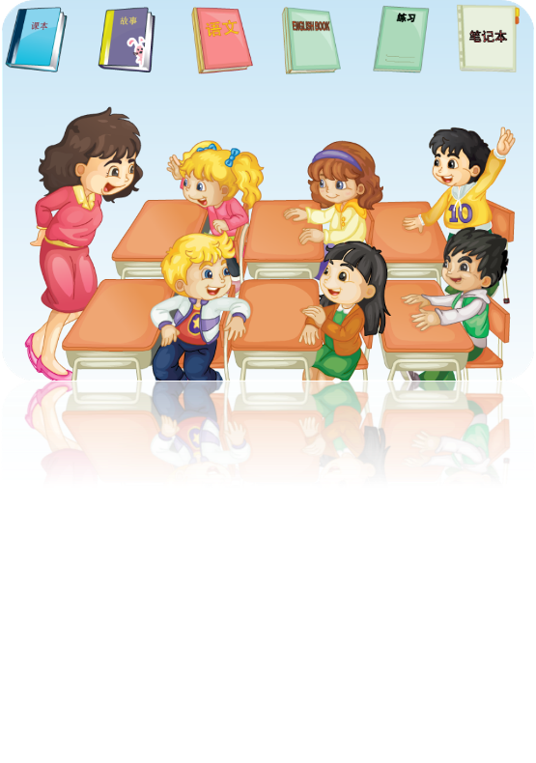
Play a game
Review
Guess! What’s in my hand?

Slide 3
Let’s chant
Lead-in

Slide 4
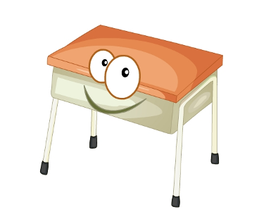
What’s this ?
Presentation
desk
It’s a desk.

Slide 5
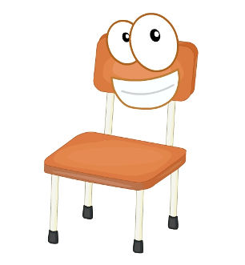
What’s this ?
Presentation
chair
It’s a chair.

Slide 6
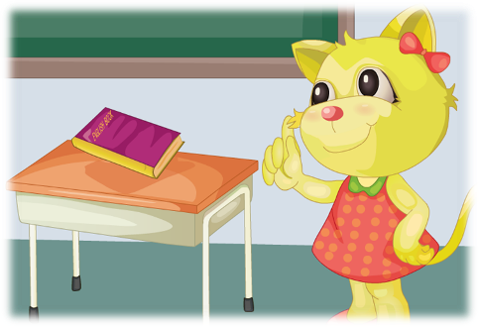
What’s on the desk?
Presentation
It’s an English book.

Slide 7
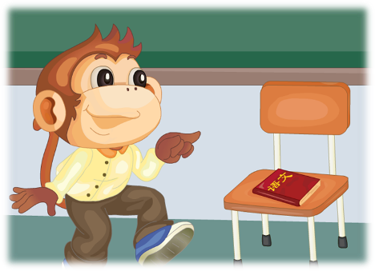
What’s on the chair?
Presentation
It’s a Chinese book.

Slide 8
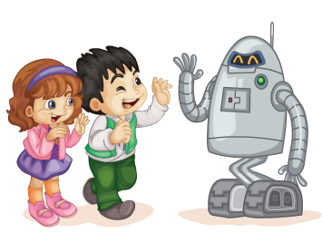
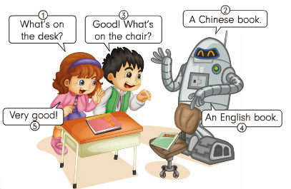
What did they say?
Presentation
Listen and say

Slide 9
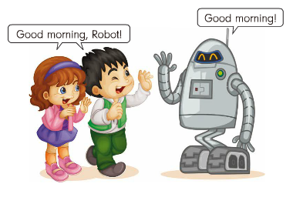
Presentation
Good morning, Robot!
Good morning!

Slide 10
Presentation
Listen and number
3
A Chinese book.
What’s on the desk?
Good! What’s on the chair?
2
1
5
Very good!
An English book.
4

Slide 11
Practice
录音 | 课文句子
Good morning, Robot!
Good morning!
What’s on the desk?
A Chinese book.
Good! What’s on the chair?
An English book.
Very good!

Slide 12
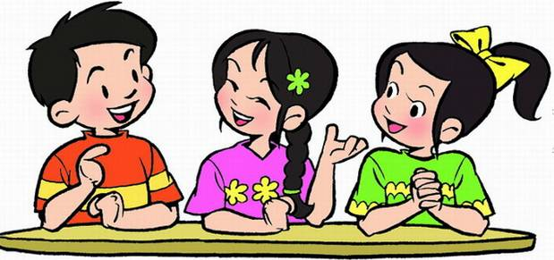
Practice
Role-play
三人一组，分角色表演对话。

Slide 13
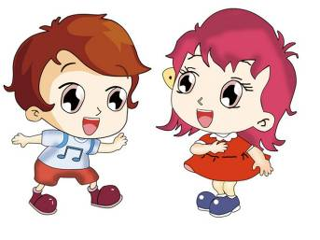
Practice
Game
听指令做动作
Show me/Touch…

Slide 14
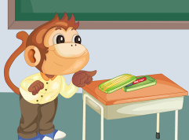
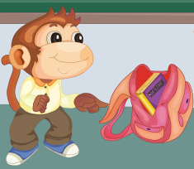
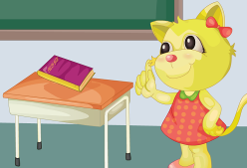
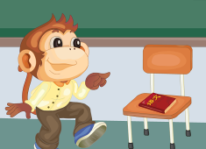
Practice
Group work
看图模仿课文，四人一组，编写新的对话。

Slide 15
Summary
1.本节课的重点单词有哪些？
desk
chair
2.本节课的重点句型有哪些？
What’s on the chair?
What’s on the desk?

Slide 16
Homework
1.模仿Just talk语音、语调朗读对话，并编写新的对话。
2.学会唱Let’s chant部分的歌曲，并唱给爸爸妈妈听。
Close

