Slide 1
Unit 7
Teenagers should be allowed to
choose their own clothes.
Section A (第3课时)
WWW.PPT818.COM

Slide 2
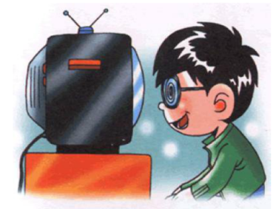
Warming up
Do you think teenagers should be allowed to use the Internet?

Slide 3
Warming up
Do you think teenagers should be allowed to use mobile phones?

Slide 4
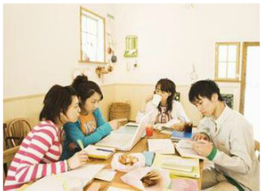
Warming up
Do you think teenagers should be allowed to study with friends after class?

Slide 5
Warming up
Do you think teenagers should be allowed to drink or smoke?

Slide 6
Warming up
Do you think teenagers should be allowed to choose their own clothes?

Slide 7
Grammar
Focous
I don’t think sixteen-year-olds should be allowed to drive. | I agree. They aren't serious enough.
Do you think teenagers should be encouraged to make their own decisions? | No,I don’t agree with this. Teenagers are too young to make their own decisions.
Teenagers should not be allowed to have part-time jobs. | I disagree. They can learn a lot from working.
Do you think we may be allowed to take photos if we don't use a flash? | If you don't use a flash,then it may be OK.

Slide 8
1.You must clean your bedroom every day. Your bedroom must be cleaned every day . 2.Parents should encourage teenagers to do social work for their community. Teenagers__________________________________________________.
Rewrite the sentences according to the example.
4a
should be encouraged to do social work for their community
3.Can Lucy do her homework tomorrow instead? Can ______________________________________________________? 4.Do you think we must keep teenagers away from the Internet? Do you think teenagers________________________________________? 5.Parents should give teenagers chances to make their own decisions. Teenagers __________________________________________________.
Lucy's homework be done by her tomorrow instead
must be kept away from the Internet
should be given chances to make their own decisions

Slide 9
Fill in the blanks with the correct forms of the words in brackets.
4b
Should teenagers __________(ask) to move out when they start working? In many Western countries, teenagers_________(allow) to move out at eighteen. Their parents believe that they should __________(educate) to take care of themselves from a young age. This way, when they __________(start) working they can manage their own lives. However, in most Asian societies, it is not common for teenagers to __________(move) out. Chinese parents believe that it is better for children to live with parents who can __________(take) care of them. But the young should then look after their parents as they get older. That is why many Chinese adults __________(continue) to live with their parents.
be asked
are allowed
be educated
start
move
take
continue

Slide 10
4c
You and your friend are starting an English club. Make a list of rules about what should and should not be allowed.
A: Members should be allowed to use dictionaries.
B: Yes, but they should only use English-English
dictionaries.

Slide 11
Language Points
1.educate 教育
educate sb. (to do sth.) 教育某人做……
【拓展】education n. 教育
2.make one's own decision =decide on one's own=decide for oneself 自己做决定
e.g.:I can make my own decision/decide for myself and manage my own life.

Slide 12
语法拓展
被动语态（三）——含情态动词的被动语态
含有情态动词should 的被动语态的结构：should +be+及物动词的过去分词
一、肯定句式：主语+情态动词+be+动词的过去分词+（by+宾语）
e.g.:Your homework should be finished by yourself.

Slide 13
二、否定句式：主语+情态动词+not+be+动词的过去分词+（by+宾语）
e.g.:Teenagers should not be allowed to go out at night.
三、一般疑问句结构为：情态动词+sb./sth.+be+动词的过去分词+（by+宾语）？
回答：Yes,主语+should./No,主语+shouldn't.
e.g.:—Should these young trees be watered every day?
—Yes,they should./No,they shouldn't.

Slide 14
四、特殊疑问句结构为：主语+疑问词+一般疑问句？
e.g.:What should students be allowed to do?
【注意】①含有双宾语的主动句变为被动句时，把代表人的间接宾语变为被动句的主语，把直接宾语作为被动句的宾语；若把主动句的直接宾语变为被动句的主语，间接宾语前必须加介词for或to。
e.g.:My aunt gave me a book on my birthday.
I was given a book on my birthday by my aunt.
A book was given to me on my birthday by my aunt.

Slide 15
②当主动句中的谓语动词是feel,hear,make,see,watch,look at,notice等时，其后作宾语补足语的动词不定式要省略to，但变为被动句时，要补上动词不定式符合 to。
e.g.:We heard Mary sing a song at the party.
Mary was heard to sing a song at the party by us.
③含有短语动词的被动句，其短语中的介词或副词不能丢掉。
e.g.:A tall building was put up in my hometown.

Slide 16
Exercise
一、单项选择。
( )1.—It's difficult for children to cross the river to school.
—I think a bridge ______ over the river.
A.should be built B.will build
C.is built D.was built
( )2.Teenagers ______ allowed to drive.
A.should not be B.should be not
C.not should be D.shouldn't
A
A

Slide 17
B
( )3.A computer ______ me by my mother last week.
A.was given B.was given to
C.was giving D.is giving
( )4.He ______ stay outside last night.
A.was seen B.is seen
C.was seen to D.saw
( )5.—Do you know Earth Day?
—Sure.It ______ in 1970 to tell us to protect our planet.
A.sets up B.set up
C.was set D.was set up
C
D

Slide 18
二、句型转换。
1.The lights should be turned off before you leave the classroom.(改为主动语态)
You ______ ______ off the lights before you leave the classroom.
2.I can't hear her sing.(改为被动语态)
She can't ______ ______ ______ sing.
3.Should we throw waste paper everywhere?(改为被动语态)
______ waste paper ______ ______ everywhere?
4.Books should be put into the desk.(对画线部分提问)
______ ______ books ______ ______?
should turn
be heard to
Should be thrown
Where should be put

Slide 19
Homework
Recite Grammar Focus and translate them.

Slide 20
Thank you！

