Slide 1
Unit 2 Feelings He’s excited.
WWW.PPT818.COM

Slide 2
Let's enjoy a happy song!
If you're happy and you know it, clap your hands
If you're happy and you know it, and you really want to show it.
If you're happy and you know it, stomp your feet
If you're happy and you know it, and you really want to show it.
If you’re happy and you know it, stomp your feet .
If you're happy and you know it, say OK. .
If you're happy and you know it, and you really want to show it.
If you're happy and you know it, say OK.

Slide 3
Feelings

Slide 4
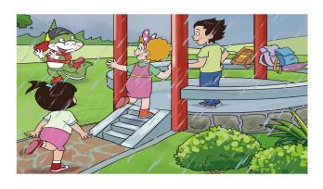
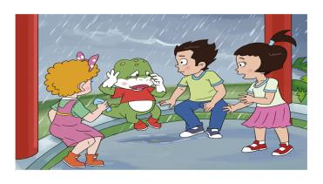
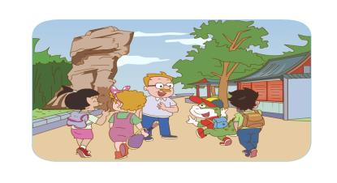
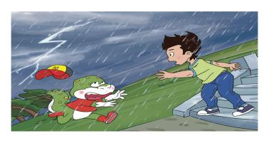
A
B
excited
sad
dad
2
happy
4
angry
C
D
1
3

Slide 5
Why is Danny happy?
看起来，看上去
Mr Wood:You look so happy,Danny.
Danny:Yes. We're going to the park.

Slide 6
Why is Danny excited?
Li Ming:Oh,it's
raining.
Jenny:What's Danny doing there?
Li Ming:He's dancing in the rain. He's excited.

Slide 7
Why is Danny running?
Danny:Help!The sky is angry.
Li Ming:Danny, come back!

Slide 8
Why is Danny so sad? What does Wang Hong say to sad Danny?
丢失（lose的过去式）
Danny:Oh,no!
I've lost my cap.
Wang Hong:
Don't be sad.We can help you.

Slide 9
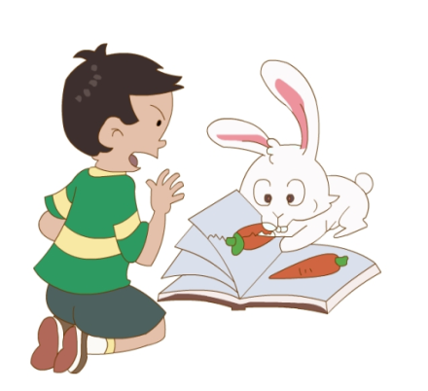
Let's talk
A:What's he doing?
B:He‘s looking at the rabbit.
He's angry.

Slide 10
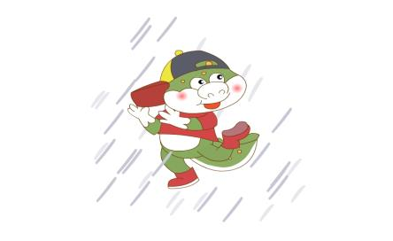
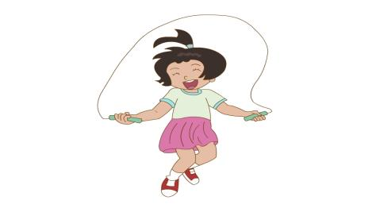
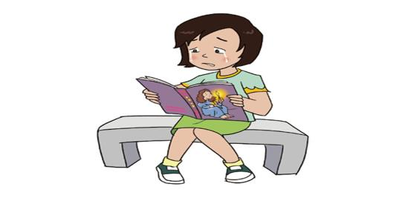

Slide 11
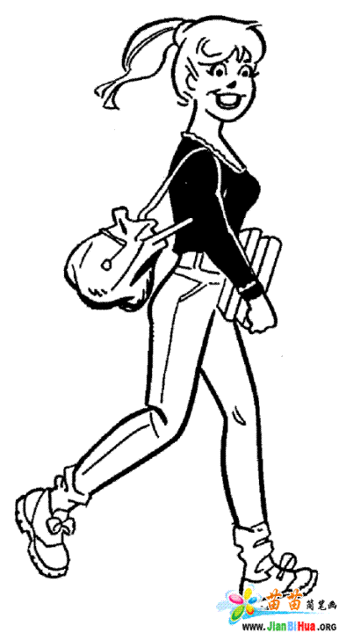
My Feeling Book
I'm going shopping.I'm happy.

Slide 12
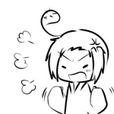
My Feeling Book
I'm watching TV.
I'm angry.

Slide 13
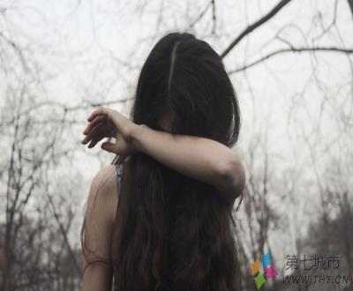
My Feeling Book
I lost my purse.
I'm sad.

Slide 14
Feelings
What have we learned today?
excited
happy
sad
angry

Slide 15
Homework
1. Listen to the tape and repeat.
2. Talk about your feelings to your friends and your parents.

Slide 16
Goodbye

