Slide 1
陕旅版小学英语三年级下册
Unit6 Where Is My Eraser?
第1课时
WWW.PPT818.COM

Slide 2
学习目标
1
听说单词：chair, desk, window, door, floor, classroom。
巩固句型：
This is a chair. / That is the door.
These are desks.
培养学生的表达能力。
2
3

Slide 3
故事欣赏Where is Tobi

Slide 4
How many chairs and desks are there in our classroom?

Slide 5
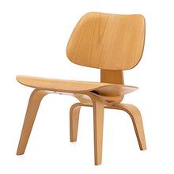
Part A Let’s learn
chair
椅子

Slide 6
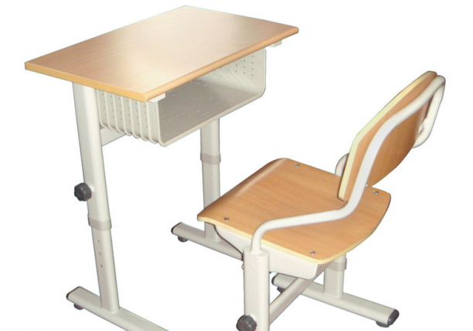
desk
课桌；桌子

Slide 7
window
窗户

Slide 8
door
门

Slide 9
classroom
教室

Slide 10
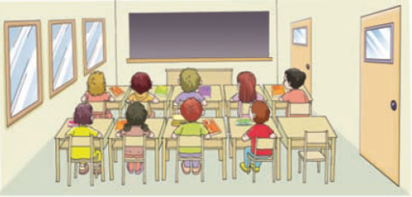
Part C Look and write
two doors three windows
four boys five girls
ten desks and chairs

Slide 11
Pair works
两到三人一组，指着实物，练习
This is a desk / chair/ door / window, etc.
These are desks and chairs.

