Slide 1
Unit 9
I like music that I can dance to.
Section A Period 1 1a-2d
WWW.PPT818.COM
Notes:
1
1

Slide 2
Free talk
Do you like music?
What's your favorite music?
What kind of music do you like?

Slide 3
I prefer music that has great lyrics.

Slide 4
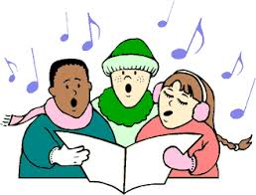
I love music that I can sing along with.

Slide 5
light music
I like music that isn’t too loud.

Slide 6
I like music that I can dance to.

Slide 7
1b
Listen and check (√) the kinds of
music Tony and Betty like.
 | Music that I can dance to | Music that has great lyrics | Music that I can sing along with
Tony
Betty
√
√
√
√

Slide 8
Pair Work
Talk about the music, movies or books that you like.
A: What kind of … do you like?
B: I like … that I … What about you?
A: I prefer … that …

Slide 9
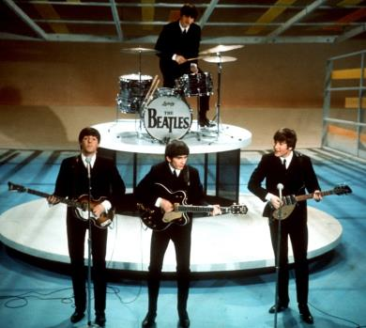
I like / love / prefer music that …

Slide 10
An example
A: What kind of movie do you like best?
B: I like movies that are exciting /
funny / scary …

Slide 11
2a Listen and circle T (for true) or
F (for false).
Carmen likes musicians who play
different kinds of music.
2. Xu Fei likes the Australian singer
Dan Dervish.
3. Carmen likes electronic music that’s
loud.
4. Xu Fei prefers groups that play
quiet and slow songs.
T
F
T
F
T
F
T
F

Slide 12
2b Listen again and complete the sentences.
Carmen says | 1. I really love Dan Dervish. I like musicians _____________________________. 2. The Modern are really great. I love electronic music ___________.
Xu Fei says | 3. I like musicians _______________________. 4. I think The Modern are too noisy. I prefer groups __________________________.
who play different kinds of music
that’s loud
who write their own songs
that play quiet and slow songs

Slide 13
Pair Work
Make conversations using the information in 2a and 2b.
A: Does Xu Fei like The Modern?
B: No, he doesn’t. He prefers …

Slide 14
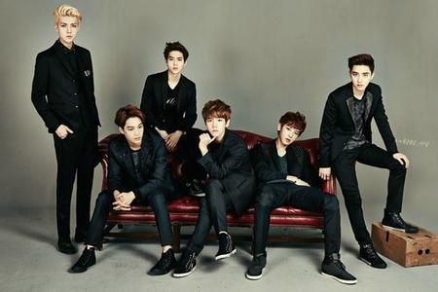
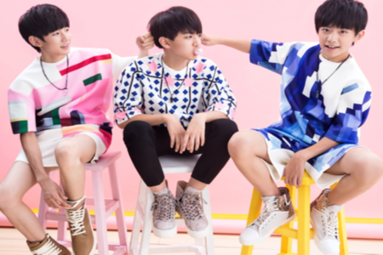
Pair Work
EXO
TFboys
A: Do you like …?
B: No. I prefer … What about you?

Slide 15
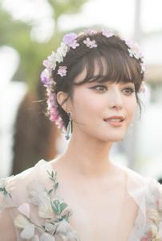
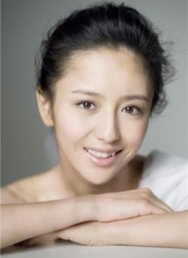
Pair Work
Fan Bingbing
Tong Liya
A: Do you like …?
B: No. I prefer … What about you?

Slide 16
2d Read and answer the questions.
What does Scott plan to do this weekend?
Why does Scott like listening to smooth music?
What is Jill going to do this weekend?
He plans to listen to the new CD he bought.
Because he thinks smooth music can relax his mind after a long week at work.
He is going to watch a movie.

Slide 17
Language Points
1. I prefer music that has great lyrics.
prefer v. 更喜欢，更喜爱 (相当于like ... better)
1) prefer sth. 更喜欢……
I prefer action movies.
我更喜欢动作片。
2) prefer doing / to do sth. 更喜欢做某事
I prefer watching / to watch TV at home.
我更喜欢在家看电视。

Slide 18
3) prefer sb. to do sth. 宁愿某人做……
My mother prefers me to stay with her a little longer.
我妈妈更喜欢我和她多呆一会儿。
4) prefer sth. to sth. 比起……更喜欢……
She prefers cats to dogs.
比起狗来她更喜欢猫。

Slide 19
5) prefer doing sth. to doing sth.= prefer to do sth. rather than do sth. 喜欢做……而不喜欢做……；宁愿做……而不愿做……
Mary prefers dancing to singing.
玛丽喜欢跳舞胜过喜欢唱歌。
They prefer to stay at home rather than go out with their parents.
他们宁愿呆在家里，不愿和父母出去。

Slide 20
2. I suppose I’ll just listen to this new CD …
suppose v. 推断；料想
As she's not here, I suppose she must have gone home.
因为她不在这儿, 所以我猜想她一定已回家了。
I don't suppose you're serious, are you?
我想你并不是当真的, 对吗?
I never supposed him a hero.
我从未把他想象成英雄。

Slide 21
3. smooth music
smooth adj. 平滑的；悦耳的
Her skin is as smooth as silk.
她的皮肤像丝绸一样光滑。
Our path in life will not always be smooth.
我们人生的道路不会总是平坦的。
She has the most beautiful blue eyes and a voice as smooth as silk.
她有着美丽的蓝色眼睛和十分悦耳的嗓音。

Slide 22
4. Well, if you have spare time, …
spare adj. 空闲的；不用的
What do you like doing in your spare time?
你在闲暇时喜欢做什么？
Please stay with us. We have a spare room for you.
请住下吧，我们有一个空房间给你住。
I have no spare money.
我没有余钱。

Slide 23
HOMEWORK
1. Remember the language points and grammar.
2. Read the conversation in 2d.
Notes:
23
23

Slide 24
Thank you!

