Slide 1
Module 9 Unit 2
Wishing you happiness every day.
WWW.PPT818.COM

Slide 2
Learning goals
能理解单词及句子: happiness、Wishing you happiness every day；
能理解课文内容并进行简单的复述;
能运用 Wishing you happiness every day 这类语句表达良好祝愿。

Slide 3
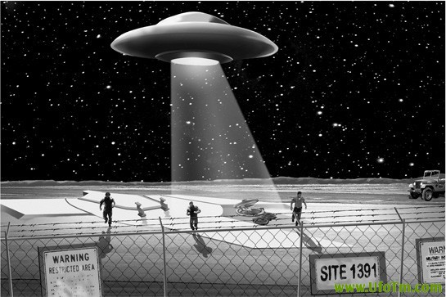
Lead-in
What is this？
It’s a UFO.

Slide 4
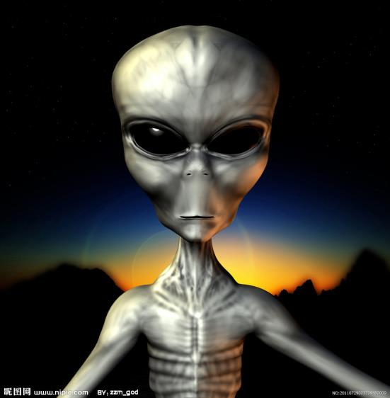
What is it？
It’s a alien（外星人）.

Slide 5
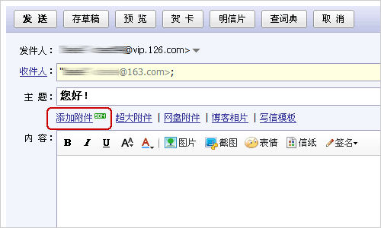
It’s an ______.
email

Slide 6
课文学习
1 Look, listen and say.
—I’m writing an email to my friends from the earth. I miss them.
—Dear friends, I miss you. Best wishes to you. Love, Bobo.

Slide 7
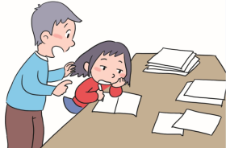
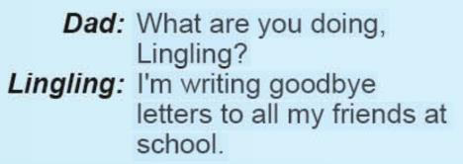
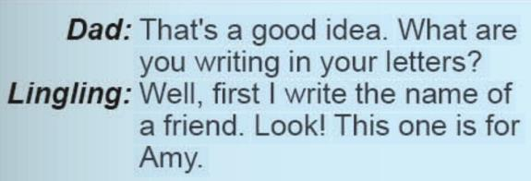
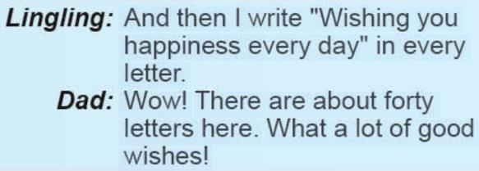
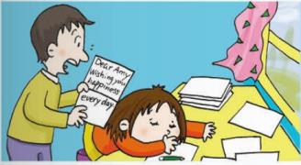
2 Listen and read.

Slide 8
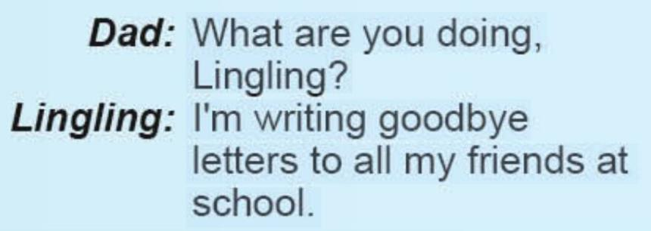
Read paragraph 1 and answer ：
A
（ ）What is Lingling doing？
A: She is writing goodbye letters to her friends.
B: She is sending goodbye letters to her friends.

Slide 9
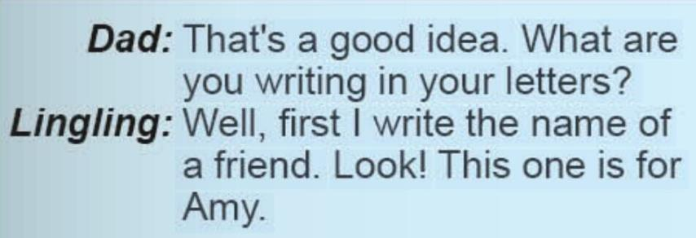
Read paragraph 2 and answer ：
（ ）What does she write first ？
A: First she writes the name of a friend.
B: Frist she writes the address of a friend.
A

Slide 10
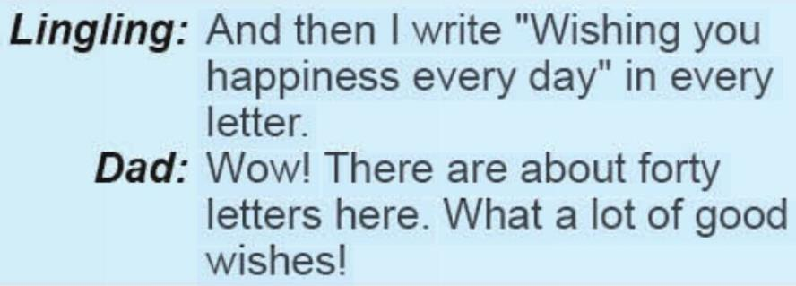
What does she write then？
Then she writes: ______________________________________
Read paragraph 3 and answer ：
Wishing you happiness every day!

Slide 11
Let’s retell!
goodbye letters
forty
name
wishing
Lingling is writing_________to all her friends at school. First she writes the_________of a friend. And then she writes "_________you happiness every day" in every letter. Look! This one is for Amy. And there are_________letters to write.

Slide 12
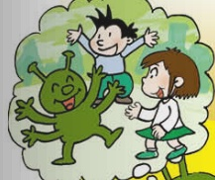
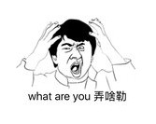
New words
happiness 幸福，愉快
what 多么

Slide 13
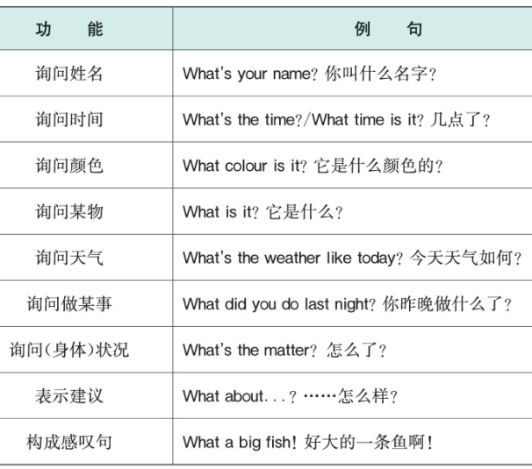
课文讲解
what的用法汇总

Slide 14
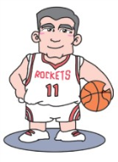

Slide 15
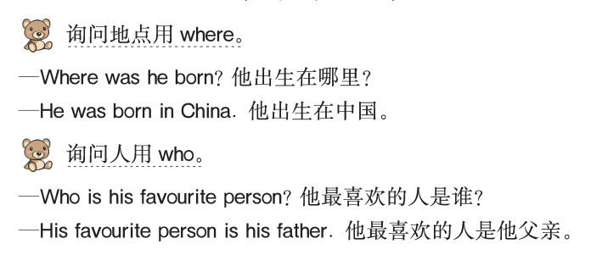

Slide 17
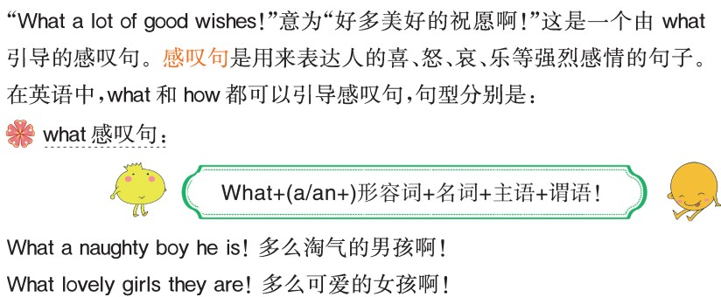
what引导的感叹句

Slide 18
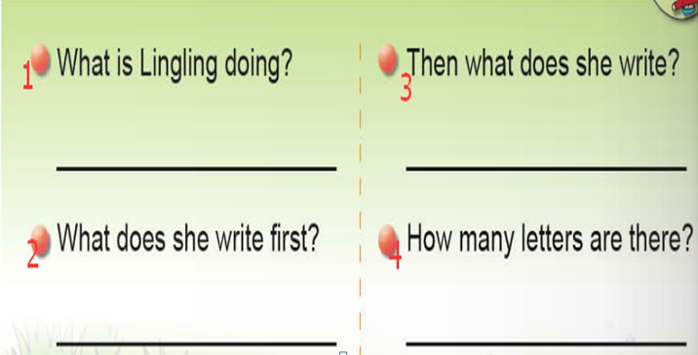
课文学习
3. Now read and write. Then ask and answer.

Slide 19
Answers
1. She is writing goodbye letters to all her friends at school.
2. First she writes the name of a friend.
3. Then she writes "Wishing you happiness every day" in every letter.
4. There are about forty letters.

Slide 20
课文学习
4. Listen and say. Then sing.

Slide 21
Goodbye, goodbye, my friend.
（再见， 再见， 我的朋友。）
It’s nearly the end, the end.
（这将是要结束，结束）
Good luck, good luck to you!
（祝你好运， 祝你好运！）
Good luck, good luck to you!
Goodbye, goodbye, my friend.
It’s nearly the end, the end.
Wishing you happiness every day.
（祝你幸福每一天。）
Wishing you happiness every day.

Slide 22
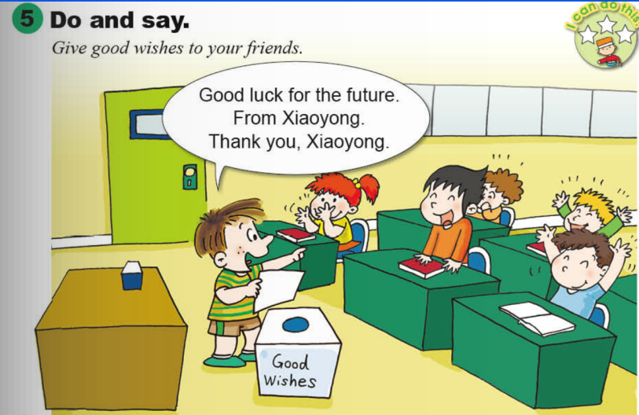
课文学习

Slide 23
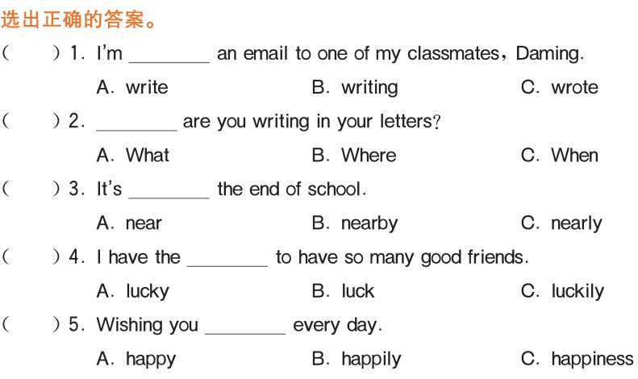
Exercise

Slide 24
Homework
1. Recite the dialogue and practise in pairs.
2. Give your best wishes to your good friends.

