Slide 1
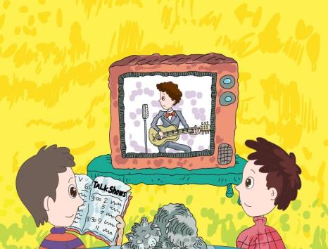
人教版八年级上册
Unit5
Do you want to watch a game show?
Section A（第2课时）
WWW.PPT818.COM
0

Slide 2
1.通过核心句型的集中学习，学生能更加牢固地掌握电视节目及其形容词。 2.通过组句训练，强化本单元重点知识的学习和突破语法难点。 3.通过开放性的口语活动，能够在真实的语境中使用目标词汇和句型。
学习目标

Slide 3
自学互研
新词自查
根据句意及汉语提示完成句子
1. The old man told us some funny jokes (笑话) and made
us laugh.
2. I expect (期望) to learn the news about the earthquake
in Ya An on TV.
3. I am planning (打算) to watch a soap opera tonight.
4. My sister hopes (希望) to be a teacher when she grows
up.

Slide 4
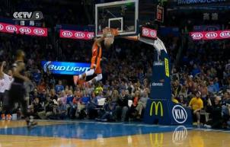
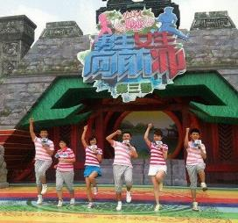
情景导入
Ask and answer
What do you think of the TV shows?
Do you want to watch…?
Why do you like watching…?
sports show
news
talent show
soap opera
game show
sitcom

Slide 5
Read the sentences.
Grammar Focus
Do you want to watch the news? | Yes, I do./ no, I don’t.
What do you plan to watch tonight? | I plan to watch Days of Our Past.
What can you expect to learn from sitcoms? | You can learn some great jokes.
Why do you like watching the news? | Because I hope to find out what’s going on around the world.
What do you think of talk shows? | I don’t mind them. / I can’t stand them./ I love watching them.
0

Slide 6
Fill in the blanks.
Do you _____ _____ watch the news?
—What do you _____ ______ talk shows?
—I don’t _______ them./ I can’t ______ them./ I _______ watching them.
3. —What do you ______ _______ watch tonight?
—I _____ _____watch Days of Our Past.
4. What can you expect to learn ______sitcoms?
5. —Why ______ ______ like ______ the news?
—Because I hope to ______ ______ what’s ______ ______ around the world.

Slide 7
3a Make a conversation and then practice it
with a partner.
A: What do you plan to watch on TV tonight?
B: I hope to __________________ , but I also want
to ___________________. How about you? Do you
________________ a talk show or _____________?
A: Oh, I want to .
watch a sitcom
watch the news
want to watch
a talent show
watch a talent show

Slide 8
Number the sentences in the correct order.
A. What do you plan to watch on TV tonight?
B. How about you?
C. Do you want to watch a talk show or a talent show?
D. Oh, I want to watch a talent show.
E. I hope to watch a sitcom, but I also want to watch the news.
0

Slide 9
3b Answer these questions. Give answers that
are true for you.
What do you think of game shows?
2. What comedy shows do you like to watch?
3. Do you plan to watch a sports show tonight?
4. What can you expect to learn from the news?

Slide 10
Answer to Q 1:
I really love watching them, because they make me happy and relax.
Answer to Q 2:
I like to watch The Big Bang Theory and Mr. Bean. They are so interesting.
Answer to Q 3:
No, I can’t stand it. I think it’s boring.
Answer to Q 4:
I hope to know what happened around the world.

Slide 11
3c Ask your classmates questions and write their names in the chart.
Find someone who… | Students’ names
wants to watch a movie
hopes to watch a sitcom
expects to watch the news
plans to watch a sports show
never wants to watch a game show

Slide 12
Pair work
A: Do you want to go to a movie?
B: Yes, I do. I want to see an ___________.
action movie
0

Slide 13
Do
A: ___ you _________
go to a movie?
B: Yes, I do. I _______
watch a _________.
want to
want to
comedy

Slide 14
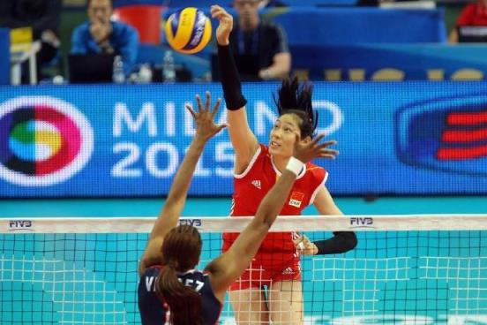
A: What do you plan to watch tonight?
B: I plan to watch ______ ______ _____.
a sports show

Slide 15
The ways to express likes and dislikes
Expressing likes
I love…
I like…
Expressing dislikes
I don’t like…
I can’t stand…
I don’t mind…

Slide 16
问题探究
1. What can you expect to learn from sitcoms?
你希望从情景剧中学到什么？
其中 expect to do sth. 希望/ 期望干某事。
learn from 后可以接人也可以接事物，构成短语
learn from sb. 向某人学习
learn from sth. 从某事中学习
e.g. —What can you expect to learn from sitcoms?
—I hope to learn some great jokes.

Slide 17
2. What do you think of talk shows?
What do you think of ...?
= How do you like…? “你认为······怎么样?”
谈论对某事物的喜好程度, 可选择的回答有：
I like it./I don’t mind it./I don’t like it./
I can’t stand it./I like it very much./I love it./
It’s beautiful./They’re fantastic.

Slide 18
3. I don’t mind them.
mind 介意； 在乎。表示请求或是征求意
见时后接名词， 动名词或代词。多用以下
句型：Would you mind doing…?
Do you mind …?
e.g. Would you mind opening the door?
Do you mind my dog?

Slide 19
4. I can’t stand them!
stand 忍受 （多用于否定句、疑问句），
常与 can’t 连用。stand 后接名词、代词、
动名词。例如：
1）I can’t stand soap operas.
2）Jim can’t stand his mother any more.
3）All of us can’t stand waiting for the bus
too long.

Slide 20
课堂评价
一、根据汉语，补全英语句子。 1. ——你觉得游戏节目怎样？
——我忍受不了那些东西。 —______do you________ _______game shows?
—I _______ _______ them. 2. 他们对每样东西的看法如何？ ______ did they _____ _______everything?
3. 我们喜欢在课堂上用英语问问题。 We enjoy______ _______ ____ _______ in class. 4. 你介意把这件事告诉他吗？ Would you________ ________him about this?
What
think of
can’t stand
What
think of
asking questions in English
mind telling

Slide 21
5. 他们不能忍受太阳镜。你呢？
They can’t _____ sunglasses. ____________you?
6. Linda对运动节目不在乎。
Linda _______ ______ ________ ________.
7. ——Ken认为谈话节目怎么样？
——他很喜爱它们。
—What ____Ken think of _____ ________?
—He ______them.
stand
How about
doesn’t mind sports shows
does
talk shows
loves

Slide 22
二、选择题
1. A: What do you think of sitcoms?
B: Oh, I _________ mind them.
A. can’t B. don’t C. am not
2. A: What does she think of the talk show?
B: She ________ stand them.
isn’t B. doesn’t C. can’t
3. She wants to _________.
A. swim B. swimming C. swims
B
C
A

Slide 23
4. — ____ do you think of the movie? — It’s very interesting. I like it.
A. Why B. Which C. How D. What
5. It’s too hot in the classroom. We can’t ___ it.
We all ___ up and go out of the classroom.
A. mind; stand B. stand; stand C. sit; stand
6. How about _____ out for a walk?
A. to go B. going C. go D. goes
D
B
B

Slide 24
Summary
重点词汇：think of, want, love, like, learn
重要句型：Do you want to…?
What do you think of…?
I don’t mind them./ I can’t stand it.

Slide 25
Homework
Firstly, review the knowledge of grammar focus.
Secondly, ask parents’ attitudes towards the different kinds of TV shows, and communicate it with your partner.

