Slide 1
Unit 8 Pets Reading
WWW.PPT818.COM

Slide 2
Twinkle twinkle little star
Twinkle twinkle little star, How I wonder what you are, Up above the world so high, Like a diamond in the sky, Star light,
Star bright, The first star I see tonight, I wish I may, I wish I might, Have the wish I wish tonight,
These words
rhyme.

Slide 3
chase
catch
hide
hunt
trick
bite
trouble
hutch
Match the two parts
box or cage for keeping rabbits
stop someone from being seen
look for
run after
cut into sth with teeth.
some difficulties
some amazing things (games)
stop and hold a moving thing

Slide 4
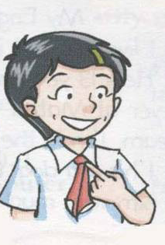
My dog
1. What does her dog like to do?
It doesn’t just chase and catch a ball. It hunts, do wonderful tricks, builds camps out of sticks.

Slide 5
2. What doesn’t it do?
It never barks, bite or fight.
3. Is the dog clever?
Yes, it’s the cleverest animal of all.

Slide 6
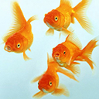
What is the fish doing?
It’s swimming around and bubbling.
Where is it? Is it in a rabbit hutch?
It’s in a fish tank. It’s not in a rabbit hutch.

Slide 7
Millie’s goldfish
Is the goldfish a wonderful pet?
Does she need a bed, a rabbit hutch and much food?
Yes, she is.
No, she doesn’t.

Slide 8
What do they usually do?
What doesn’t she do?
Bubble.
She doesn’t bark or miaow.

Slide 9
Is the cat very lazy?
Do you like cats?
Where do cats sleep?
On the window-ledge, on your bed, in a drawer, in your shoes, cardboard box, on your lap, in your frocks

Slide 10
My dog is the ________ animal of all. Besides (除了) chasing and _______ a ball, he can do many other things for me. When I ____, he hunts with eyes open ____. He _____ camps out __ sticks for me. He’d never ____, ___ or ____. I love him very much and I’ll ________ him forever(永远).
cleverest
catching
hide
wide
builds
of
bark
bite
fight
look after

Slide 11
wonderful
My goldfish is a _________ pet. She isn’t any _______. She doesn’t ____ or ______. She likes to ______. She doesn’t need a bed or a ___________. We don’t have to ____ her much.
trouble
bark
miaow
bubble
rabbit hutch
feed

