Slide 1
Module 2
My English class
Unit 1
Open your book
WWW.PPT818.COM

Slide 2
Teaching objectives
1. To learn the words in unit 1.
2. To learn everyday language of the
classroom.
3. To master sit down, stand up, put up,
open your book.

Slide 3
Sing the ABC song
ABCDEFG HIJKLMN
OPQ RST UVW XYZ
XYZ, now you see,
I can say my ABC.

Slide 4
1
Listen and read
T: Good morning, class.
Ss: Good morning, Miss Zhou.
T: Please _______ .
sit down

Slide 5
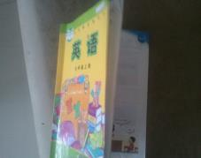
Open your book.
Listen.
Draw.
Sit down.
1
2
3
4
Put up
your hand.
Close your
book.
Stand up.
2
5
6
7

Slide 6
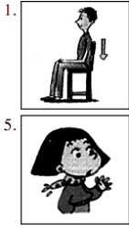
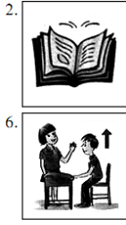
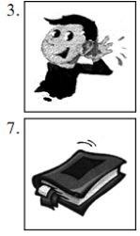
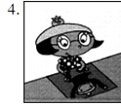
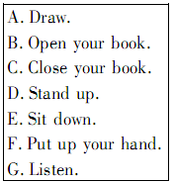
Match
F B G A F D G
1___2___3___4___5___6___7___

Slide 7
It's time for class.
上课时间到了
Open your book, please.
请打开书本

Slide 8
Stand up
Sit down
Close your book
Open your book

Slide 9
Match
1. Put up …
2. Open…
3. Stand…
4. Sit…
a)…your book
b)…down.
c)…up.
d)…your hand.

Slide 10
Play games
1. Put up your hand.
2. Open your book.
3. stand up, please.
4. Listen.
5. Close your book.
6. Sit down, please.
7. Draw.

Slide 11
Write: Now listen and check.
1. Close your book.
2. Listen.
3. Open your book.
4. Put up your hand.
5. Sit down.
6. Stand up

Slide 12
完成英语句子
1. 提问题或回答问题前得先
2. 客人到你家你应该叫他
3. 老师进教室上课，你应
_________ 向老师问好。
4. 听写单词时你先得
5. 早上你早读要先
stand up
sit down
open your book
listen
draw
put up your hand
close your book
Put up your hand
Sit down，please
Stand up
Close your book
Open your book

Slide 13
stand
open
close
sit
动词V.
快速
记忆
draw
put
listen
book
名词n.
hand

Slide 14
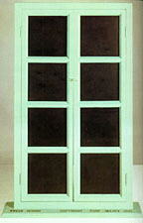
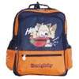
box
window
pencil-box
open
close
door
bag
book
fridge

Slide 15
Open the book,
read and read.
打开书，
读啊读。
Close the book,
listen to me.
合上书，
听我说。
Open the box,
let's have a look.
打开盒子，
让我们看一看。
Close the eyes,
think think think.
闭上眼睛，
想啊想啊想。

Slide 16
Give orders
Stand up.
Draw a picture.
Open your book.
Close your book .
Listen to the tape.
Put up your hand.
Sit down on your chair.

Slide 17
Give orders
Jump.
Clap your hands.
Touch your head.
Point to the ceiling.
Stamp your feet.跺脚
Touch your hip. 臀部

Slide 18
Learn to read
rule
pool
soup
do
school
group
fruit
/ u: /

Slide 19
/ u /
good
wood
put
book
foot
push
look
1. How many cookies could
a good cook cook.
2. A good book is a good friend
Look, look, look, Who’s cooking?
It’s Mr. Food, the good cook.
Cook, cook, cook, where’s the book?
Please take a look, in the cook book.

Slide 20
Learn to read
talk
walk
also
pork
wall
call
pour
short
/ɔ:/

Slide 21
dog
job
body
box
rob
want
fog
/ ɔ /
Tom’s got a lot of dollars in
his pocket and bought a hot dog.

Slide 22
英汉互译
1. Please sit down.
2. 早上好！
3. Listen and repeat.
4. 举起你的手。
5. Close your book.
1.请坐
2.Good morning！
3.听和复述
4.Put up your hand.
5.关上你的书

Slide 23
英汉互译
6. 站起
7. Open your book.
8. 我的英语书
9. listen
10. 说和做
6. Stand up.
7. 打开你的书
8. My English book
9. 听
10. Say and do.

Slide 24
补全句子
1.请打开他的书！
2.两人一起合作。
3.现在听和核对。
4.请坐下。
5.听和复述
____ his , please！
_______ in pairs.
_________and .
Please ____________.
_______ and _______.
Open book
Work
Now listen check
sit down
Listen repeat

Slide 25
句型转换
1.Good morning! (作出回答)
2.He stands up.（改为祈使句）
，please！
Good morning
Don’t stand up

Slide 26
句型转换
3.Sit down，please！（改为否定句）
sit down！
4.Draw the picture！（改为否定句）
5.Don’t open your book！(改为肯定句)
Don’t
Don’t draw the picture
Open your book!

Slide 27
选择正确的be动词填空
am
are
is
is
are
1. I _____ a student.
2. We _____ friends.
3. He _____ a good boy.
4. She ______ my sister.
5. They _____ playing football.

Slide 28
选择正确的be动词填空
are
am Are
am
is
Is
am
6. You ______ my friend.
7. I ____ a boy. _____ you a boy?
No, I _____ not.
8. The girl ____ Jack's sister.
9. __ your brother in the classroom?
10. Who ______ I?

Slide 29
选择正确的be动词填空
are
is
is
are
is
11. The jeans ____ on the desk.
12. My sister's name ____Nancy.
13. There ____ a girl in the room.
14. There ____ some apples on the tree. 15. There ____ a boy, two girls, three
men and ten women in the park.

Slide 30
Homework
抄写S8上面的短语或句子五遍。
练习书法1-2页。

