Slide 1
Study skills & Task
Unit 7 Seasons
WWW.PPT818.COM

Slide 2
Study skills
The suffixes –y
Noun | Adjective
cloud
wind
rain
snow
sun
fog
cloudy
windy
rainy
snowy
sunny
foggy

Slide 3
Study skills
The suffixes –y
Noun | Adjective
luck
health
sleep
shine
noise
fun
lucky
healthy
sleepy
shiny
noisy
funny

Slide 4
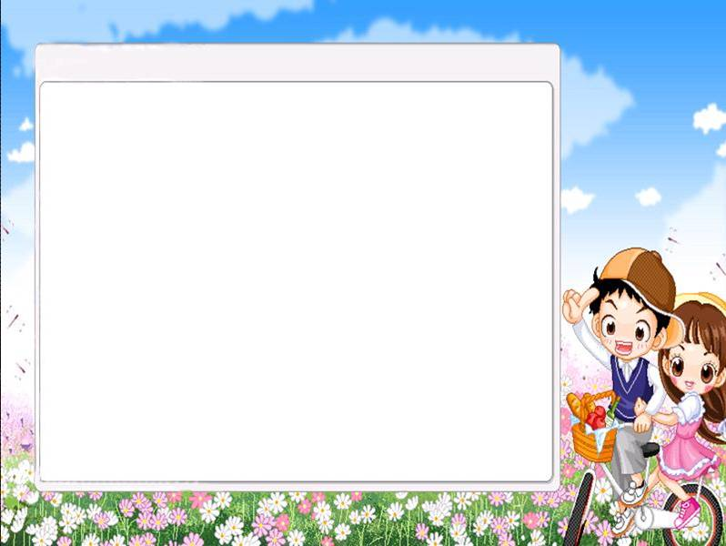
Practice
Help Millie complete the article in Part B on Page 89.

Slide 5
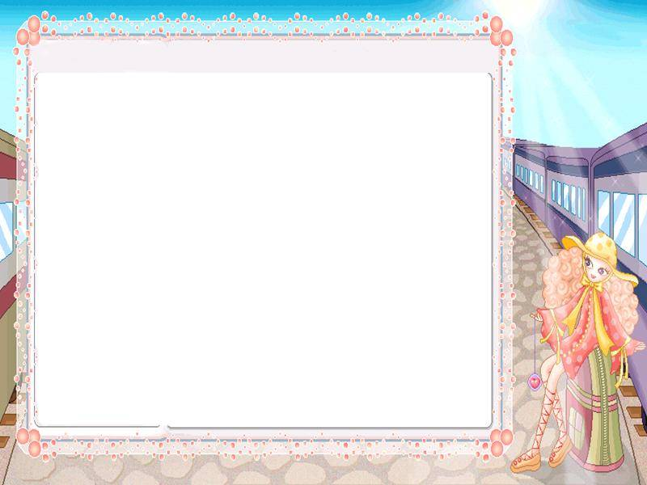
Simon's favourite season

Slide 6
Read and answer
What is Simon’s favourite season?
What’s the weather like in Harbin?
What activity does Simon often do in winter?
What can people see in the Ice Festival ?
Winter.
It’s cold and snowy.
He often has snowball fights.
Beautiful ice lanterns.

Slide 7
Read and match
Para 1
the activity
Para 2
the weather
Para 3
the favourite season

Slide 8
Read and find good sentences
Winter is my favourite season.
I always enjoy….
Everything is covered in deep white snow.
It’s exciting to have big snowball fights.
Moreover, I enjoy…
It is really wonderful.
…

Slide 9
Your favourite season
Which is your favourite season?
What is the weather like then?
What does your city look like then?
Why do you like this season?
What activities do people enjoy doing in this season?

Slide 10
My favourite season
Para 1 My favourtie season is .
It’s .
Para 2 The weather is .
.
Para 3 I often .
It’s really wonderful.

Slide 11
Homework
Talk about your favourite season with your friends or partners.

