Slide 1
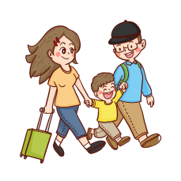
外研（新标准）版-七年级上册
Module 5 Unit 2
We start work at nine o’clock.
教学课件
WWW.PPT818.COM

Slide 2
Ask and answer
Warm-up
A: When is your Chinese lesson?
B: We have Chinese at half past eight.
语文
科学
历史
英语
化学
12
12
12
12
12
9
3
9
3
9
3
9
3
9
3
6
6
6
6
6

Slide 3
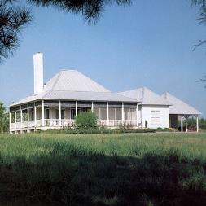
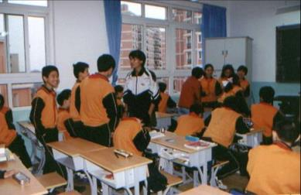
Vocabulary
house
have a
break

Slide 4
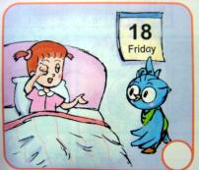
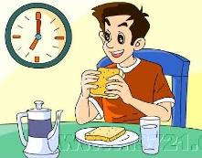
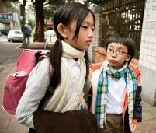
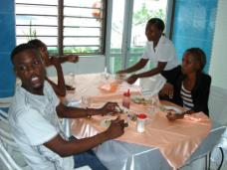
get up
have breakfast
go to school
have lunch

Slide 5
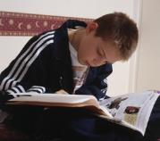
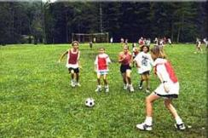
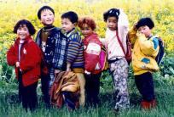
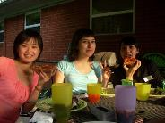
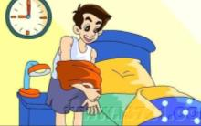
do homework
play football
go home
have dinner
go to bed

Slide 6
Work in pairs
Look at the pictures, and then ask and answer.
What’s the time?
It’s half past six. Oh, I get up at half past six.

Slide 7
What’s the time?
It’s seven o’clock. Oh, I have breakfast at seven o’clock.
What’s the time?
It’s eight o’clock. Oh, I have class at eight o’clock.

Slide 8
A: What’s the time?
B: It’s twelve o’clock.
A: Oh, I have lunch at twelve.
(12 :00 have lunch)
A: What’s the time?
B: It’s half past four.
A: Oh, I go home at half past four.

Slide 9
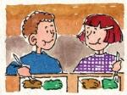
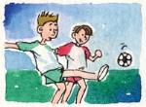
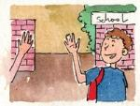
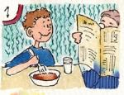
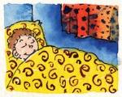
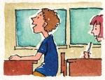
Reading comprehension
Reading
Say something about the pictures.
play football
have lunch
go home / leave school
have breakfast
have lessons
sleep

Slide 10
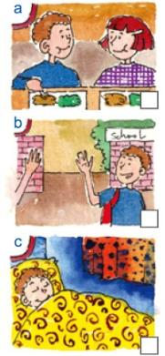
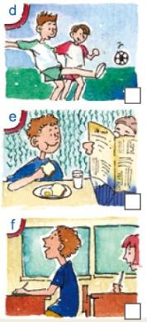
Read the passage and put the pictures in order.
e
a
f
b
d
c

Slide 11
Fill in the form as quickly as possible.
 | When | What to do
in the morning | 7:30 | get up
 | 8:30
 |  | lessons start
 | 11:00
 | 12:30
 | 1:30
 |  | go home
 | 10:00
go to school
9:00
have a break
have lunch
in the
afternoon
lessons start
3:30
in the evening
go to bed

Slide 12
Read the passage and check the sentences true or false.
I have breakfast at 7:00 in the morning.
2. I go to school at 8:30.
3. I play football at 11:00.
4. We have meat and rice with vegetables or hamburgers at 12:30.
5. Lessons finish at 3:30.
6. I do my homework at 10:00 in the evening.
F
T
F
T
T
F

Slide 13
Underline the correct expressions.
I get up / start work at half past seven.
We have a break / have lunch at half past twelve.
I go home / watch TV in the evening.
I do my homework / see my friends in the evening.
I go home / go to sleep at ten o’clock.

Slide 14
Read the passage and fill in the form.
活动 | （英文） | 时间
起床 | get up | half past seven
吃早餐
上学
上课
休息
have breakfast
half past seven
go to school
half past eight
have lessons
nine o’clock
have a break
eleven o’clock

Slide 15
活动 | （英文） | 时间
吃午餐
回家
做作业 |  | /
吃晚餐 |  | /
睡觉
have lunch
half past twelve
go home
half past three
do homework
have dinner
go to bed
ten o’clock

Slide 16
Fill in the form according to your daily schedule.
活动 | （英文） | 时间
起床
 | have breakfast
 | go to school
上课
休息
 | have lunch
回家
 | do homework
吃晚餐
 | go to bed

Slide 17
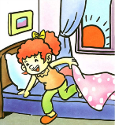
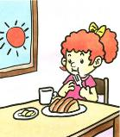
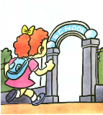
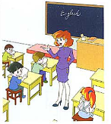
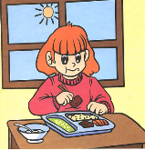
Work in pairs. Talk about your school day.
Work in pairs
get up
have breakfast
go to school
lessons start
have lunch
have a break

Slide 18
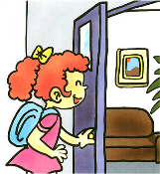
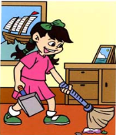
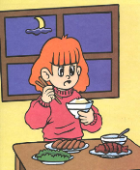
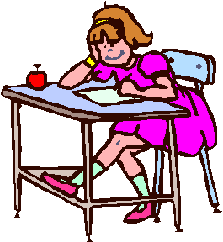
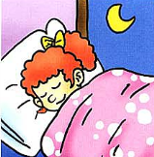
go home
do housework
have dinner
do homework
go to bed

Slide 19
Speaking
Look at the timetable and talk about your lessons.
Eg. I have English at eight o’clock.
I don’t have music at eight o’clock.
 | Monday | Tuesday | Wednesday | Thursday | Friday
8:00 | English | Chinese | Maths | Chinese | English
9:00 | History | Chemistry | Music | English | Maths
10:30 | Chinese | English | Computer | Chemistry | Chinese
2:30 | Maths | P.E | Chinese | Computer | Art
4:00 | Art | Science | English | History | P.E

Slide 20
Language points
1. I get up at half past seven in the morning, and then have breakfast.
get up是一个固定搭配，意为“起床” 。如：
What time do you get up?
你几点起床？
I get up at six every morning.
每天早上我六点钟起床。

Slide 21
【拓展】 get up还有“站起, 起立”之意，相当于stand up。如：
All the students get up.
所有的学生都站起来了。
The class got up when the teacher came in.
老师进来时全班起立。

Slide 22
[Practice]
Complete the sentences.
1. 他们早上7点半起床。
They _______ _______ at half past seven in the morning.
2. 请站起来。
Please ___________ ______.
get up
get / stand up

Slide 23
and then 相当于一个副词，意思是“于是，然后”。如：
Let’s go for a drink and then go home.
我们先去喝一杯然后再回家。
Read the text first and then explain the new words.
先读课文，然后解释生词。

Slide 24
2. Then we go home at half past three.
then用作副词，表示“那是，然后，当时”。
如：
Then he went back to his seat.
然后他回到座位上去。
Then he slowly walked past the house.
然后他慢慢地走过这座房子。
His dog nosed me, and then let me go in.
他的狗闻了闻我，然后放我进去了。

Slide 25
【拓展】
then, and then的区别:
二者都表示“然后，于是”，都起着副词的作用，只是在语气上and then更强调前后两个事物时间上联系得更紧密些，and then可以引导并列句，then则不行。如：
He came here and then he left.
He came here. Then, he left.

Slide 26
go home是一个固定搭配，意为“回家”。因为home在这里作副词，故home的前面不能加介词to。如:
We go home at half past three.
我们3点半回家。
Can I go home now?
我现在可以回家吗？

Slide 27
【拓展】 go to school表示“去上学”, go to work表示“去上班”, go to bed表示“去睡觉”。如：
In the evening, I go home and have dinner.
Students go to school at 8 o’clock in the morning.
My Mum and Dad go to work by bus in the morning.

Slide 28
3. We start lessons in the afternoon at half past one.
start作及物动词时，意为“开始；着手”，后面可直接接名词或代词作宾语；start也常用于“start to do sth. ”或“start doing sth.”
结构中，意为“开始做某事”。如:

Slide 29
I start my work at nine o’clock every day.
我每天九点开始工作。
When did you start to learn English?
你什么时候开始学英语的？
The girl starts playing the piano after dinner.
晚饭后女孩开始弹钢琴。

Slide 30
【拓展】
start也可用作名词，意为“开始；开端”。如:
The start of the film is very interesting.
电影的开头非常有趣。
You should make a plan from the start.
你从一开始就应该制定一个计划。

Slide 31
[Practice]
用所给单词的适当形式填空。
1. The first class _________(start) at eight o’clock.
2. My brother started _________________ (play) football when he was ten years old.
starts
playing / to play

Slide 32
Writing
Look at these sentences.
I get up at seven o’clock. I go to school at eight o’clock.
I get up at seven o’clock and go to school at eight o’clock.
We have a break. We talk to our friends.
We have a break and talk to our friends.

Slide 33
Let’s do some exercises.
Join these sentences with and then.
1. In the morning, we get up. We go to school.
In the morning, we get up and then go to school.
2. In the afternoon, we have lessons. We play football in the playground.
In the afternoon, we have lessons and then play football in the playground.

Slide 34
3. In the evening, I have dinner. I do my homework.
In the evening, I have dinner and then do my homework.
4. In the evening, I do my homework. I go to bed.
In the evening, I do my homework and then go to bed.

Slide 35
一、根据汉语写单词。
Exercise
1. The matches ______ (结束) at half past nine.
2. We _____ (不) live in New York.
3. Sam likes _____ (做) housework.
4. The book show _____ (开始) at nine.
5. On Saturday we watch TV __ (或者)
play games.
finish
don’t
doing
starts
or

Slide 36
6. After having two lessons, we have a
______ (休息).
7. We have meat and rice ____ (和)
vegetables.
8. We have lunch in the ________ ____
(餐厅) at half past twelve.
9. Do you have ______ (晚餐) at half past
six in the evening?
break
with
dinning hall
dinner

Slide 37
二、用所给的单词的适当形式填空。
1. She ____ (go) to bed at nine o’clock.
2. You ________ (not go) home.
3. She _______ (watch) TV in the evening.
4. He gets up and ___ (have) breakfast.
5. _______ (lesson) start at half past one in the afternoon.
6. We do our __________ (homework) in
the evening.
goes
don’t go
watches
has
Lessons
homework

Slide 38
三、英汉词组互译。
1. 起床
2. 课间休息
3. 去上学
4. 吃早饭
5. 喝水
get up
have a break
go to school
have breakfast
drink water

Slide 39
6. at half past ten
7. go to bed
8. go to the playground
9. have dinner
10. go home
在十点半
去睡觉
去操场
吃晚饭
回家

Slide 40
四、句型转换。
1. I go to school at 8:30. (就划线部分提问)
_____ __ you __ to school?
2. She gets up at half past six. (改为否定句)
She ______ ___ up at half past six.
3. In the morning, we have a break. We
play football. (用and把两个句子连起来)
In the morning, we have a break ___ ____ _______.
When
do
go
doesn’t
get
and
play
football

Slide 41
4. We start lessons at nine o’clock.
(改为一般疑问句)
___ you ____ ______ at nine o’clock?
5. They do the housework in the evening.
(改为否定句)
They _____ __ the housework in the
evening.
Do
start
lessons
don’t
do

Slide 42
Homework
Write a short passage called My School
Day.
Hi! I’m XXX . I am a … I go to school at …
get up…
go to school
start lessons…
have lunch
go home…
do my homework…
have dinner…
go to bed…

