Slide 1
Unit 7 Topic 1
We're preparing for a food festival.
Section B
WWW.PPT818.COM

Slide 2
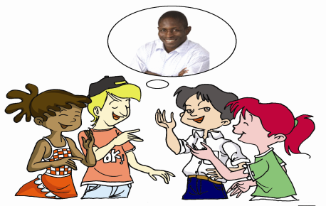
Do you remember what Michael will do for the food festival?
Do you remember what Kangkang will do for the food festival?
He says (that) he will make a poster.
He says (that) he’ll get in touch with Craig on the
Internet to get more information about him.

Slide 3
Listen and fill in the blanks.Then practice with your partner, paying attention to the pronunciation and intonation.
2
kangakang 19:45:30
Hello, Craig! This is Li Weikang, from Beijing, China. I’m a student in Beijing
International School.
Craig 19:46:43
What can I do for you?
Kandkang 19:47:20
Oh, I know you _________ Free the Children and help poor children. So my friends and I decided to help you _______ some money.
Craig 19:48:05
Thank you very much.
Kangkang 19:49:15
It’s a pleasure. Well, we are __________ for a food festival. May I _________ you to our food festival?
Craig 19:51:01
I’d love to, but I’m sorry I can’t, because I ___________________these days.
Kangkang 19:51:58
It’s a great pity, but never mind. We decided to_________________ about you. Will you please tell me something about yourself and Free the Children?
Craig 19:56:15
Sure. But I’m busy now. I’ll send you an e-mail ______________, OK?
Kangkang 19:57:26
OK, thanks a lot. My email address is Kangkang@hotmail.com. Bye-bye!
n.住址，地址
started
raise
preparing
invite
have no time
make a poster
later on

Slide 4
Key sentences of 2
— May I invite you to our food festival?
— I’d love to, but I’m sorry I can’t, because I
have no time these days.
— It’s a great pity, but never mind.

Slide 5
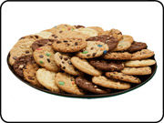
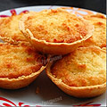
American chocolate cookies
Greek cheese pies
I have a sweet tooth, and I think a lot of students will buy western food, such as American chocolate cookies and Greek cheese pies.
adj.西方的，西部的

Slide 6
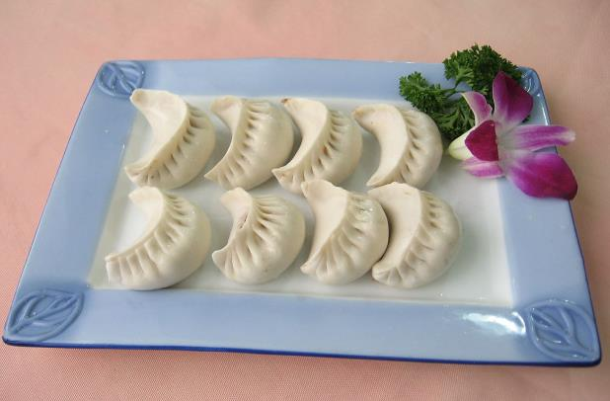
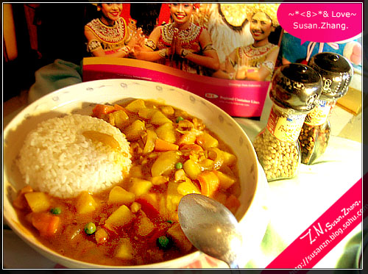
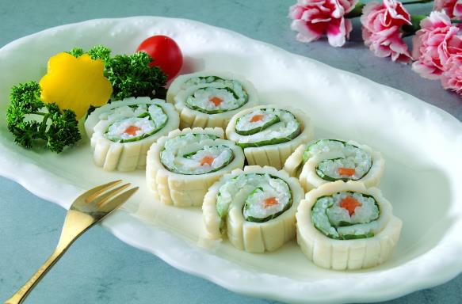
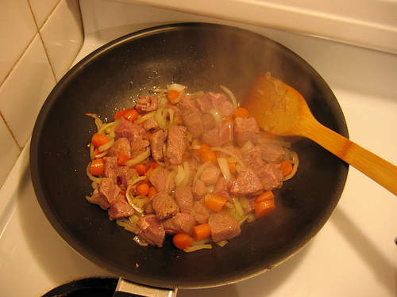
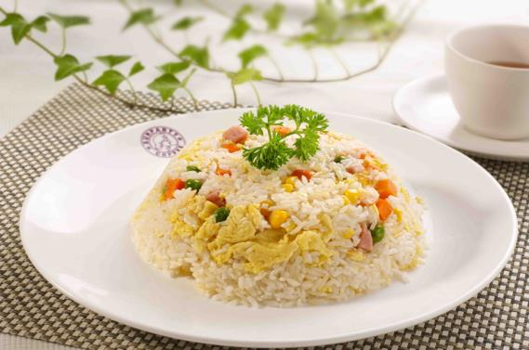
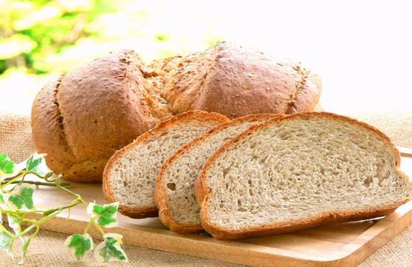
I have some delicious food to share with you.
South African beef curry
Japanese sushi
Russian black bread
Indian curry
Chinese fried rice
Chinese dumplings
adj.非洲的；n.非洲人
n.寿司
adj.俄国（人）的；俄语的；
n.俄国人；俄语
adj.油炸的
印度的咖喱食品

Slide 7
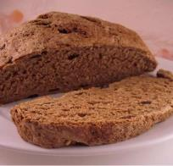
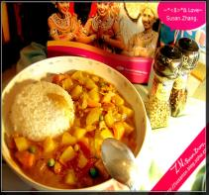
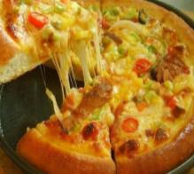
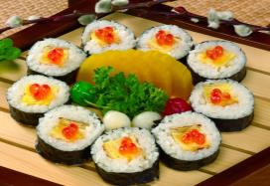
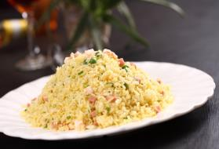
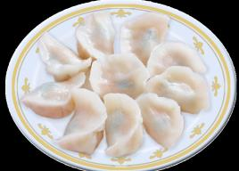
Do you remember them?
Russian black bread
South African beef curry
Indian curries
Italian pizza
Japanese sushi
Chinese fried rice
Chinese dumplings

Slide 8
1b
Listen to 1a and complete the passage.
Jane,Michael,Kangkang and Maria are talking about what they would like to cook for the food ______ .Michael would like to prepare some _______food,such as American chocolate _______ and Greek cheese_____. Jane plans to______Indian curries. Kangkang is sure that Chinese fried _________ and dumplings will be popular and Maria will serve South African ______curry.
festival
western
cookies
pies
cook
rice
beef

Slide 9
Key points of 1a
1.have a sweet tooth =like eating sweet food意为“喜欢吃甜食”
2.What's more 而且/还有
3.I'm sure that... 我确信……
E.g: 我确信他会来的。
I'm sure that he will come here.
4.That's good enough. 很好
5.I believe we'll raise a lot of money for Free the Children.
此句为省略引导词that的宾语从句。
意为“我们相信我们将为‘解放儿童’筹集很多钱。”

Slide 10
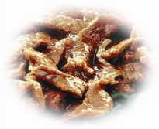
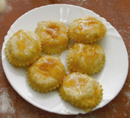
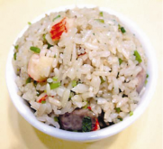
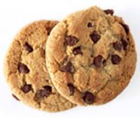
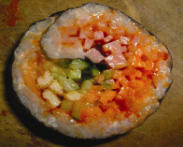
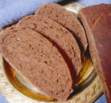
1c
Where are the foods from? Listen again and match. Then make similar conversations after the example.
American B. Indian C. Chinese D. Greek
E. Japanese F. Russian G. South African H. Italian
cheese pies
curries
beef curry
G
D
B
pizza
H
chocolate cookies
A
fried rice
sushi
black bread
C
E
F

Slide 11
Example:
A:Where do you think cheese pies are from?
B:I think/guess(that) they are from Greece.
American B. Indian C. Chinese D. Greek
E. Japanese F. Russian G. South African H. Italian
cheese pies
curries
beef curry
G
D
B
pizza
H
chocolate cookies
A
fried rice
sushi
black bread
C
E
F

Slide 12
You can remember names of countries and their people easily if you make a list of them.For example,India-Indian; Russia-Russian;Italy-Italian.
China
Chinese
South Africa
South Arican
Japan
Japanese
America
American
India
Indian
Russia
Russian
Italy
Italian
Greece
Greek

Slide 13
Project
Suppose you and your friends are chatting about preparing for the food festival on QQ. Make a conversation about it. You may begin like this:
A: Will you come to the food festival?
B: Yes.
A: What will you cook?/What would you like to cook?
B: I think I will prepare...
I plan / decide / want to cook …
What about you?
A: I plan to cook …
…

Slide 14
3a
Read the pairs of words and phrases aloud,paying attention to the sounds of the underlined letters.Then listen and try to imitate.
down—done town—ton
found—fund ground—grunt
found money town’s fund
enough houses touch ground

Slide 15
3b
Read the sentences,paying attention to the stress and weak form.Then listen and try to imitate.
The structural words such as that are often unstressed.
1.I’m 'sure that 'curries and 'dumplings will be 'popular.
2.I 'think that 'we can 'sell 'newspapers to 'raise 'money.
3.I 'guess that 'they are on our 'school 'playground.

Slide 16
Exercise in class
根据首字母或汉语提示完成下列句子。
1.We are _________ _____ (准备 ) a food festival.
2. Nison is an I_____ . He is from India.
3.He often i______ me to his home.
4.I like w______ food,such as Italian pizza and Greek cheese pies.
5. His parents will buy him a computer _____ ____ (随后 ).
6.Could you tell me the bank's a_________?I don't know where it is.
7. I often invite my friends ________ (have) dinner.（用正确形式填空）
8.I have some exciting news to tell you.______ _______,I will give you a big surprise.(根据句意填空)
preparing for
ndian
nvites
estern
later on
ddress
to have
What's more

Slide 17
summary
1.Some new words:
western,Indian,Italian,African,Russian,curry,
fried,sushi,address
2.Object clauses:
I think beef curry is OK.
I believe we’ll raise a lot of money for Free the
Children.
We learn:
We can:
1.Invite somebody:
May I invite you to our food festival?
2.Express sorry for somebody:
It’s a great pity,but never mind.

Slide 18
Homework
Read 1a and 2 at least five times,then practice with your friends.
Remember the names of the countries and their people.
3.Finish Section B in your workbook.
4.Preview Section C.

Slide 19
Thank You!

