Slide 1
Unit 5
Do you want to watch a game show?
Section B Period 2 (3a-Self Check)
WWW.PPT818.COM

Slide 2
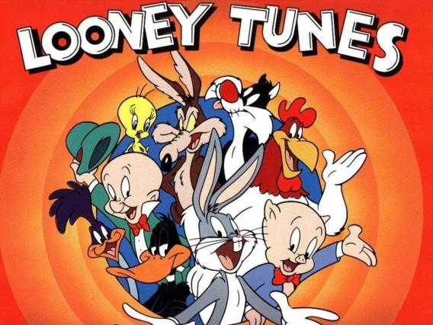
What is your favorite cartoon?

Slide 3


Slide 4
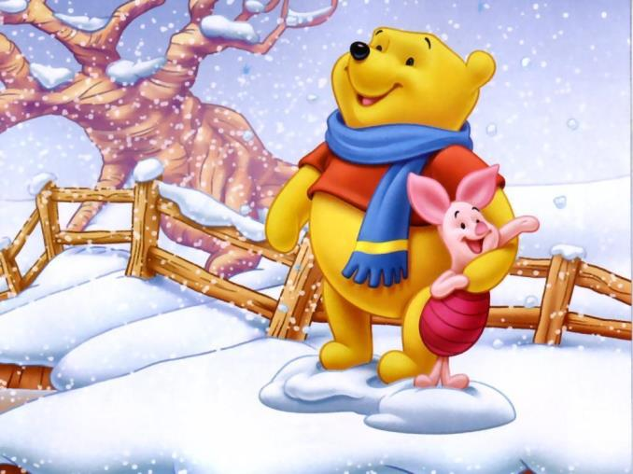

Slide 5
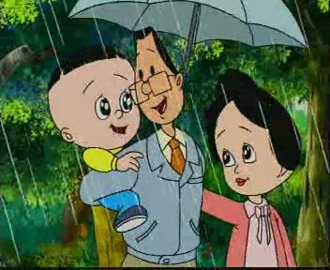
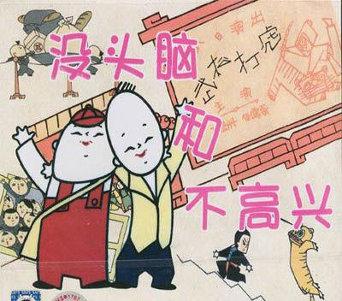

Slide 6
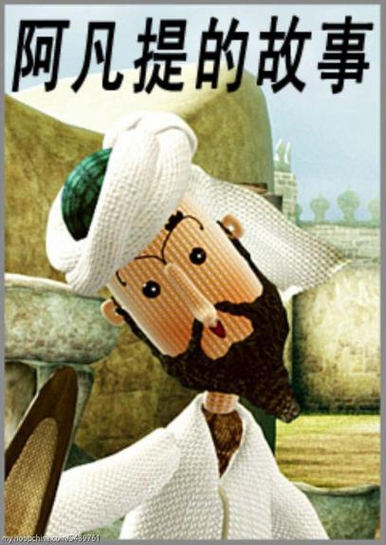


Slide 7
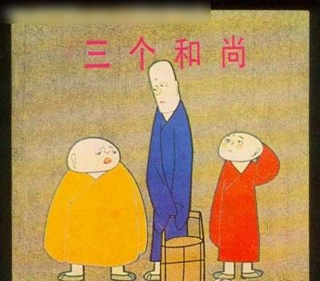
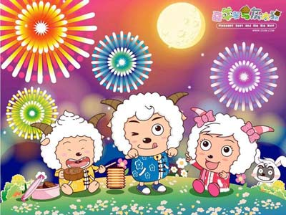
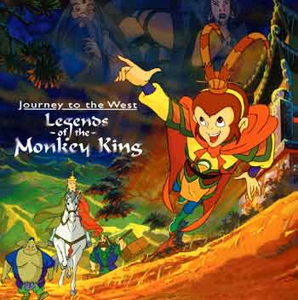

Slide 8
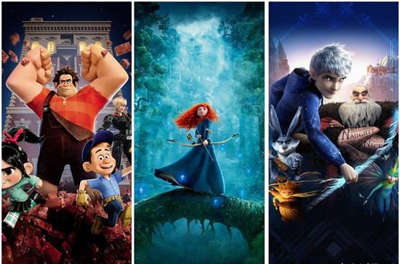
《Rise of the Guardians》
《守护者的崛起 》
《Wreck-It Ralph》
《无敌破坏王》
《Brave》
《勇敢传说》

Slide 9
3a
Fill in the blanks in the movie review. Use the words in the box to help you.
fantastic shows action want comes from
played about like exciting plan

Slide 10
exciting action
Mulan is an _________ ________ movie. It ____________ an old Chinese story. The movie is ________ a village girl, Mulan. She dresses up like a boy and takes her father’s place to fight in the army. I think the actress ________ Mulan’s role well. The other actors are also _______ and they did a good job in the movie. I _______ Mulan very much. The movie _______ her love for her family, friends and country. If you _________ to watch a movie this weekend and you _______ to see something enjoyable, choose Mulan!
comes from
about
played
fantastic
like
shows
plan
want

Slide 11
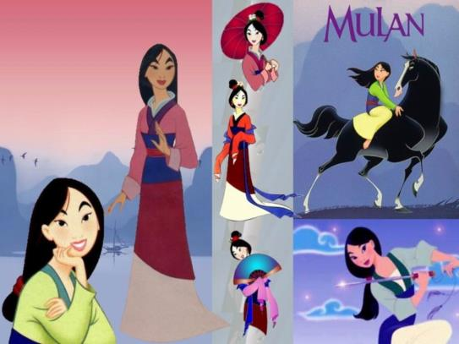
Let’s watch cartoons!

Slide 12
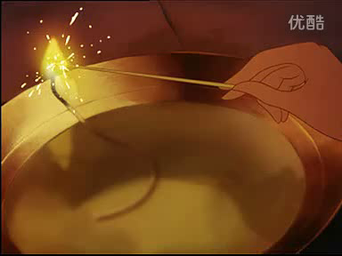

Slide 13
3b
Write notes for your own movie review.
The name of the movie: _____________________
The kind of movie: _________________________
What the movie is about: ____________________
What you think of the movie/stars: ____________

Slide 14
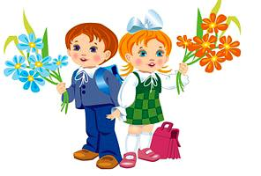
What do you think of other movies? Discuss with your partner.

Slide 15
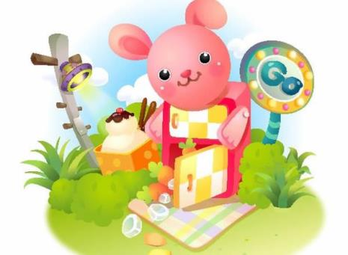
Write your movie review using the notes in 3b.
3c

Slide 16


4
What do you and your partner think of these TV shows or movies? Write description words for each one.
What do you think of soap operas?
I think they’re boring!

Slide 17
 | Me | My partner
soap operas
talent shows
news
sports shows
game shows
talk shows
comedies
scary movies
action movies
cartoons

Slide 18
Example:
A: Do you want to watch the news?
B: No, thanks.
A: Why not? Do you think it’s boring?
B: No, not at all. I really think the news is interesting.
A: Then why don’t you want to watch it?
B: I have to finish my homework.
A: Oh. OK.

Slide 19
What do you think of ...?
你认为······怎么样？
这个句型用来询问对方对某事的看法，也可以说How do you like ...?。当然对这样的问题不能简单地用yes或no来回答，而要具体说明理由。
What do you think of the food here?
你觉得这里吃得怎样？

Slide 20
Self Check
1
Write questions and answers using the words in brackets.
What do you think of soap operas?
1. A: ________________________________ (what / think of / soap operas)
B: ______________________ (can’t stand)
2. A: ____________________________________
(what show/want to watch / tonight)
B: _____________________________ (talent show)
I can’t stand them.
What show do you want to watch tonight?
I want to watch a talent show.

Slide 21
3. A: _______________________________
(what / expect to learn / game show)
B: _______________________________ (interesting information)
4. A: _______________________________ (what / hope to watch / tomorrow)
B: ______________________ (news)
5. A: ____________________________ (do / plan to watch / action movie)
B: ______________________ (no / plan to watch / comedy)
What do you expect to learn from a game show
I expect to learn some interesting information.
What do you hope to watch tomorrow?
I hope to watch the news.
Do you plan to watch an action movie?
No, I plan to watch a comedy.

Slide 22
根据汉语，补全英语句子。
1、“你觉得游戏节目怎样？”“我忍受不了那些东西。”
“______do you______ _____ game shows?”
“ I ______ _______ them. ”
2、他们对每样东西的看法如何？
______ did they _____ _____ everything?
What
think of
can’t stand
What
think of

Slide 23
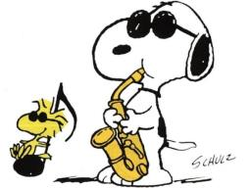
3. 你怎样认为连续剧怎样？我受不了。
_____ do you ______ ___ ____ ______?
I ______ ______ ______ .
4. 他不喜欢情景喜剧。
He _______ _______ _______.
What
think of soap operas
can’t stand them
doesn’t like sitcoms

Slide 24
2
Which of these statements do you agree with (√) or disagree with (×)? Give at least one reason.
1. I think game shows are meaningless. ( ) ____
2. I can’t stand soap operas. ( ) ___________
3. I think sitcoms and talent shows are relaxing. ( ) ____________
4. I love talk shows. ( ) __________
5. I think comedies are fantastic. ( ) ________

