Slide 1
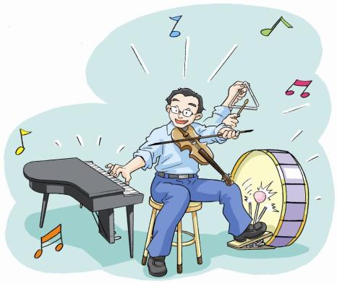
6
Music
第二课时
WWW.PPT818.COM

Slide 2
Let's guess
They are animals.
They are small.
They are black.
They like eating cakes,rice,hot dog and meat.
What are they?

Slide 4
1.Does the man help the people?
2.Are there any mice in the city at last?

Slide 5
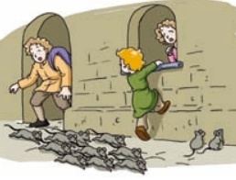
Tell the story
PPT模板：www.1ppt.com/moban/ PPT素材：www.1ppt.com/sucai/
PPT背景：www.1ppt.com/beijing/ PPT图表：www.1ppt.com/tubiao/
PPT下载：www.1ppt.com/xiazai/ PPT教程： www.1ppt.com/powerpoint/
资料下载：www.1ppt.com/ziliao/ 范文下载：www.1ppt.com/fanwen/
试卷下载：www.1ppt.com/shiti/ 教案下载：www.1ppt.com/jiaoan/
PPT论坛：www.1ppt.cn PPT课件：www.1ppt.com/kejian/
语文课件：www.1ppt.com/kejian/yuwen/ 数学课件：www.1ppt.com/kejian/shuxue/
英语课件：www.1ppt.com/kejian/yingyu/ 美术课件：www.1ppt.com/kejian/meishu/
科学课件：www.1ppt.com/kejian/kexue/ 物理课件：www.1ppt.com/kejian/wuli/
化学课件：www.1ppt.com/kejian/huaxue/ 生物课件：www.1ppt.com/kejian/shengwu/
地理课件：www.1ppt.com/kejian/dili/ 历史课件：www.1ppt.com/kejian/lishi/
There are many mice in the city.

Slide 6
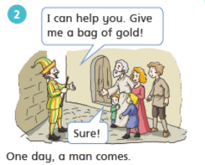
dddd
ddddddddddddddddddddd
One day, a man comes.

Slide 7
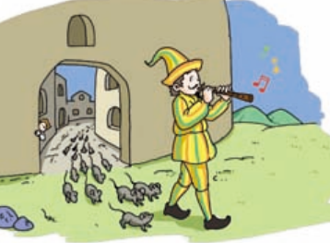
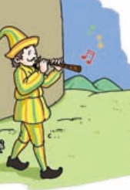
The man plays the magic music.
All the mice walk behind him.

Slide 8
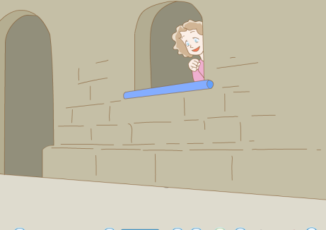
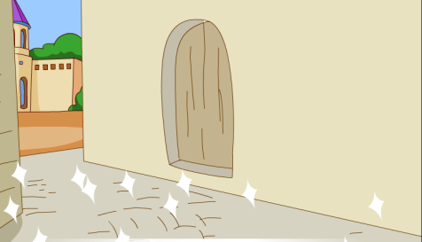
There are no mice in the city now.

Slide 9
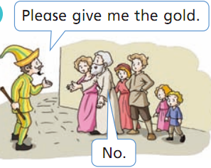
They don't give the bag of gold to the man.

Slide 10
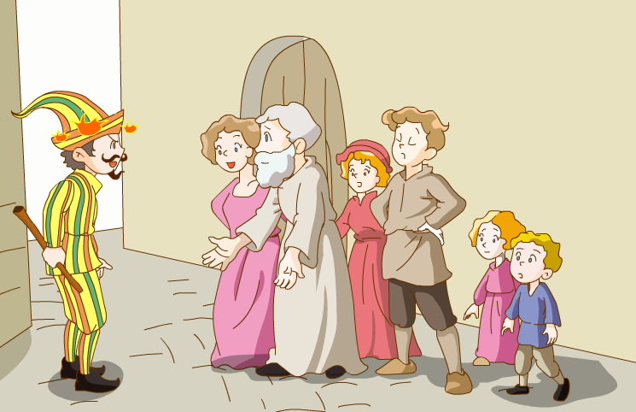
The man is very angry.

Slide 11
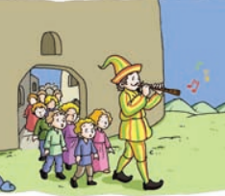
The man plays the magic music again.
All the children walk behind him.

Slide 12
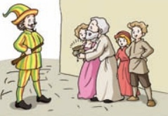
Yes.
The people give the man his gold.

Slide 13
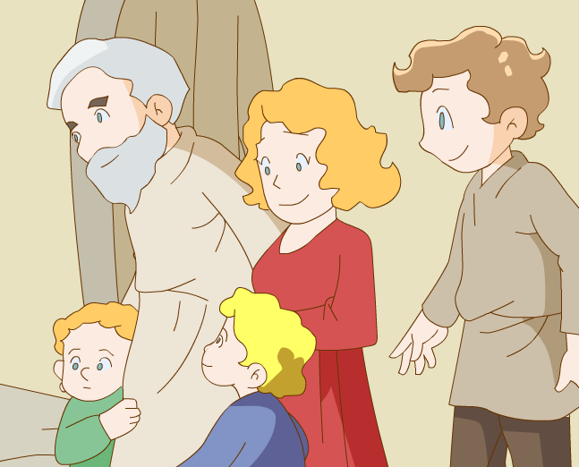
The children come home.
They are happy.

Slide 14
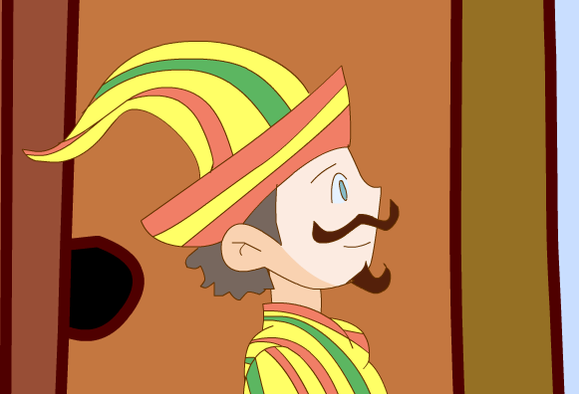
1.Does the man help the people?
Yes, he does.
2.Are there any mice in the city at last?
No, there aren't.

Slide 15
Watch and think
1.How does he help?
2.Why does he help?

Slide 16
Think and choose
How does he help?
A.He catches the mice .
B. He plays magic music.

Slide 17
The man plays magic music.
All the mice walk behind him.

Slide 18
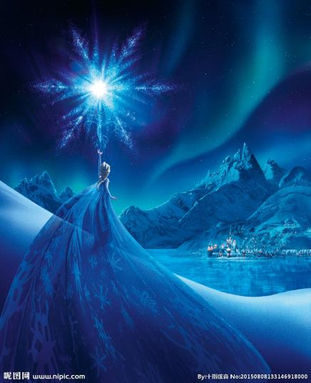
He is magic too.
She is magic.

Slide 19
Think and choose
Why does he help?
A. He wants to live in the city.
B. He wants money.

Slide 20
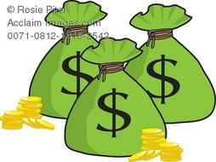

Slide 21
Let's follow
Does the man get the gold first?

Slide 22
Does the man get the gold first?
No, he doesn't.
What does he do next?

Slide 23
3.What does he do next?
He plays the magic music again.
All the children walk behind him.

Slide 24
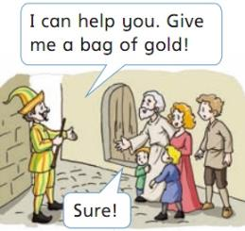
Let's act
…
1.六人一组
2.Be fluent.
语言流畅。
3.Be active.
表情形象。
4.Be creative.
内容创新。
…

Slide 25
Fill in the blank
magic
help
walk
mice
gold
A long time ago, many mice are in the city. One day, a man comes. He can the people.But he needs a bag of gold.
Then the man plays music. All the mice walk behind him.
There are no in the city now. But the people don't give him the gold.
The man is very angry. He plays magic music again. All the children behind him.
The people give the man his . The children come home.

Slide 26
Discussion
What do you want to do
if you can play magic music?
I want to....

Slide 27
Homework:
1.Read the story 3 times.
2.What do you want to do if you can play magic music?
Write down your ideas.
3. Enjoy the original story-The Pied Piper.

