Slide 1
Unit 5 Country Life
He goes to school by school bus
WWW.PPT818.COM

Slide 2
1.What’s your name?
2.What’s your favourite subject?
3.How do you go to school?
4.What do you do after school?

Slide 3
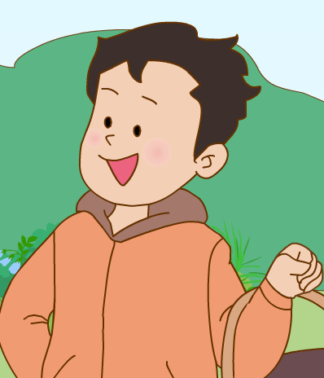
1.What’s his name?
Guo Liang

Slide 4
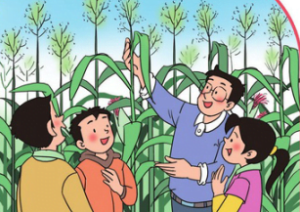
2.What’s his favourite subject?
He likes science.
He has science classes in the field.

Slide 5
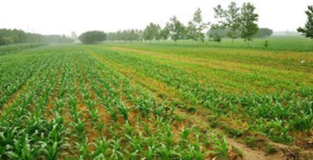
field

Slide 6
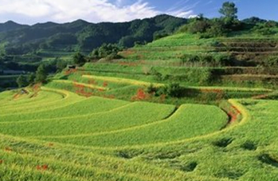
field

Slide 7
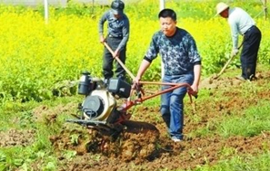
They work in the field.

Slide 8
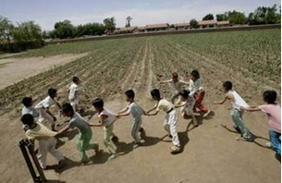
They play in the field.

Slide 9
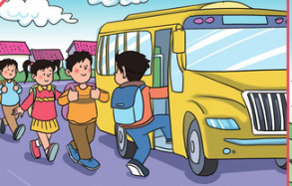
3.How does he go to school?
He goes to school by school bus.

Slide 10
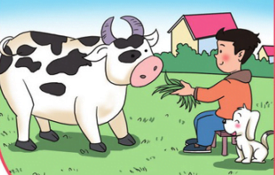
4.What does he do after school?
After school he often
__________________________.
helps his parents feed the cows

Slide 11
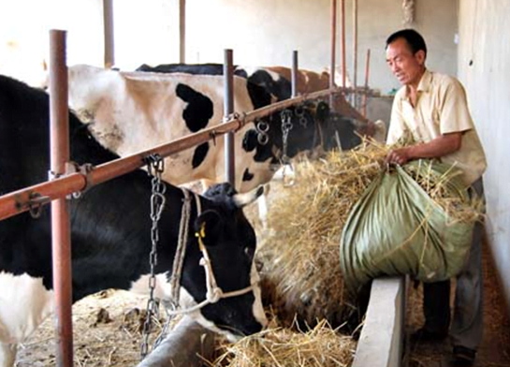
Feed the cows some grass.

Slide 12
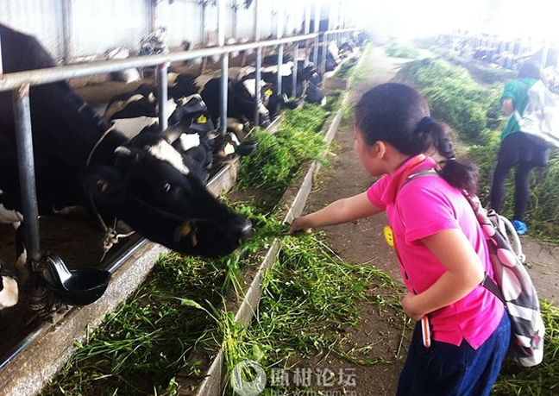
Feed the cows some vegetables.

Slide 13
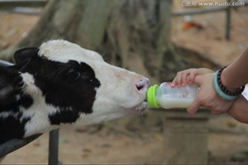
Feed the cows some milk.

Slide 14
Read and judge “T” / “F”
F
( ) 1. Guo Liang is in Grade Five.
Grade
Four
( ) 2. Guo Liang lives in the city.
F
country
( ) 3. At the weekend, Guo Liang usually goes to his father’s vegetable garden.
F
orchard

Slide 15
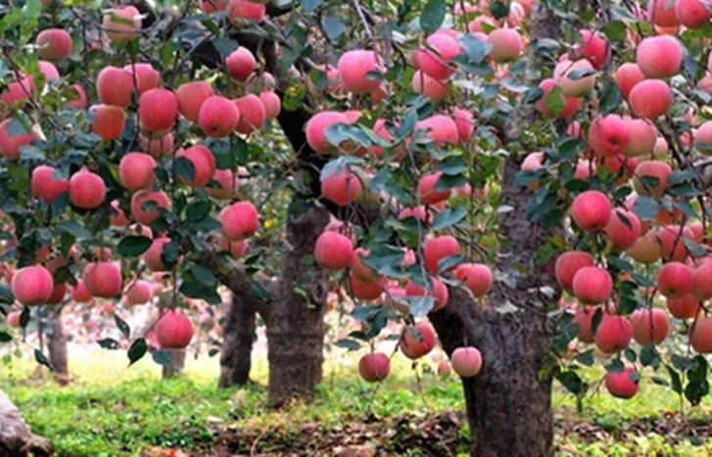
apple orchard

Slide 16
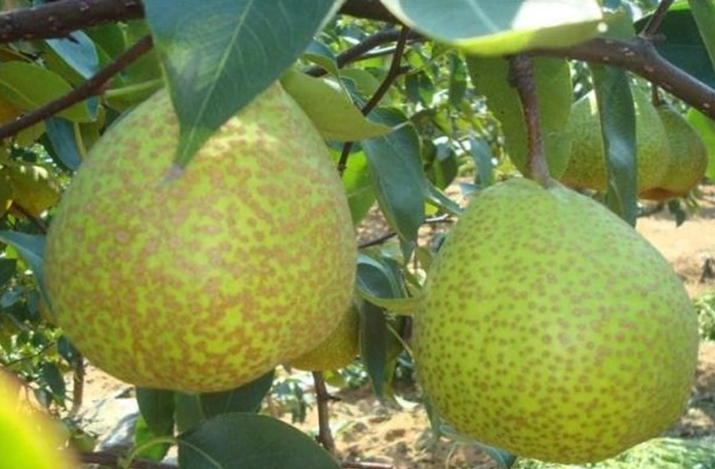
pear orchard

Slide 17
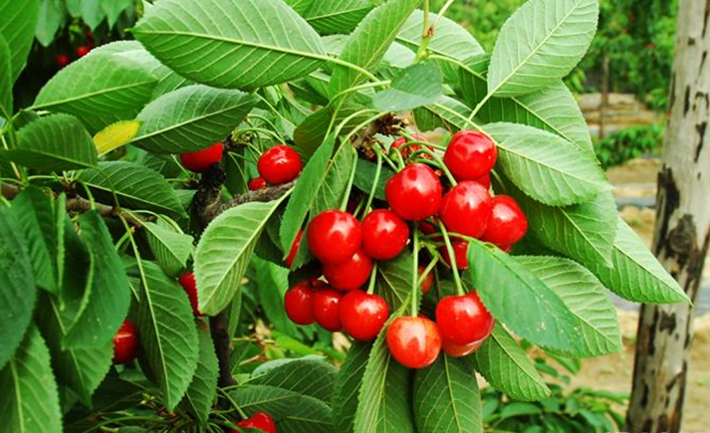
cherry orchard

Slide 18
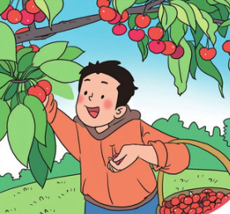
pick fruit
Guo Liang often helps him ___________.
Look! He is _______________.
How ______ he is!
picking cherries
happy

Slide 19
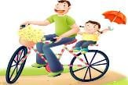
Grade Four
lives in
goes to school
likes
sometimes
After school he often
At the weekend, he usually
Guo Liang often
Look! He is
happy

Slide 20
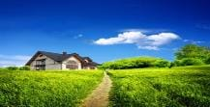
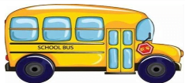
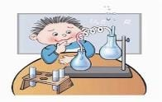
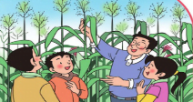
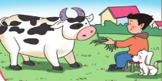
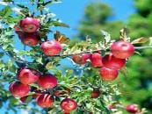
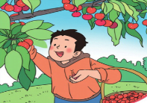

Slide 21
in the field pick fruit go to school after school
Hello, everyone! I am Guo Liang. I live in the country. I ______ by school bus. My favourite class is science. Sometimes I have science classes ________. I have many interesting things to do ___. I often feed the cows. At the weekend, I usually go to my father’s orchard to help him ____. I enjoy my life.

Slide 22
Homework:
1. 读 read.
2. 完成课本习题
3. 复述课文 Retell the story about Guo Liang.

Slide 23
Thank You

