Slide 1
Module 12 Western music
It's so beautiful!
WWW.PPT818.COM

Slide 2
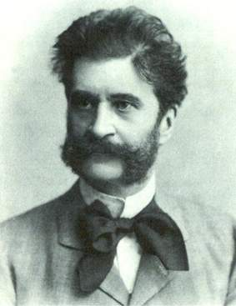
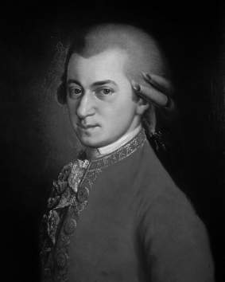
Strauss
Mozart

Slide 3
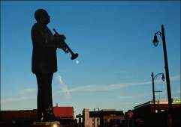
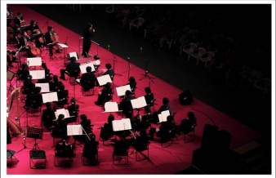
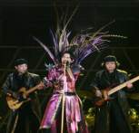
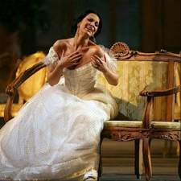
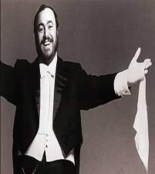
Guessing game
What kind of music are they?
blues
classical
jazz
pop
rock
opera
techno
rap

Slide 4
Answers:
blues
classical
jazz
opera
pop
rock
techno
slow, sad
serious, traditional
fast
dramatic, beautiful
lively
fun
modern

Slide 5
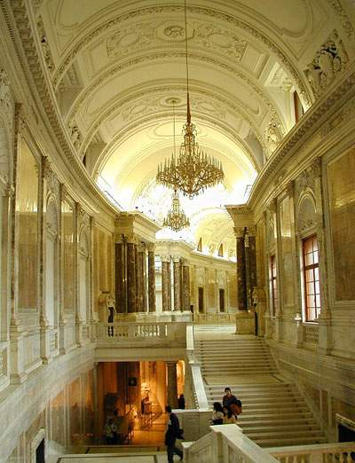
维也纳是奥地利的首都，也是世界著名的音乐之都。每年1月1日在维也纳著名的音乐厅——金色大厅所举办的“维也纳新年音乐会”闻名世界。

Slide 6
Listen and number the words as you hear them.
( ) lively ( ) modern ( ) music
( ) noisy ( ) pop ( ) rock
( ) sound ( ) violin ( ) Western
7
5
1
9
8
6
3
4
2

Slide 7
Work in pairs. Answer the questions about the conversation in Activity 1.
Which modern music does Tony like?
2. What does Tony’s mum think about rock music?

Slide 8
3. Why doesn’t Tony like traditional Western music?
4. Which music does Tony’s dad think is too noisy?

Slide 9
Now listen again and check.

Slide 10
Which modern music does Tony like?
He likes pop and rock music.
2. What does Tony’s mum think about rock music?
It’s lively.
3. Why doesn’t Tony like traditional
Western music?
It’s too slow.
4. Which music does Tony’s dad think is
too noisy?
He thinks pop music is too noisy.

Slide 11
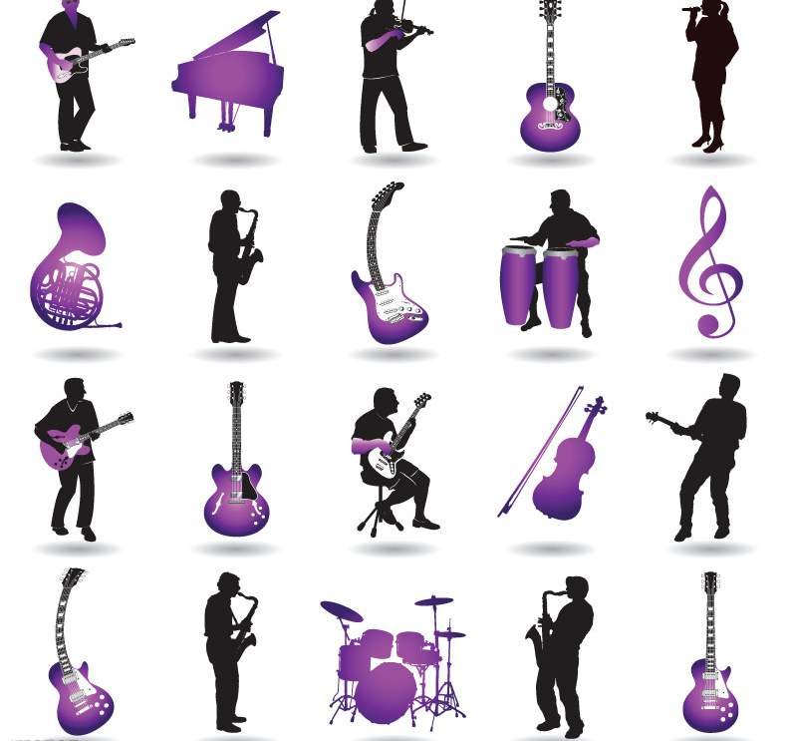
Listen and read.

Slide 12
Everyday English
What a beautiful city!
I’m a fan of rock music.
Give us a break!
I don’t believe it!

Slide 13
Now check (√) the true sentences.
( ) 1. They’re listening to Western music.
( ) 2. Tony knows little about Strauss.
( ) 3. Strauss was born in the capital of
Australia.
( ) 4. The Blue Danube is pop music.
( ) 5. Lingling enjoys Beijing opera very
much.
√
√
√

Slide 14
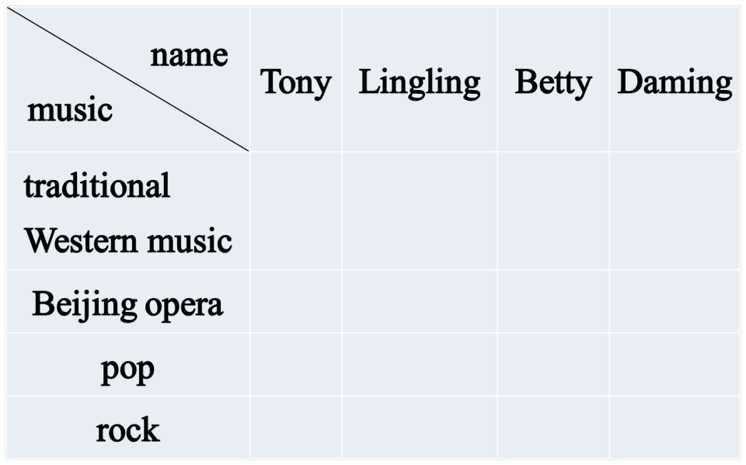
Check (√) the types of music the students like.
√
√
√
√
√
√

Slide 15
Complete the sentences with the correct form of the words from the box.
1. Strauss wasn’t ________. He came from Austria.
2. Daming thinks the ______ in rock
music are too ______.
German
drums
noisy

Slide 16
3. Tony can’t ________ that Daming doesn’t like rock music.
4. Betty likes ______ traditional Western music and pop music.
5. Tony thinks the sound of the ______ in Beijing opera is very different.
believe
both
voice

Slide 17
Complete the sentences about yourself.
1. My favourite music is ...
2. I like it because ...
3. My parents like ...

Slide 18
Pronunciation and speaking
Listen and read.
What a beautiful city!
It’s so beautiful!
3. I love his music!
4. Listen to this!

Slide 19
Pair work
Ask and answer questions about the music you like or don’t like.
— What music do you like?
— I like pop. It’s lively and good to
dance to, but I don’t like rock. It’s
too noisy. What about you?

Slide 20
— Do you like pop music or rock music?
— well, I prefer pop music. I think rock
music is too noisy.
— …

Slide 21
New word
lively adj. 活泼的；轻快的
e.g. She is a lively girl.
modern adj. 现代的
e.g. Do you like modern music or
classical music?

Slide 22
through prep.穿过
e.g. I have to go through that door
every day.
pop (=popular) adj. 流行的； 受欢迎的
e.g. Pop music is my favourite music.

Slide 23
noisy 是形容词，意思是“吵闹的”，反义词是 quiet “安静的”。即：
noisy — quiet
吵闹的 反义词 安静的
例如：
This city is not quiet, it’s noisy.
这座城市不安静，是吵闹的。

Slide 24
sound 和 voice 辨析
sound 和 voice 都是名词，意为“声音”。sound 可以指人或动物发出的声音，或物体碰撞声。可以说，大自然的任何“声音”都可以用 sound。而 voice 一般指人的声音，说话、谈笑或唱歌，都可用 voice。

Slide 25
例如：
At night she heard a strange sound．
夜里她听到一种奇怪的声音。 The girl has a sweet voice．
那女孩嗓音很美。

Slide 26
※短语句型※
1. Who’s it by? 是这是谁创作的？
这里的by是介词，意思是“由……创作（编著、导演、作曲等）”。
e.g. A. 这首乐曲是谁创作的？
B. 这是一本鲁迅写的书。
2. I’m (not) sure. 我(不)确定。
e.g. A. 我肯定他今天下午会来。
B. 他不确定谁会赢得这场比赛。
3. the capital of… ……的首都
e.g. A. 北京是中国的首都。
B.伦敦是英国的首都吗？
Who is this music by?
This is a book by Lu Xun.
I’m sure he’ll come this afternoon.
He is not sure who will win the match.
Beijing is the capital of China.
Is London the capital of England?

Slide 27
※短语句型※
4. traditional Beijing Opera 传统的京剧
e.g. 你听说过传统的京剧吗?
5. a fan of… ……迷/爱好者
e.g. A. 他妈妈是个古典音乐爱好者。
B. 我的同桌是个足球迷。
6. Give us a break. 本意是：让我们休息一会儿。
引申为：别再烦我们了（让我们清静一会儿吧）！
e.g. 别再烦他了，他正在做作业呢。
Have you heard of traditional Beijing Opera?
His mother is a fan of classical music.
My deskmate is a fan of football.
Give him a break. He is doing his homework.

Slide 28
※短语句型※
7.I don’t believe it! 我不相信。
e.g.我不相信他所说的.
I don’t believe what he said.

Slide 29
8. Which river goes through Shanghai?
哪条河穿过上海？
through 意为“穿过，经过”，常与pass, go, walk 等动词连用。
across, through都有“通过，穿过”之意。区别是：

Slide 30
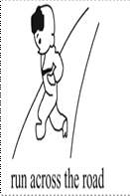
① across 表示从一定范围的一边到另一边，与on 有关， 表示动作是在某一物体的表面进行的。
The boy is running across the road.
小男孩正穿过公路。
② through 表示从中间通过，强调动作是在里面进行的。
The train is going through the tunnel.
这辆火车正穿过隧道。

Slide 31
Try to complete the sentences
1. 它是谁的作品?
Who’s it ______?
2. 它叫什么名字?
What __ it _____?
3. 我是说唱乐迷.
I’m ___________.
4.让我们清净会儿吧!
Give us ________!
5. 那究竟是什么?
What _______ is that?
6.我简直无法相信!
I don’t _______ it!
7.它活泼,又好跟着跳舞.
It’s lively and good _____________.
by
on earth
is
called
believe
a fan of rap
to dance to
a break

Slide 32
二、根据汉语完成句子。
1. 谁是你最喜欢的古典音乐家?
__________________________________
2. 萨莉不喜欢流行音乐，是吗？
__________________________________
3. 让我们休息一下。
______________
Who’s your favourite classical musician?
Sally doesn’t like pop music, does she?
Give us a break.

Slide 33
4. 你喜欢传统西方音乐还是流行音乐？
_____________________________
_____________________
5. 哪条河穿过上海？
_______________________________
6. 你不喜欢摇滚乐？我不信。
______________________________
______________
Do you like traditional Western music or pop music?
Which river goes through Shanghai?
You don’t like rock music? I don’t believe it!

