Slide 1
Unit 1 My name's Gina.
Section B(1a～1f)
WWW.PPT818.COM

Slide 2
1．数词
本课中的zero…nine都是数词。表示数字、数目和顺序的词叫数词，表示“多少”的词为基数词；表示“第几”的词为序数词。
zero，one，…nine都是基数词，表示数目的多少。
用法如下：
①表示年龄、数字、日期。
②表示编号。
③表示电话号码、传真号码、门牌号、身份证号。
④表示时间。

Slide 3
2．—What's your telephone number？你的电话号码是多少？
—It's 587­6275。
是587­6275。
这是用于询问对方电话号码的特殊疑问句，询问电话号码时用特殊疑问词what，回答时用It's＋电话号码。或：My telephone number is＋电话号码或直接回答电话号码。it指代上文的“telephone number”，按号码顺序将两组基数词读出即可。
另外：telephone电话，也可缩写为phone，作动词时，意为“给某人打电话”。
【拓展】What's…number？也可用于询问房间、身份证、车牌号等号码。eg：
What's your car number？你的车牌号是多少？

Slide 4
一、根据句意及首字母或图片提示写单词。
—What’s your __________ number?
—It’s 381-4586.
telephone
number
2. His phone _________is 232-6988.
3. —What’s six and three?
—It’s _________
nine
4. _______ and three is seven.
Four
5. Five and ________ is five.
zero

Slide 5
二、用英语写出下列电话号码。
6.330-2129_______________________________________
7.524-0639_______________________________________
8.632-4123_______________________________________
9.531-6639________________________________________
10.302-4315______________________________________
three three zero two one two nine
five two four zero six three nine
six three two four one two three
five three one six six three nine
three zero two four three one five

Slide 6
三、单项选择。
11.—What’s your ?
—It’s 885-5286.
A.name B.telephone
C.telephone number D.color
12.—What’s four and three?
—It’s _______.
A.seven B.eight
C.one D.six
C
A

Slide 7
13.119 is a______ number.
A.telephone B.book
C.car D.cup
14.—Gina is my friend.
—What’s________ telephone number?
A.his B.her
C.my D.you
A
B
15.—Is your name Linda Brown?
—_________ .
A.Yes,I am B.Yes,it is
C.Yes,he is D.No, she isn’t
B

Slide 8
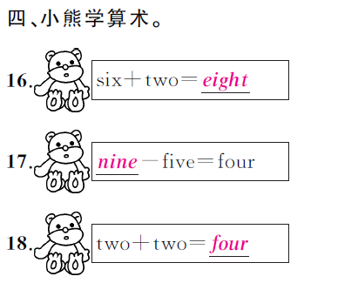

Slide 9
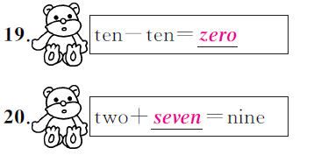

Slide 10
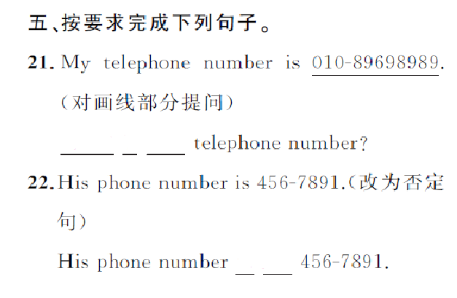
What
is
your
is
not

Slide 11
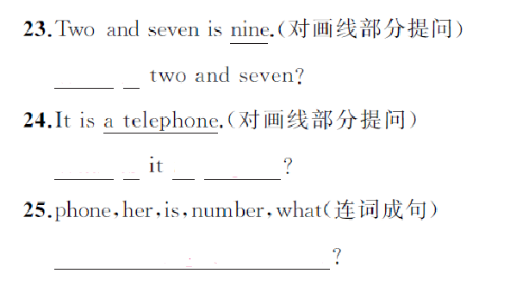
What
is
What
is
in
English
What is her phone numer

Slide 12
