Slide 1
Unit2 There are forty students in our class.
人教精通版四年级下册
WWW.PPT818.COM

Slide 2
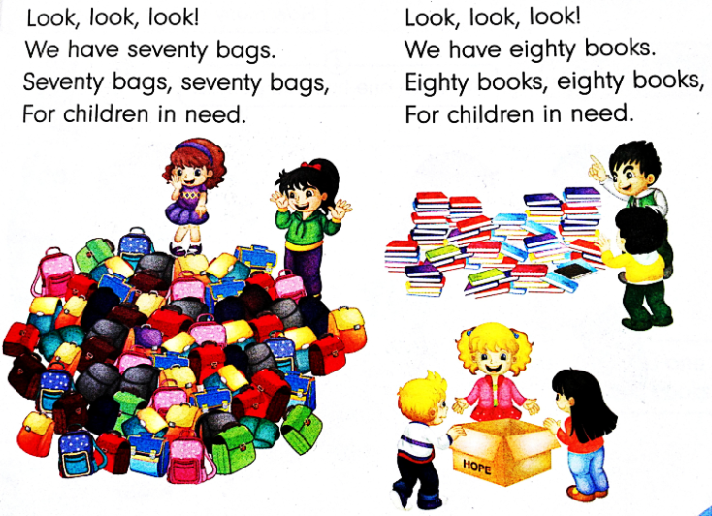
Review
Let’s chant

Slide 3
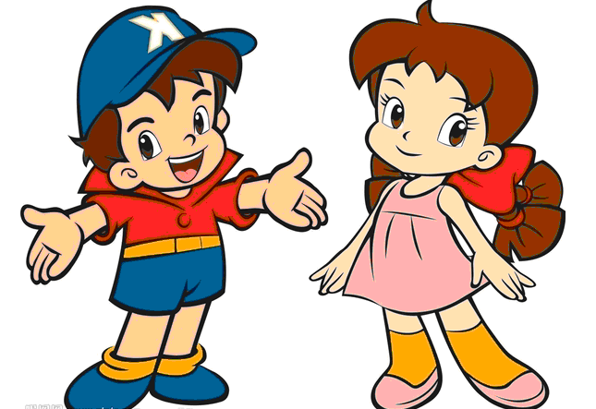
Review
Ask and answer
How many … do you have?
bags
70
books
80

Slide 4
Presentation
Let’s learn
pen
pencil

Slide 5
Presentation
Think and say
How many pens do you have?
I have …
How many pencils do you have?
I have …

Slide 6
Presentation
Look and Think
Who are they?
Where are they?
What are they doing?

Slide 7
Presentation
Look and say
What does Mr Zhang want to know?
（单击图片可播放动画）

Slide 8
Presentation
Listen and say
How many pens do they have?
They have ninety pens.

Slide 9
Presentation
Listen and say
How many pencils do they have?
They have one hundred pencils.

Slide 10
Practice
Follow to read
录音 | 课文句子
T: How many pens do you have?
S1: We have ninety pens.
T: How many pencils do you have?
S2: We have one hundred pencils.

Slide 11
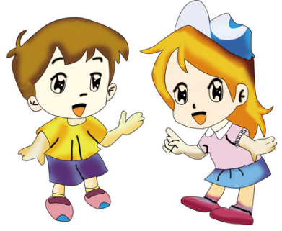
Practice
Role-play
三人一组，表演课文对话。

Slide 12
Presentation
Let’s learn
ninety

Slide 13
Presentation
Let’s learn
one hundred

Slide 14
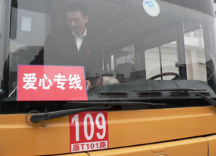
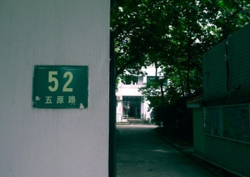
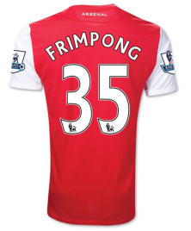
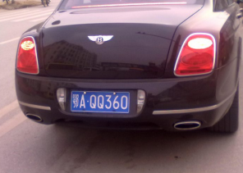
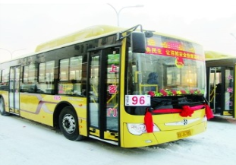
Practice
你能英文说出生活中的这些数字吗？

Slide 15
Practice
Let’s do a survey
 | Class 1 | Class 2 | Class 3
bags
books
pens
pencils
How many books do you have?
We have one hundred books.

Slide 16
Summary
1. 本课重点学习的单词是什么？
pen
pencil
ninety
one hundred
2. 本课的重点句型是什么？
How many … do you have?
We have ...

Slide 17
Homework
1.跟读课文Just talk部分的录音，注意语音、语调。
2.寻找生活中的数字（100以内），制作成一张海报，并标注上相应的英文。
3.预习Lesson12。
Close

