Slide 1
人教精通版五年级上册
Unit6 It’s a grapefruit.
WWW.PPT818.COM

Slide 2
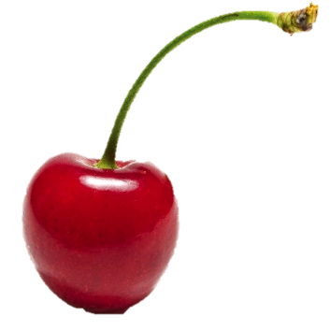
>>Review
Let’s guess
cherry

Slide 3
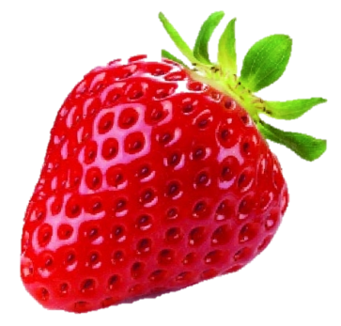
>>Review
Let’s guess
strawberry

Slide 4
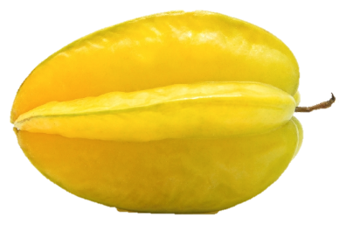
>>Review
Let’s guess
star fruit

Slide 5
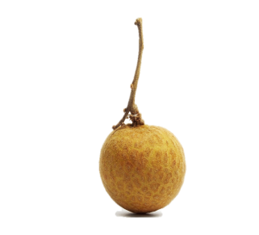
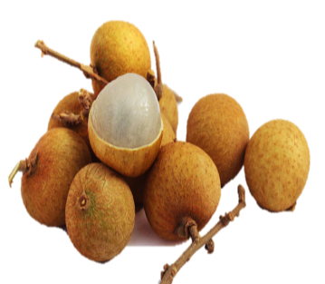
>>Presentation
Look and say
a longan
longans

Slide 6
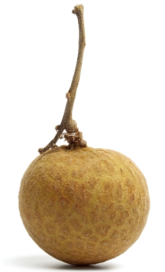
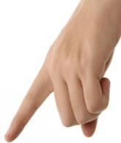
>>Presentation
Look and say
A: What is _____?
B: It’s a ________.
this
longan

Slide 7
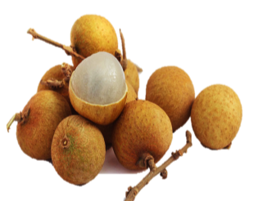
>>Presentation
Look and say
A: What are _____?
B: They’re ________.
these
longans
They’re = They are

Slide 8
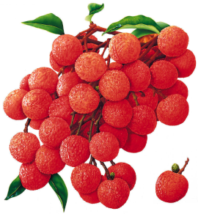
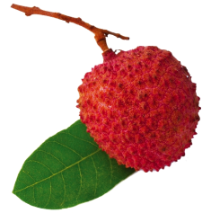
>>Presentation
Look and say
a lychee
lychees

Slide 9
>>Presentation
Look and say
A: What is _____?
B: It’s a ________.
that
lychee

Slide 10
>>Presentation
Look and say
A: What are ______?
B: They’re ________.
those
lychees

Slide 11
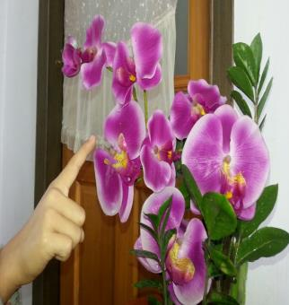
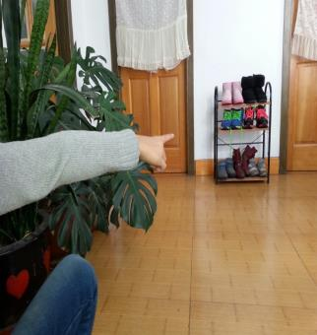
>>Presentation
Look and say
A: What are _____?
B: They’re _______.
A: What are _____?
B: They’re _______.
these
those
flowers
shoes

Slide 12
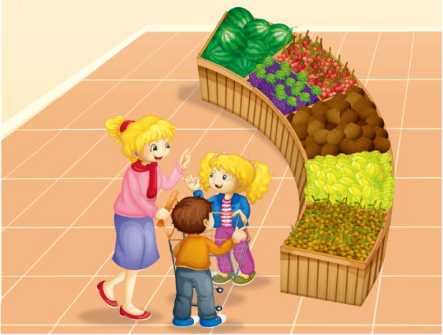
>>Presentation
Just talk
Look and say
What’s in the shop?

Slide 13
>>Presentation
Just talk
Listen and say
What do the boy and girl want?
They want some longans and lychees.

Slide 14
>>Presentation
Key points
Can I have some … ?
我能拥有一些… 吗？
Sure. / Yes, you can.
｛
当然。/ 是的，你能。
Sorry，you can’t.
对不起，你不能。

Slide 15
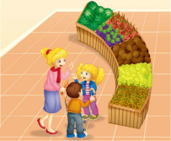
>>Presentation
Just talk
Listen and imitate
Little boy: Mum, can I have some grapes?
Mum: Yes!
Little boy: Look! What are these?
Kate: They’re longans.
Little boy: And what are those? Are they
longans, too?

Slide 16
>>Presentation
Just talk
Listen and imitate
Kate: No, they aren’t. They’re lychees.
Mum: Yes, they’re lychees.
Kate & boy: Mum, can we have some longans
and lychees?
Mum: Sure.
Kate & boy: Thank you, Mum!

Slide 17
>>Practice
Read it by yourself for one minute .
自读对话一分钟。
一分钟倒计时
60
Learning tip :
10
10
50
自己读对话，比一比看谁能在一分钟内读完，并且读得准确、流利！
20
20
40
30
30
开始

Slide 18
>>Practice
Show time
小组合作，练习对话并表演，其他同学评价。
Pronunciation (语音) |  | Fluency (流利) | Cooperation (合作)
OK!
Great!
Super!

Slide 19
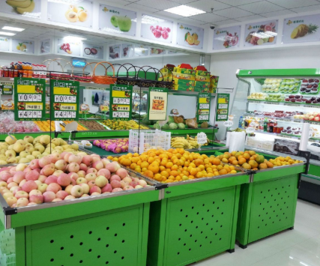
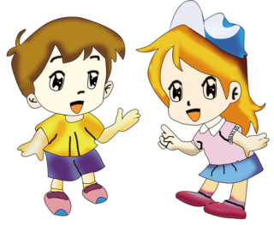
>>Practice
Make a conversation
假设你和同学一起去水果店购物，仿照本课对话，两人一组，编写一段新的对话并表演。

Slide 20
>>Practice
Let’s do a survey
What are these/those? Do you like them?
Names
Fruits
coconuts
hami melons
cherries
strawberries
apples
peaches
watermelons
grapefruits
oranges

Slide 21
>>Summary
本课新学习的水果类词汇有：
a longan
a lychee
longans
lychees

Slide 22
>>Summary
本课学习的重点句型：
—What are these / those?
—They’re …

Slide 23
>>Homework
1.观看课文动画，按照正确的语音、语调朗读课文对话。 2.查找并搜集健康水果的种类，并制作成一套自己的水果类单词卡片。
3.做一做本单元的相关练习。

