Slide 1
Unit 7 Spring Festival
Did you have a big dinner.
WWW.PPT818.COM

Slide 2
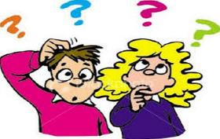
Look at the pictures and say what festivals they are.

Slide 3
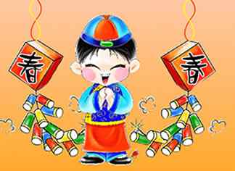
Chinese Spring Festival
春节

Slide 4
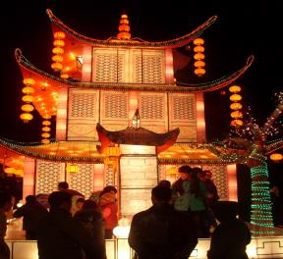
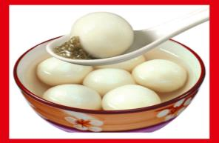
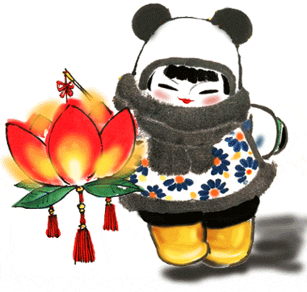
The Lantern Festival
元宵节

Slide 5
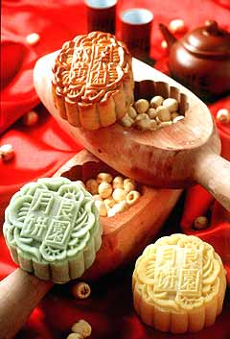
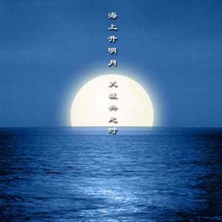
Mid-Autumn Festival
中秋节

Slide 6
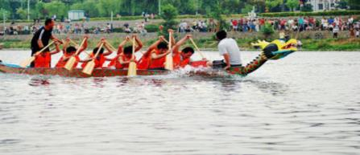
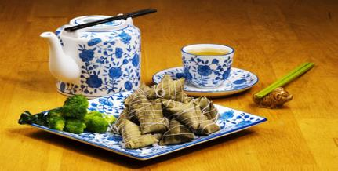
The Dragon Boat Festival
端午节

Slide 7
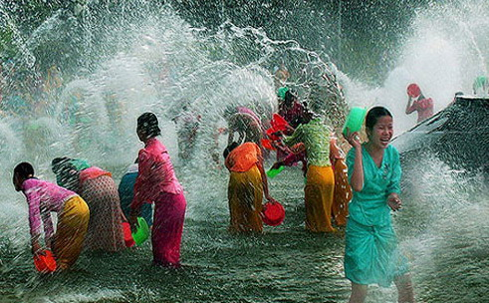
The Water Festival
泼水节

Slide 8
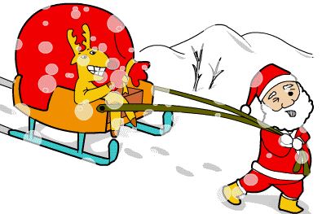
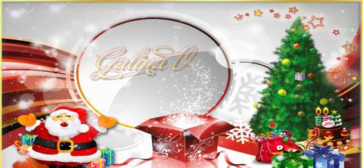
Christmas Day
圣诞节

Slide 9
Discussion
What is your favourite festival?
Why do you like it most?
What did you do at the festival?

Slide 10
What did you do at the Spring Festival?

Slide 11
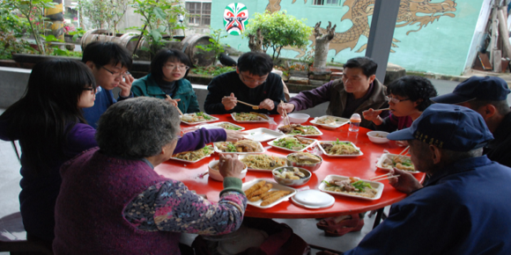
The family got together and had a big dinner.

Slide 12
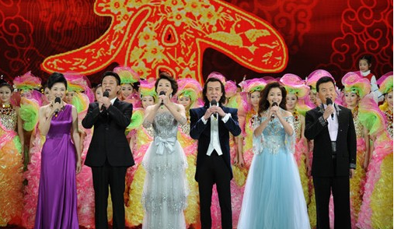
The family watched the Spring Festival Gala.

Slide 13
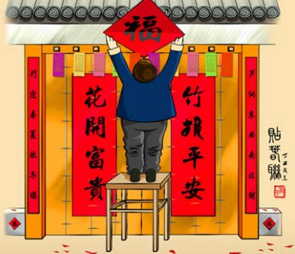
We put up the Spring Festival couplets.

Slide 14
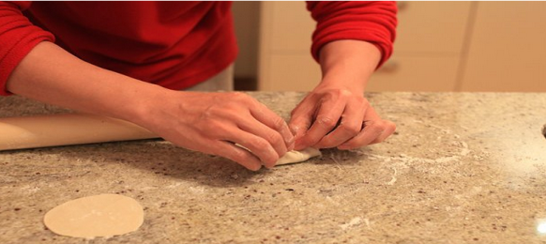
The family made Jiaozuo together.

Slide 15
Good bye

