Slide 1
Module 9 Friendship
Unit 1
Could I ask if you’ve mentioned this to her?
WWW.PPT818.COM
1

Slide 2
Mrs King: Hello!
Lingling: Hello! Could I speak to Betty, please?
Mrs King: I'm sorry, she's not in at the moment.
Lingling: Is that Mrs King?
Mrs King: Yes, this is Betty's mother. Is it
important? Can I take a message?
Lingling: Yes, please. This is Lingling, Betty’s
classmate. I have a problem with my
best friend and I need her help.
Mrs King: Oh, I'm sorry to hear that, Lingling.

Slide 3
But Betty is visiting her grandmother. She won't be back until tomorrow. Maybe you can try calling my friend, Jane. She works on the Friendship Helpline at school.
Lingling: Thanks so much, Mrs King. May I have the number? Mrs King: You can call her on 58590808.
Lingling: Thank you, Mrs King.
Mrs King: You're welcome, Lingling. I hope my friend can help you.

Slide 4
My best friend
what……
when
why
where
who
how old/ long if/whether
Could/ Can you tell me_____________?
She is always _________(有耐心的) with me.
patient
She often __________（鼓励）me when I have problems.
encourages

Slide 5
1. Why did Lingling call Betty?
2. What advice did Mrs King give her?
Because she had a problem with her best friend.
She advised her to call the Friendship Helpline.
Lingling

Slide 6
Can you list some expressions we use when we call somebody?
1. May I speak to Mary?
2. Is that Jim speaking?
3. This is Mary speaking.
4. Hold on, please.
5. Who is that (speaking)?/ Who is calling?
6. Can I take a message?
我能和玛丽通话吗
是Jim吗？
我是玛丽。
别挂电话。
是谁？
我可以带个口信吗？
对不起， 他不在。
对不起，我得挂电话了。
7.Sorry, he isn’t in right now.
8.Sorry, I have to hang up now.

Slide 7
Listen and answer
1. What is Lingling’s problem?
A. Lingling doesn’t like her best friend to see her other friends.
B. Lingling's best friend doesn’t like her to see her other friends.
C. Lingling's best friend doesn't like to play with her.
2. Lingling and her best friend are in the _________ school now?
A. same B. new C. different
3. Does Lingling get help from the helpline?
Yes, she does.

Slide 8
Read and find out how the Helpline asks Lingling's problems .
3.So could you explain what happened then?
1.How can I help you?
2.Tell me when the problem started.
5.Could I ask if you’ve mentioned this to her?
4.Can you tell me how she’s different?
6.Do you know why she treats you like that?
when started → what happened → how→ why

Slide 9
Read and answer
1. Tell me when the problem started.
We got separated when we went to different schools last term, but we stayed in touch.
A.分开 B.团聚
2. Could you explain what happened then?
She is so different.
3. Can you tell me how she is different?
She doesn’t like me to see my other friends.
4. Could I ask if you’ve mentioned this to her?
Yes, but she refused to listen.
She didn’t like to listen.
5. Do you know why she treats you like that?
No, I don't know. Maybe she doesn't feel very sure of herself in her new school.
She is not confident.

Slide 10
What is the advice from Friendship Helpline?
Try to find out whether _______
________________.
she feels
lonely without you
Be______________.
patient with her
Explain to her that she can______
____________________________.
make
friends with your other friends too
Try to_____________________.
introduce her to them
Notes:
10

Slide 11
How did the Helpline ask for information?
Tell me when the problem started.
Could you explain what happened then?
Can you tell me how she’s different?
Do you know why she treats you like that?
Could I ask if you’ve mentioned this to her?
Tell me + 从句
Tell me when you started to have the problem.
告诉我你什么时候开始有这个问题的？
Could you explain + 从句
Could you explain what happened?
能解释一下发生了什么吗？
Can you tell me + 从句
Can you tell me how you communicate with him?
能告诉我你是如何与他交流的？
Do you know why he got angry?
Do you know + 从句
你知道为什么他会生气吗？
Could I ask if you always play with your friends?
Could I ask + 从句
问一下是否你和你的朋友总一起玩。
S + V + wh-(what/when/where/how/why)+ 从句
S + V + whether/if + 从句 （陈述语序（S + V + O））
Notes:
11

Slide 12
1.have a problem
2.get separated
3.last term
4.stay in touch
5.this term
6.at first
7.refuse to do sth.
8.treat sb.
9.feel sure of oneself
10.try to do sth.
11.find out
12.feel lonely
13.be patient with sb
有问题
分开，分隔
上个学期
保持联系
这个学期
首先
拒绝做某事
对待某人
对某人有信心
尽量做某事
找出
觉得孤独
对某人有耐心

Slide 13
14.explain to sb.
15.make friends with sb.
16.introduce sb. to sb.
17.encourage sb. to do sth
18.join in
19.no problem
向某人解释
与某人交朋友
向某人介绍某人
鼓励某人做某事
参加
没问题

Slide 14
Now Check (√) the true sentences.
1. Lingling called to ask for advice about
her schoolwork.
2. Lingling and her best friend are now in
the same school.
3. Lingling is happy to see her best friend
at the same school.
4. Lingling is having a hard time in the new
school.
5. Lingling gets help from the helpline.
×
her problem with her best friend.
√
√
×
√

Slide 15
Watch and complete the passage.
Lingling has a _________with her best friend. She wants to get ______ from the Friendship Helpline. They’ve been friends for five years. They got _________ when they went to different schools last term. This term, her best friend came to her school. But Lingling found her best friend was ________. She doesn’t like Lingling to see her other friends.
problem
help
separated
different
lonely
The Friendship Helpline thinks maybe her friend feels ______. She probably _______ Lingling like that because she does not feel sure of herself. She probably _______ hurting Lingling. The Friendship Helpline suggests Lingling should be _______ with her, __________ her to Lingling’s other friends and ___________ her to join in more.
treats
regrets
patient
introduce
encourage

Slide 16
Complete the passage with the correct form of the words in the box.
encourage herself introduce lonely patient regret separate treat
separated
When you get (1) ________ from a friend, it may create problems for your friendship. She may not want you to see your other friends. If this is the case, she probably (2) ______ you like that because she does not feel sure of (3) _______. Try to find out whether she feels (4) ______ without you. It is natural to feel like that. She probably (5) _______ hurting you. Be (6) _______ with her, (7) ________ her to your other friends and (8) _________ her to join in more.
treats
herself
lonely
regrets
patient
introduce
encourage

Slide 17
Proverb(谚语)
A friend in need is a friend indeed.
患难见真情

Slide 18
My problems with friendship.
我的朋友想要抄袭我的作业
我和我的最好的朋友吵架了，并且我们互相之间不说话。
I had a big fight with my best friend and we don’t talk to each other now.
My friend wants to copy my homework.
我必须去一所新学校上学，但是我不想要离开我的朋友们。
我的朋友总是向我借钱。
I have to go to a new school, but I don’t want to leave my friends.
My friend always borrows money from me.

Slide 19
Talk about your problems with friendship.
A: Hello. Friendship Helpline. Who's calling?How can I help you?
B: Hello. This is ____ speaking. I have a problem with my friend. My friend wants to copy(抄袭) my homework.
A: Tell me when the problem started.
B: When we went to the middle school. She was not good at math, so she tried to copy my homework. But I think it's wrong.
A: So could I ask whether you metioned it to her?
B: Yes, but she refused to listen.
A: I think you should stop her from copying your homework and explain to her it's wrong to copy homwork. Try to help her with her homework and encourage her to study math hard. I'm sure she will understand you.
B: I see. Thank you.
A: No problem.

Slide 20
Pair-work
A: Hello. Friendship Helpline. How can I help you?
B: Hello. This is … speaking. I have a problem
with my friend. _________(My friend is always late./My friend tells lies/ I'm shy and I haven't had many friends./ My friend wants to copy(抄袭) my homework.)
A: Tell me when/what/how/why/whether …
B: …
A: So could I ask when/what/how/why/whether …?
B: …
A: I think you should … Try to …
B: I see. Thank you.
A: No problem.

Slide 21
A friend without faults
will never be found.
没有缺点的朋友是永远找不到的。
Learn to forgive(宽容) others and understand others.

Slide 22
Work in pairs and answer the questions.
When was the last time you felt sad？
Who did you tell that you were sad？
What did you do to feel better？
How can you make other people feel happy?

Slide 23
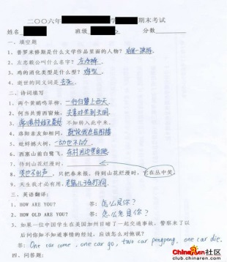
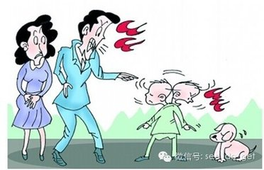
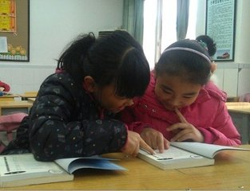
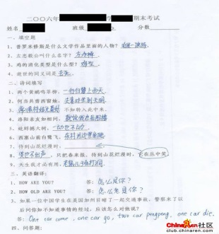
59
85
bad mark
be angry with
help…
make progress
Last Saturday, I felt unhappy because I got the bad mark. My parents were very angry with me. I told my friend about it. Then she came with a smile. She helped me with my lessons and we studied together. That made me feel happy. Then I made great progress and passed the exam. Now I think helping others can make them happy.

Slide 24
Learning to learn
When you read a story, focus on the five wh-questions:
Who is the main character?
What happens?
When does the main event or story take place?
Where does it take place?
Why?
Look through the passage and get the answers to the five wh-questions.

Slide 25
What is friendship? When it rains, I think friendship is
a small umbrella. It can give me a piece of clear sky. When I'm crying, I think friendship is
a white handkerchief. It can wipe my tears dry. When I am sad, I think friendship is
a warm word. It can bring me happiness again. When I am in trouble, I think friendship is
a strong hand. It can help me escape my troubles.

Slide 26
have a problem with...
和...有问题
分开
保持联系
向某人说起某事
拒绝做某事
那样对待某人
感到很自信
后悔做过某事
对...有耐心
向某人解释
把...介绍给...
鼓励某人做某事
get separated
stay in touch
mention sth. to sb.
refuse to do sth.
treat sb. like that
feel very sure of oneself
regret doing sth.
be patient with
explain to sb.
introduce...to...
encourage sb. to do

Slide 27
谢谢
27

