Slide 1
Unit5 July is the seventh month.
人教精通版六年级上册
WWW.PPT818.COM

Slide 2
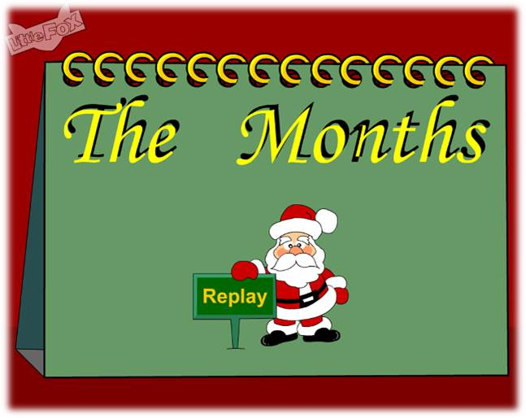
>>Warm-up
Let’s sing

Slide 3
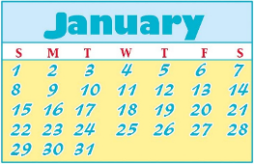
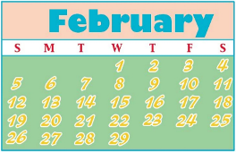
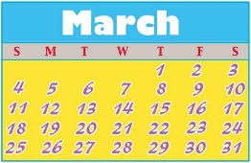
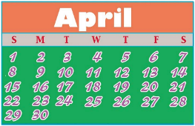
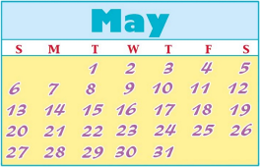
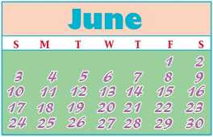
>>Warm-up
Let’s review
Which month do you like?

Slide 4
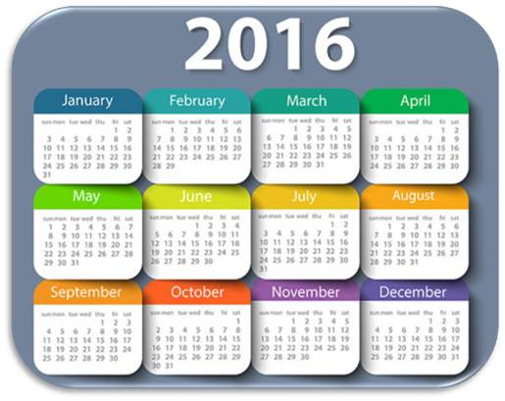
>>Lead-in
Look and say
What month goes after June?
July

Slide 5
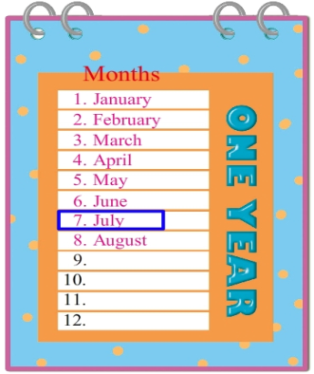
>>Presentation
Look and say
seventh
July is the _______ month of the year.

Slide 6
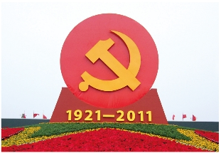
>>Presentation
Look and say
Communist Party of China
（CPC）

Slide 7
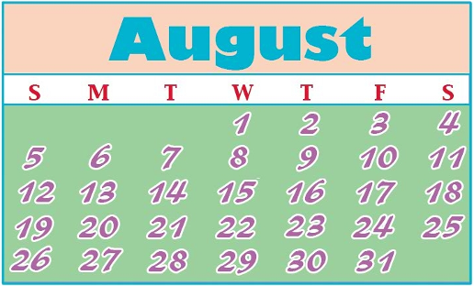
>>Presentation
Let’s learn
August
eighth
August is the _____ month of the year.

Slide 8
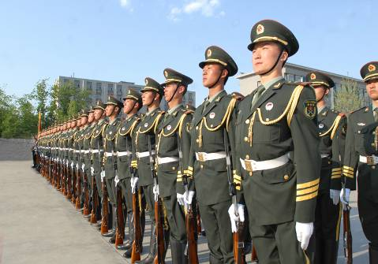
>>Presentation
Let’s learn
People’s Liberation Army
（PLA）

Slide 9
>>Presentation
Listen and say
When was Communist Party of China founded?
Communist Party of China was founded on July 1st.
When was People’s Liberation Army founded?
People’s Liberation Army was founded on August 1st.

Slide 10
>>Presentation
Look and read

Slide 11
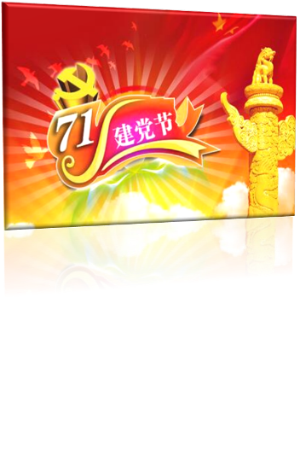
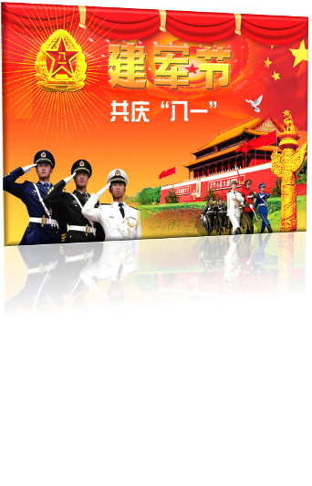
>>Presentation
Let’s learn
Party Day
Army Day

Slide 12
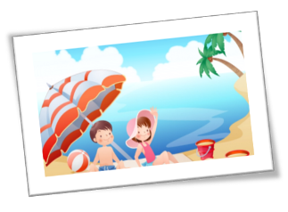
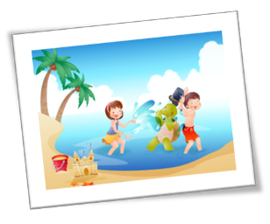
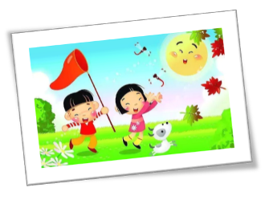
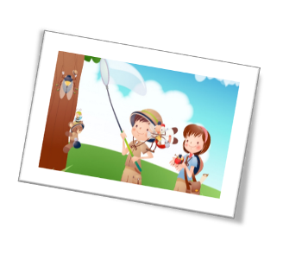
>>Presentation
Let’s learn
In August, students have their _______ holidays.
summer

Slide 13
>>Presentation
Just read and talk
Listen and imitate
July is the seventh month of the year.
July 1st is the birthday of the Communist Party of China (CPC).
Party members celebrate the day when it was founded.
August is the eighth month of the year.
The People’s Liberation Army (PLA) Day is on
August 1st.
In August, school is out.
Students have their summer holidays.

Slide 14
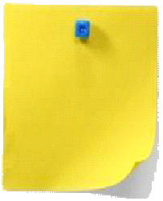
>>Practice
Let’s read
Read together.
(齐读)
Read in pictures.
（分图读）
Read in groups.
(分组读）

Slide 15
>>Practice
Let’s play!
一月
八月
二月
七月
三月
六月
四月
五月

Slide 16
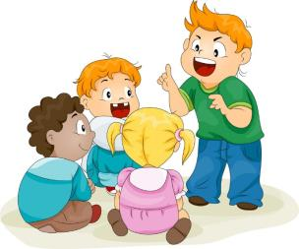
>>Practice
Group work
What do you usually do in July and August?
Tell more festivals in these
two months.

Slide 17
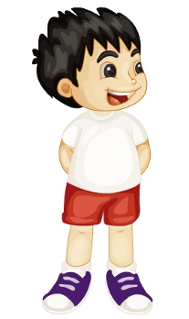
>>Practice
活动
Draw and talk
1. Draw your favorite month.
2. Write the name of the
month.
3. Talk about the festivals
and activities in the month.

Slide 18
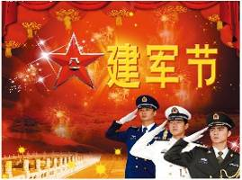
>>Summary
本课学习主要学习的月份和节日有哪些？
July
August
Party Day
Army Day

Slide 19
>>Homework
1.跟读课文动画或录音，按照正确的语音、语调朗读课文。 2.查阅7月、8月还有哪些主要的节日，有哪些庆祝活动，记录下来，并与小组分享。
3.预习 Lesson 26。

