Slide 1
Module 9 Friendship
Unit 3
Language in use
WWW.PPT818.COM

Slide 2
Language practice
I know (that) foreigners find China very
different from their own countries.
I don’t know who will come.
I’ve heard that you play in the school orchestra.
I asked your secretary.
whether she could come or not.
Do you know if Sally Maxwell is here yet?
Can you tell me where you’re from?

Slide 3
She told me. She is cooking.
I say to Jim. We’ll go surfing.
Miss Gao said. She likes oranges.
Mr Smith told his wife:“I bought a dress for you.”
Do you know? When will the meeting begin?
I knew. How does David go to school?
Can you tell me? Where did you buy the book?
Jim’s aunt asked him:“How often do you clean your bedroom?”
I want to know. Are you from America?
She told me (that) she was cooking.
I say to Jim (that) we’ll go surfing.
Miss Gao said (that) she liked oranges.
Mr Smith told his wife (that) he bought a dress for her.
Do you know when the meeting will begin?
I knew how David went to school.
Can you tell me where you bought the book?
Jim’s aunt asked him how often he cleaned his bedroom.
I want to know if / whether you are from America.

Slide 4
If / Whether clause as objects:
1.从句是一般疑问句的宾语从句 ;
2. 从句的引导词用 if 或 whether , 不能省略 ;
3. 从句的句式要由疑问句的句式改为陈述句的句式.
4. 时态，标点应随着主句的变化而变化.

Slide 5
Model:
1)“ Has Sally Maxwell arrived?” Do you know?
--- Do you know if Sally Maxwell has arrived?
2)“Do you miss the UK, or your relations?”
Can I ask ?
--- Can I ask if you miss the UK, or your relations?
主句
从句
陈述语序
引导词

Slide 6
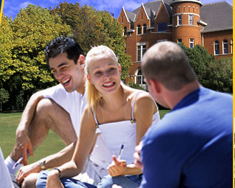
What did Ted ask Jane ?
Can you borrow
your pen to me?
He asked Jane if / whether she could borrow
her pen to him.

Slide 7
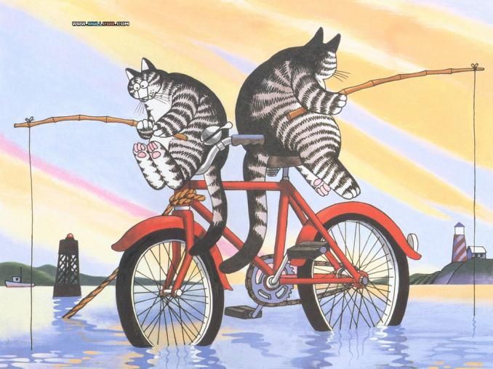
Have you got any fish?
What does the baby cat ask?
He asks if his father has got any fish.

Slide 8
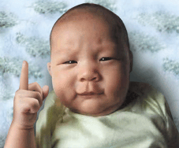
Am I cool?
What does the baby
ask?
He asks if / whether he is cool.

Slide 9
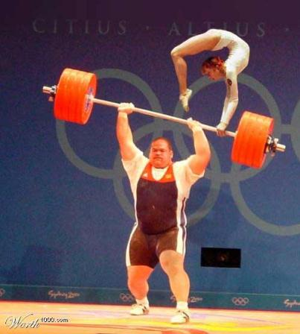
Can you hold me up?
What did the girl want to know?
The girl wanted to know if the man could hold her up?

Slide 10
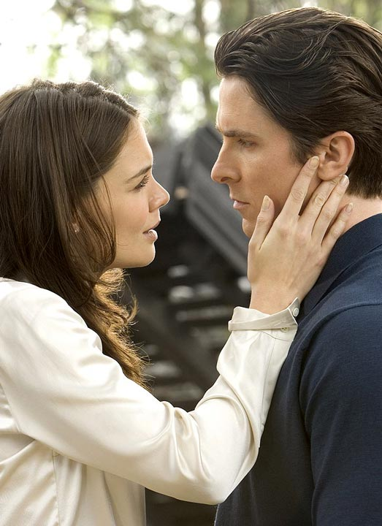
“Do you
love me?”
What did the girl ask the young man?
She asked the young man if / whether he loved her.

Slide 11
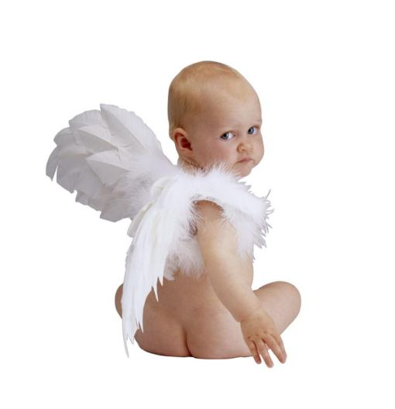
What does the baby wonder ?
Can I fly?
He wonders if / whether he can fly.

Slide 12
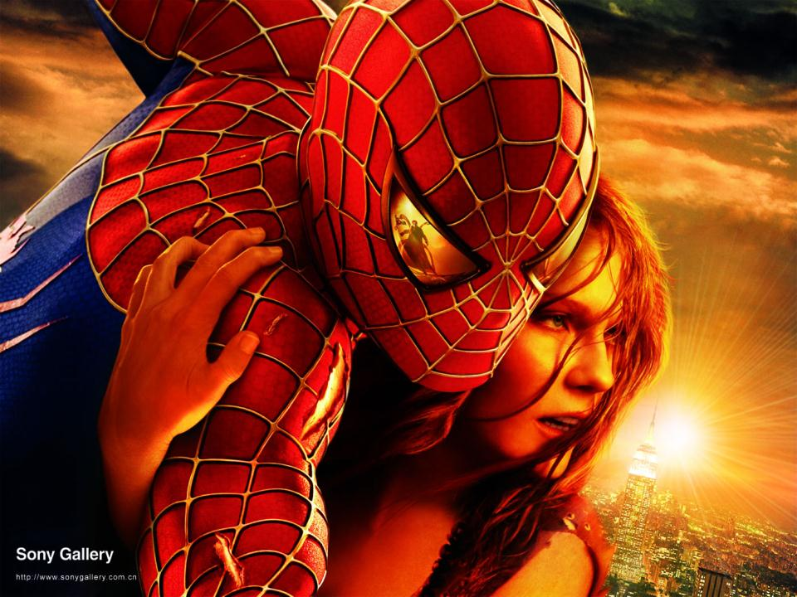
“Will you
take me to
the sky?”
What does the girl ask the Spiderman?
She asks the Spiderman if / whether he
will take her to the sky.

Slide 13
Choose the correct words to complete the sentences.
1.--- Please tell me if / why you want to come to my party.
--- I’d love to come. Thanks!
2. I don’t know how / why he did it.
--- I’ll show you.
3. --- I’m not sure when / whether Tony will come or not.
--- No, he isn’t.

Slide 14
4. --- I want to know how long / old he is.
--- He is ten years old.
5. --- Do you know if / where the orchestra will play?
--- Yes, in the concert hall in town.
6. --- Can you tell me that / who sings this song?
--- Yes, it’s Robbie Williams.
7. --- Can I ask you if / why you like living here?
--- Because everyone is so friendly.

Slide 15
8. --- Do you know when / what the next English club is?
--- Yes, it’s on Thursday, at five o’clock.
9. --- Can you tell me how / when Sally is playing?
--- Yes, at ten o’clock, I think.
10. --- I’ve heard that / who our team won the match. Is it true?
--- Yes, it is. Isn’t it wonderful!

Slide 16
Match the questions with the reasons for asking.
1. Can you tell me what your name is?
2. Is it OK if I sit here?
3. Do you know what time the shop opens?
4. Do you know where the library is?
5. Do you know if she is here yet?
1
5
a to find out information
b to find out about possibility
c to find our about a time
d to find out about place
2
3
4

Slide 17
Complete the conversation with the correct form of the words and expressions in the box.
classmate feel like foreigner lonely miss parent personal worry

Slide 18
Tom: Excuse me. I’m from our school
newspaper. My (1)____and I would like to
interview some students. Can I ask you a
few (2)____questions?
Emily: Um……
Tom: Don’t (3)____. They’re not too difficult!
Emily: OK. What would you like to know?
Tom: Well , what does it (4)____to be at school
in China?

Slide 19
Emily: It’s great! I was a bit (5)____at first, but
people here are friendly, so I am never alone
any more!
Tom: What do you think is the most difficult thing
for a (6)_____living in China?
Emily: Well the language, of course. I’M learning
it now, but it’ going to take a long time.
Tom: What do you (7)____about your country?
Emily: My(8)____.but they’re coming over to visit
me in a few months.
Tom: OK! Thank you!
Emily: You’re welcome.

Slide 20
Work in pairs. Complete the conversations with the phrases in the box.
a I’m afraid you have the wrong number
b Can I help you
c May I speak to Jack
d Hold the line
e I’ll call back later
f Jack isn’t here right now
g who’s calling

Slide 21
A: Good morning This is 234567.(1)____?
B: Hello (2)____, please?
A: (3)____, please?
B: It’s Sally.
A: (4)____, please.sorry,(5)____.
Can I take a message?
B: No, tanks, (6)_____.
A: All right Bye.
B: Bye.
B
C
G
D
F
E
C: Hello This is Mike speaking.
D: hello May I speak to Tom?
C: Tom? Sorry (7)_____
D: Sorry.
C: That’s OK
A

Slide 22
Listen and choose the problem the speaker is describing.
a) “My best friend has found a new best friend.”
b) “My long friendship with someone is coming to an end”
c) “I have moved to a new school and I’m lonely.”
d) “My best friend’s parents don’t like me.”

Slide 23
Work in pairs. Choose the best advice for the problem in Activity
a) Talk to your friend about the situation.
Try to spend some time alone with your friend. Think about what was special about Sam and try to find that special friendship again.
Don’t expect so much from one person enjoy your friendship with Sam. But look for new friendships, too.
d) Forget about Sam. Nothing stays the same all the time.

Slide 24
Write about a friend. It can be a friendship you have now or a friendship you had in the past.
1. Describe your friend How did your friendship start?
2. What made your friend so special?
3. Whatdid you do together to have fun?
4. How did your friendship end? Or if you are still friends,do you think your friendship will be the same in future? What could change things?

Slide 25
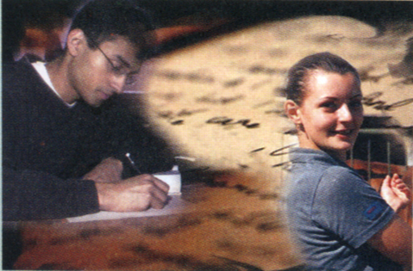
Around the world

Slide 26
宾语从句三要素："语序"、"时态"、"引导词”
宾语从句的语序
1). 宾语从句的语序是陈述语序，即“连接词+主语+谓语+其它成分”。而不是疑问句的倒装结构。
Can you tell me where will we go?（╳）
Can you tell me where we will go?（ √）
2). 陈述句变为宾语从句时,要注意人称和时态的变化,语序不变。
eg. She said, “I will leave a message on the desk.” → She said she would leave a message on the desk.
3)一般疑问句和特殊疑问句变为宾语从句时,也要注意人称和时态的变化,后面接陈述语序。
eg. “Where are the tickets?” I asked him. → I asked him where the tickets.

Slide 27
宾语从句的时态
宾语从句中谓语动词的时态，常常受到主句谓语时态的制约，此为时态呼应。
1)如果主句谓语是一般现在时或将来时，从句谓语的时态不受限制；
2)如果主句谓语的时态是一般过去时，从句一般要随着改为相应的过去时态（一般过去时、过去进行时、过去将来时、过去完成时）。
eg. I thought （that） you are free today. （╳）
I thought （that） you would be free today. （ √）
3)【注意】当宾语从句叙述的是客观真理时，不管主句谓语的时态如何，从句都用一般现在时。
eg. The teacher told us （that） the earth moves around the sun.

Slide 28
宾语从句的连接词
1．连词that，只起连接作用，在从句中不作句子成分，也无词汇意义，在口语中常被省略。
eg. He knew （that） he should work hard.
2．连词if 、whether，它们起连接作用，在从句中不作句子成分，作“是否”解，在口语中多用if。
eg. Tom don't know if/whether his grandpa liked the present.
He asked me whether or not I was coming.
一般情况下，if 和whether可以互换，但以下3种情况只能用whether：
①在不定式前：Whether to go there or not hasn't been decided.
②在介词前：It depends on（依靠） whether it is going to rain.
③与or not连用：They are talking about whether to go there or not.
3．连接代词who, whom, whose, what, which，连接副词when, where, why, how， 它们起连接作用，作句子成分，各有自己的意义。
eg. The teacher asked the new students which class he was in.
I wonder where he got so much money.

Slide 29
【注意】
1．标点由主句决定，如主句是陈述句、祈使句，则用句号；是疑问句则用问号。
eg. I heard she had been to the Great Wall. Can you tell me which bus I should take?
2．要注意个别句子中主从句人称的一致。

Slide 30
Mr. Smith thought. Does Mrs. Smith get back?
Mr. Smith thought ______ Mrs. Smith ______ ______.
Miss Green says:“I like singing.”
Miss Green says ______ ______ ______ singing.
Do you want to know ? Why didn't I see the film ?
Do you want to know ______ ______ ______ see the film ?
Nobody knew. Who is knocking at the door?
Nobody knew ______ ______ knocking at the door.
We could see. There are many animals in the zoo.
We could see _______ _______ many animals in the zoo.
The boy asked his mother :“ Do you like me ?”
The boy asked his mother ________ ______ _______ ______.
The girl asked:“ Is the moon far away from the earth?”
The girl asked _____ the moon ______ far away from the earth.
Uncle Wang told his daughter:“I bought a computer for you.”
Uncle Wang told his daughter ______ _______ a computer for
______.
if got back
that she likes
why I didn't
who was
there were
whether she liked him
if is
he bought
her

