Slide 1
Unit2 Spring is Coming!
第4课时
WWW.PPT818.COM

Slide 2
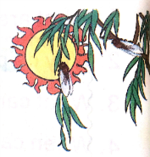
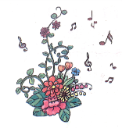
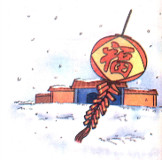
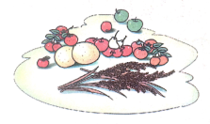
>>Presentation
Let’s chant
Seasons
Spring is gay with flower and song.
Summer is hot and the days are long.
Autumn is rich with fruit and grain.
Winter brings snow and a new year again.

Slide 3
>>Presentation
Read the words
ir
girl bird skirt shirt
short forty
sport morning
or
turn nurse
Thursday hamburger
ur

Slide 4
>>Presentation
你发现什么规律了吗？
ir - /ə:/
girl
bird
skirt
shirt
or - /ɔ:/
short
forty
sport
morning

Slide 5
>>Presentation
你发现什么规律了吗？
ur - /ə:/
turn
nurse
Thursday
hamburger

Slide 6
>>Presentation
Try to read more
first dirty third thirsty
born north storm report
burn hurt return purpose

Slide 7
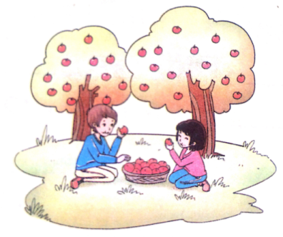
>>Presentation
Look and answer
What do children do in autumn?
They often eat apples.

Slide 8
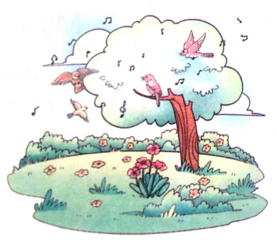
>>Presentation
Look and answer
What do birds do in spring?
They often sing songs.

Slide 9
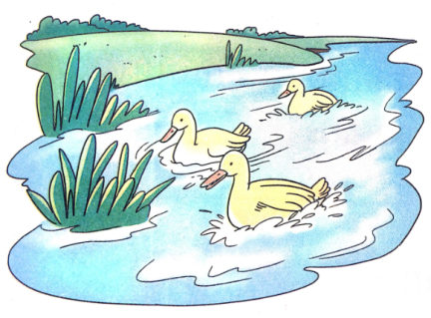
>>Presentation
Look and answer
What do ducks do in summer?
They often swim/go swimming.

Slide 10
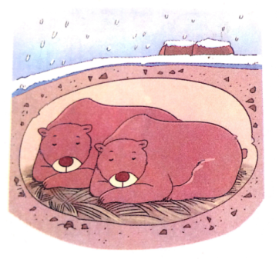
>>Presentation
Look and answer
What do bears do in winter?
They often sleep.

Slide 11
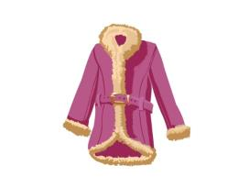
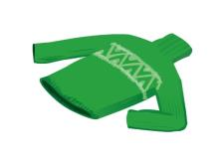
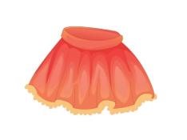
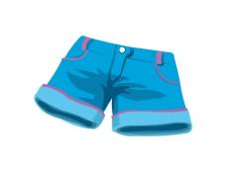
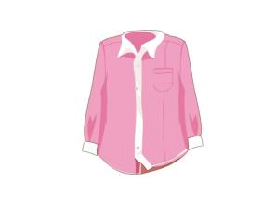
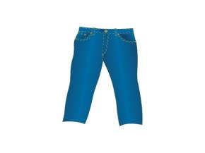
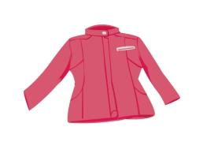
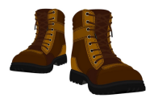
>>Presentation
Look and say
I wear …, and … in…
coat
sweater
skirt
short
shirt
jacket
trousers
boots

Slide 12
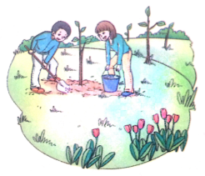
>>Presentation
Look and write
grass—green flowers—beautiful plant trees
My favourite season is spring. The grass _______. The ________________. We can _________ on Tree Planting Day.
is green
flowers are beautiful
plant trees

Slide 13
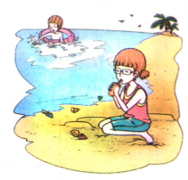
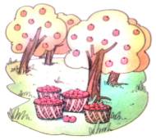
>>Presentation
Look and write
summer hot swim
It ______________. ___________.
is hot in summer
We can swim
autumn fruit climb the mountains
In autumn, there are _________. We
can _________________, too.
many fruits
climb the mountains

Slide 14
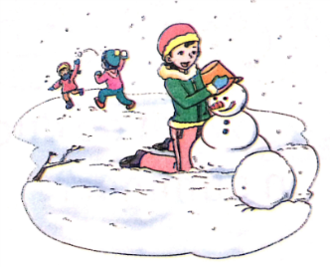
>>Presentation
Look and write
winter cold make a snowman
Winter ______. We can ______________.
is cold
make a snowman

Slide 15
>>Practice
Do a survey
Name | Spring | Summer | Autumn | Winter
Li Lei | plant trees | go swimming | ride a bike | make a snowman

Slide 16
>>Summary
语音：
字母组合ir在单词中的发音为/ə:/
字母组合or在单词中的发音为/ɔ:/
字母组合ur在单词中的发音为/ə:/

Slide 17
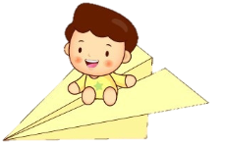
>>Homework
1.观看课文动画，按照正确的语音、语调朗读课文对话。
2.完成调查报告，并运用She/He often does… in spring. In summer, he/she likes to… Sometimes he/she … in autumn. In winter,…来描述。
close

