Slide 1
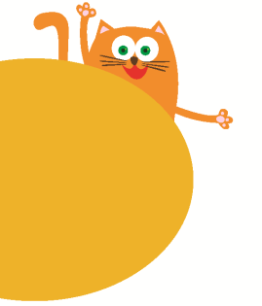
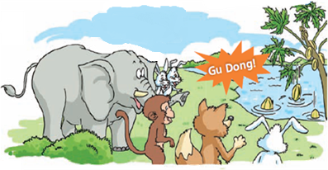
Sounds
3
第三课时
WWW.PPT818.COM

Slide 2
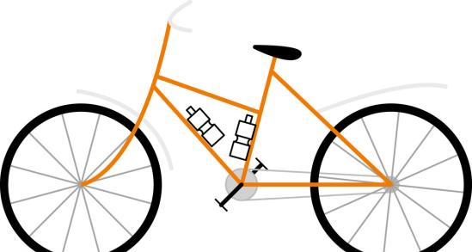
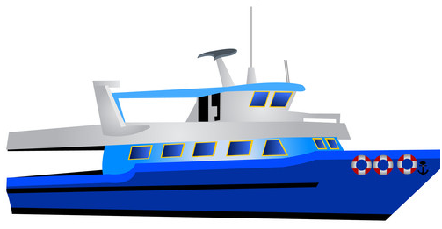
Look and say

Slide 3
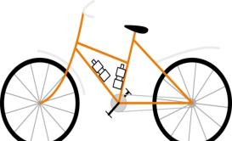
Choose and say

Slide 4
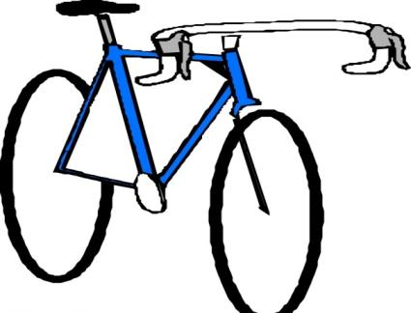
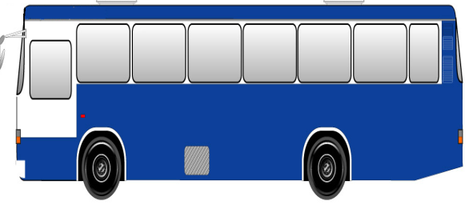
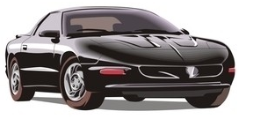
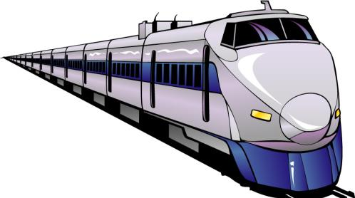
Look and spell

Slide 5
Ask and answer
What can you hear?

Slide 6
Ask and answer
What can you hear?

Slide 7
Look and talk
What can you hear?
I can hear …

Slide 8
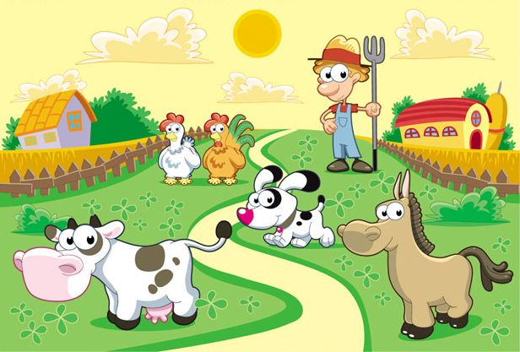
Look and say

Slide 9
Look and think
Tom is a farmer. This is his farm. It is a morning. Listen! What can you hear?
I can hear a ________. I can hear ________ and __________. I can hear _________ too.
Tom is happy on his farm.

Slide 10
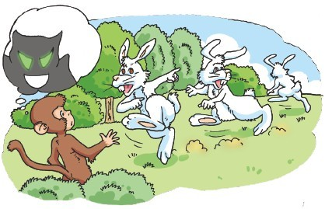
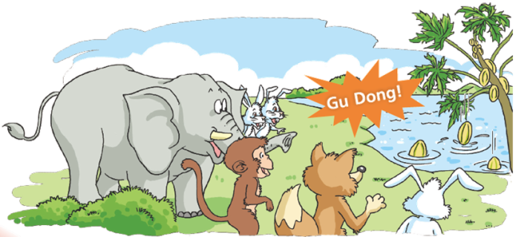
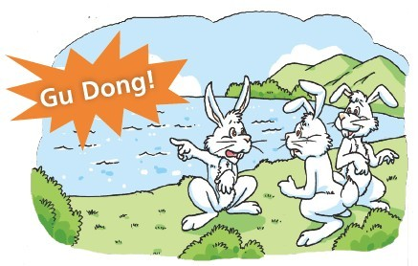
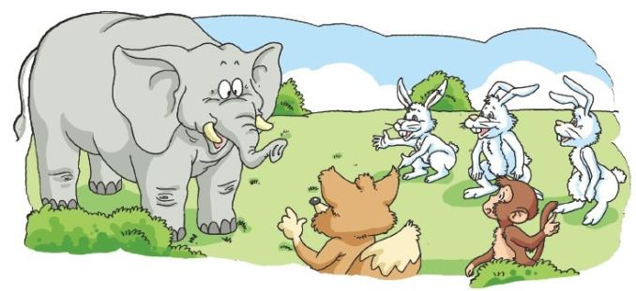

Slide 11
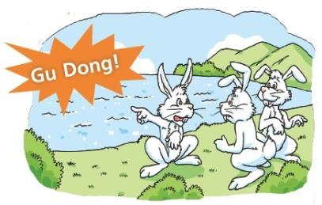
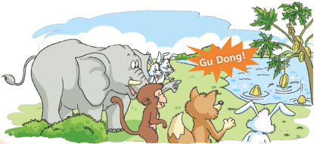
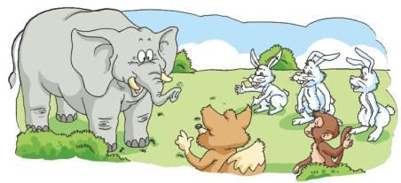
Look and number
4
1
3
2

Slide 12
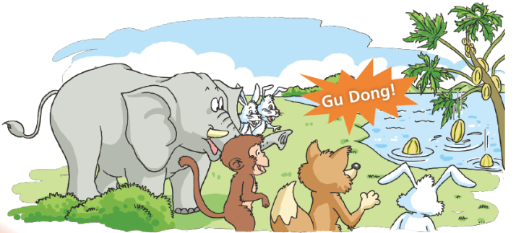
Ask and answer
How many animals?
Is Gu Dong a monster?
What is Gu Dong?

Slide 13
Ask and answer
How many animals?
Is Gu Dong a monster?
What is Gu Dong?
Five.
No, it isn’t.
It’s a papaya.

Slide 14
Listen and say
Listen! What can you hear?
I can hear “Gu Dong”!

Slide 15
Listen and say
Help! Help! Gu Dong is coming!

Slide 16
Listen and say
What’s Gu Dong?
It’s a monster!
Its mouth is big.
Its eyes are green.

Slide 17
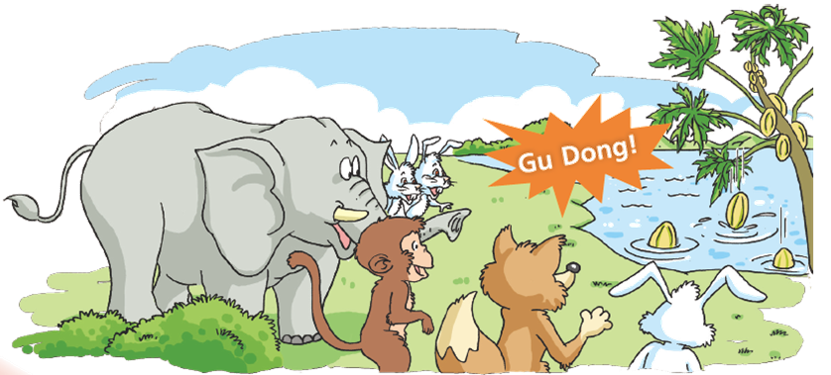
Listen and say
Don’t worry.
Look!

Slide 18
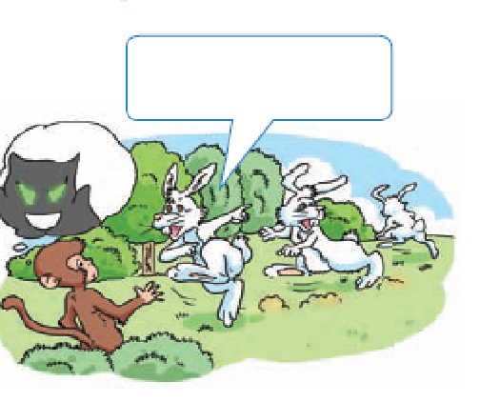
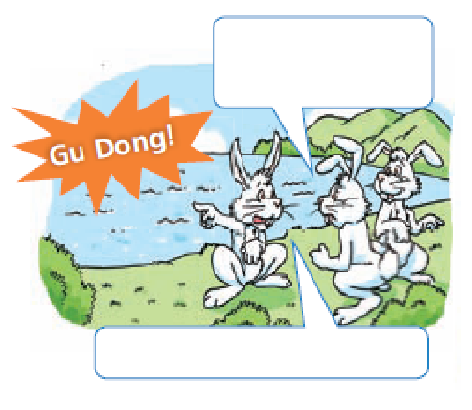
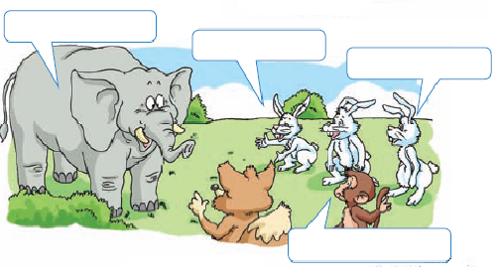
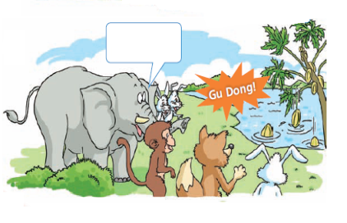
Act the story

Slide 19
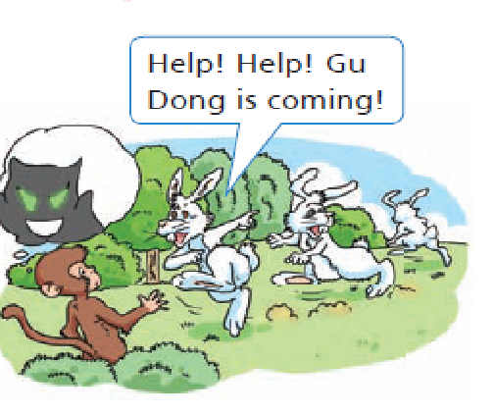
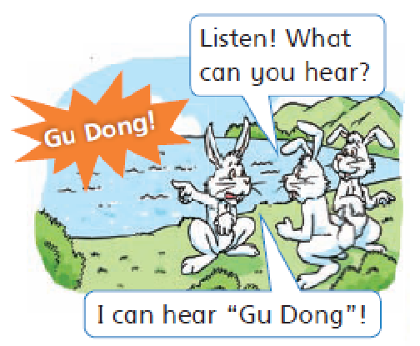
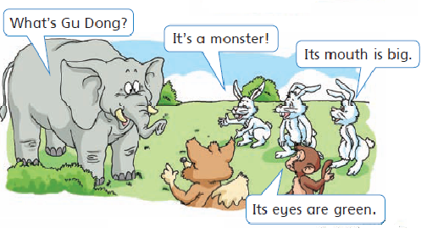
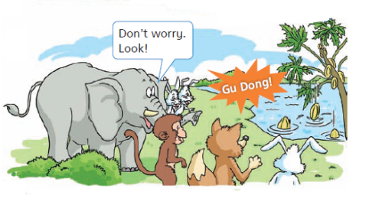
Look and read

Slide 20
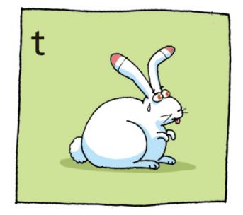
t t cat
t t boat
t t white
t t table
t t tea
t t toe
t t t
rabbit
rabbit
t t t

Slide 21
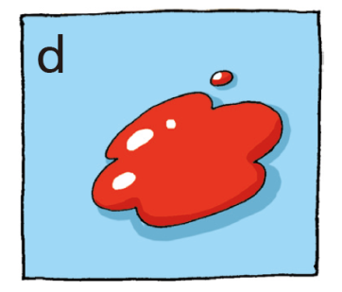
d d day
d d door
d d read
d d sound
d d d
red red
d d d

Slide 23
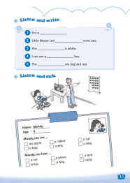
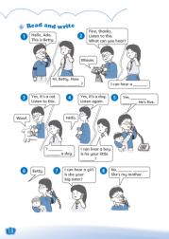
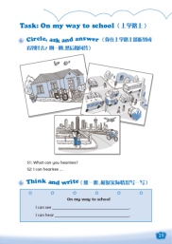
Homework
1 Read Enjoy a story.
2 Complete Workbook pages 15, 18 and 19.

