Slide 1
Unit 1 Cinderella
五年级
第1课时
WWW.PPT818.COM

Slide 2
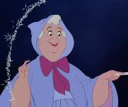
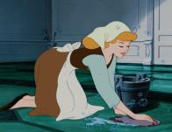
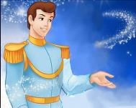
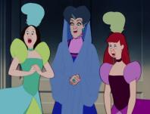
Talking time

Slide 3
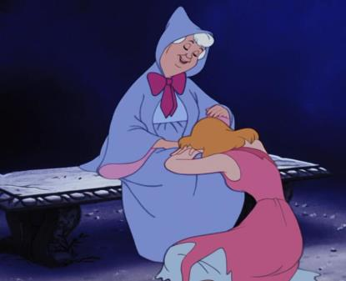
What are they talking about?
Because I can’t go to the party.
Why are you so sad?
Why can’t you go to the party?
Because I don’t have any nice clothes or shoes.

Slide 4
Grammar time
（Read the sentences on P9）
Why | are | you | so sad | ?
 | can’t |  | go to the party
Why
Because | I can’t go to the party | .
 | I don’t have any nice clothes or shoes
Because

Slide 5
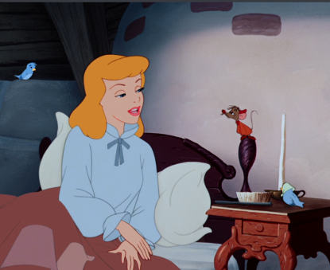
Why＆Because time
Why is the mouse not afraid?
The mouse is not afraid.
The animals are her friends.
Why are the animals her friends?

Slide 6
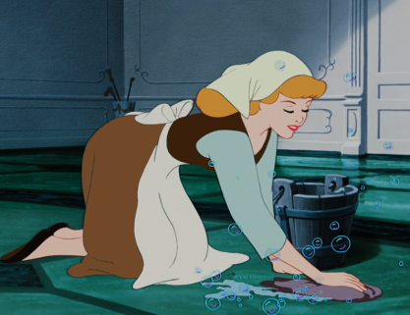
Why＆Because time
Why can’t Cinderella have a rest?
Cinderella can’t have a rest.

Slide 7
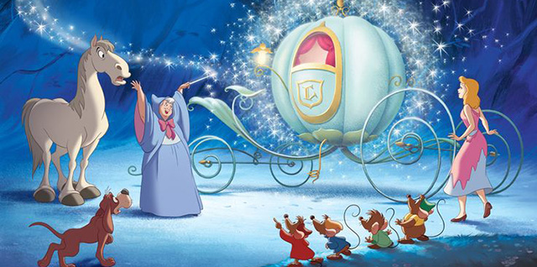
Why＆Because time
Why can the fairy help Cinderella?
The fairy can help Cinderella.

Slide 8
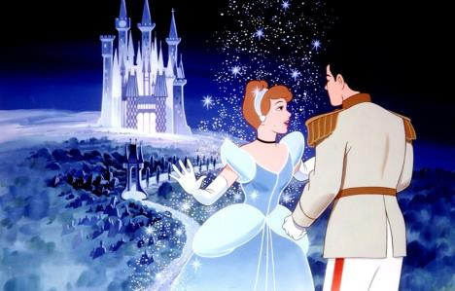
Why＆Because time
Why does Cinderella have a good time?
Cinderella has a good time.

Slide 9
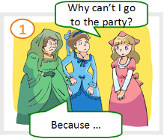
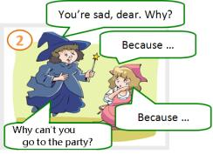
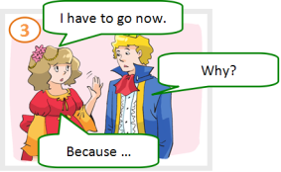
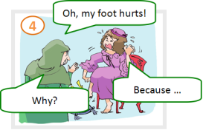
Fun time
(同桌合作，完成对话。)

Slide 10
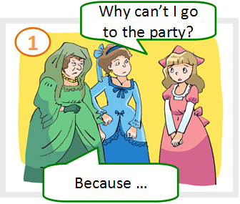
Thinking time
(发挥想象，在对话中加入更多的Why&Because。)

Slide 11
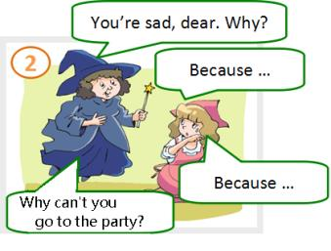
Thinking time
(发挥想象，在对话中加入更多的Why&Because。)
Why are you so sad?

Slide 12
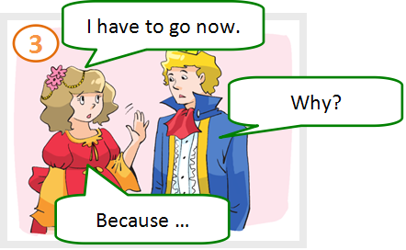
Thinking time
(发挥想象，在对话中加入更多的Why&Because。)
Why do you have to go now?

Slide 13
Thinking time
(发挥想象，在对话中加入更多的Why&Because。)
Why does your foot hurt?

Slide 14
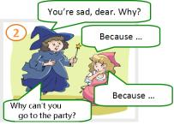
Show time
(小组合作，选择一幅图片表演。)

Slide 15
Question words(疑问词)
…
when
question words (疑问词)
where
what
who
whose

Slide 16
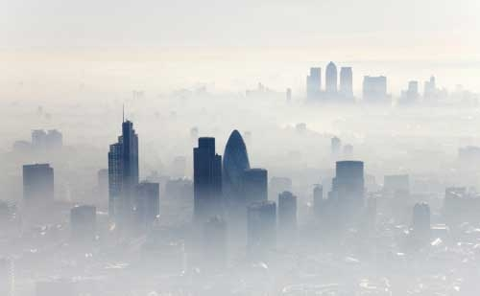
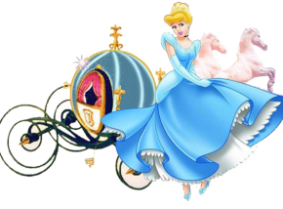
New Cinderella
what
whose
who
where
when
…

Slide 17
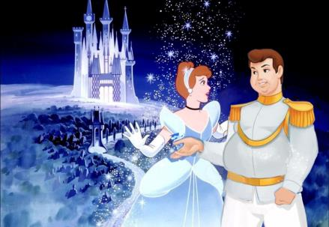
New Cinderella
what
whose
where
who
…
when

Slide 18
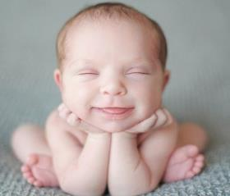
The more questions we ask , the more we get.

Slide 19
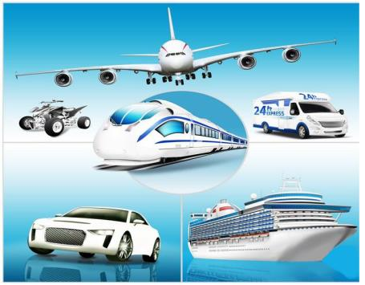
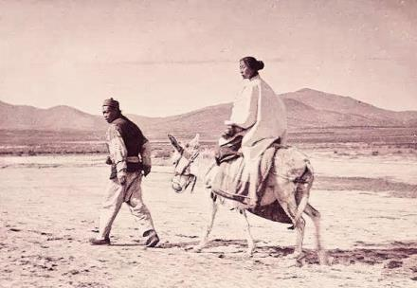
Why can’t we move fast?

Slide 20
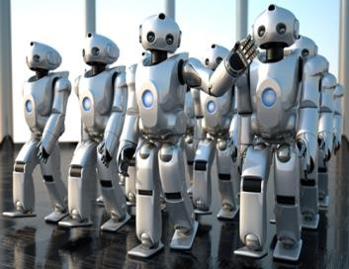
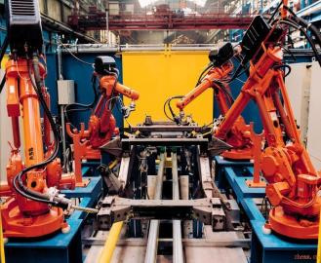
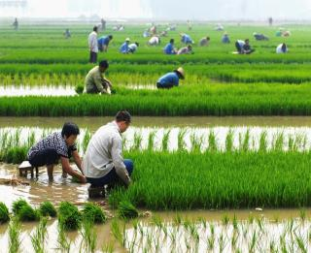
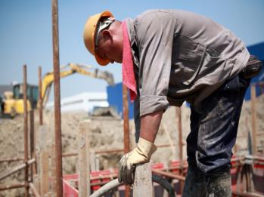
Who can help?

Slide 21
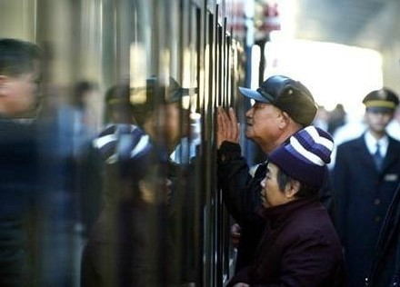
How can we see friends far away?

Slide 22
Writing time
Write down your questions in groups.
what
when
who
whose
where
…

Slide 23
Be curious, ask questions, and try to find the answers in our life.
在生活中要保持好奇心，学会提问，并试着找到问题的答案。

Slide 24
Homework
Surf the Internet, try to find the answers to your questions.

