Slide 1
Module 7 Unit 2
She was thinking about her cat.
WWW.PPT818.COM

Slide 2
Warming-up
刘易斯·卡罗尔
刘易斯·卡罗尔时(Lewis Carroll)英国数学家、逻辑学家，其真实姓名为查尔斯·道齐森(Charles Dodgson)。卡罗尔于1832年出生，幼年家境贫寒，生活艰辛，但他学习特别用功。卡罗尔(Carroll)十分喜欢文学，博览各类文学书籍，12岁就开始写作。1850年他去牛津大学(University of Oxford)基督堂学院，1854年被任命为数学讲师，直至退休。
基督堂学院院长利德尔的三个女儿常和卡罗尔玩儿，缠着他讲故事。卡罗尔很喜欢这三姐妹，常常自己编些故事讲给她们听，后来他把这些故事写了下来。小说家金斯利发现了这些手稿，便说服利德尔夫人，力劝卡罗尔发表这部作品。于是《爱丽丝漫游奇境》便问世了。

Slide 3
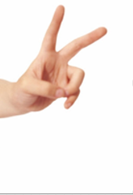
Words and expressions
twice adv. 两次；两倍
twice a week 一星期两次
once or twice 偶尔，一两次

Slide 4
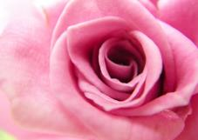
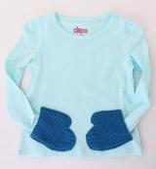
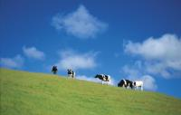
pink adj. 粉红色的 n. 粉红色
pocket n.
衣袋；口袋
field n.
牧场；田地

Slide 5
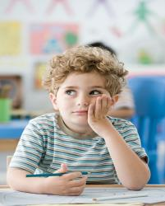
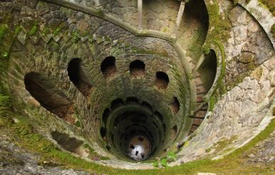
deep adj. （从顶部向下）深的
think about 考虑

Slide 6
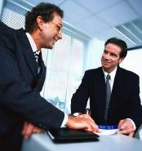
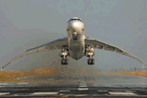
While we were talking, he came in. 我们正在谈话时，他进来了。
while conj. 当… …的时候
The plane landed safely. 飞机安全着陆。
land v. 降落（跳落、跌落）到地面（或水面上）

Slide 7
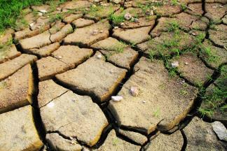
The soil is too dry for planting. 土太干了，不能种东西。
dry adj. 干的；干燥的

Slide 8
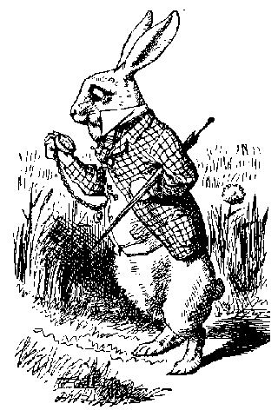
Look at the picture and say what you think is strange.
carrying an umbrella
looking at a pocket watch
↙
↘
↘
↗
wearing clothes
standing up on its back legs

Slide 9
Number the events in the order they happened.
a) Alice landed on some dry leaves.
b) Alice was sitting by the river with
her sister.
c) Alice fell down a hole.
d) A rabbit ran by.
e) Alice ran across the field after the
rabbit.
5
1
4
2
3

Slide 10
Answer the questions. Use the words and expression in the box.
deep dry field once or twice
pink pocket
1. Was Alice interested in her sister’s book? How do you know?
No, she wasn’t. Once or twice she looked into her sister’s book.

Slide 11
2. What color were the rabbit’s eyes?
3. Where was the rabbit’s watch before
he took it out?
4. What did Alice run across after the
rabbit?
They were pink.
It was in its pocket.
She ran across the field after the rabbit.

Slide 12
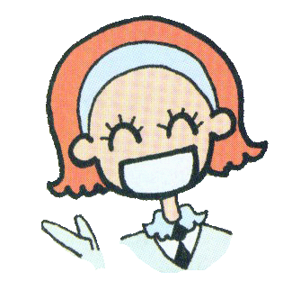
5. What did she fall down?
6. Where did she land?
She fell down a very deep hole.
She landed on some dry leaves.

Slide 13
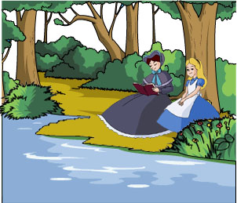
Listen and read, then say.
Alice was sitting with her sister by the river and her
by sister was reading a book.
_________________
（在······的旁边）
1.Where were Alice and her sister?
They were sitting by the river.
2.What was her sister doing?
She was reading a book.

Slide 14
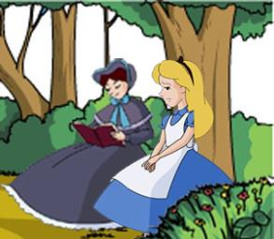
Alice had nothing to do. Once or twice she looked into her sister's book, but it had no pictures or conversations in it.
___________
（一两次，偶尔）
（这本书有什么用）
"And what is a book for," thought Alice, "without pictures or conversations?“
____________________
_______
(没有，with的反义词)

Slide 15
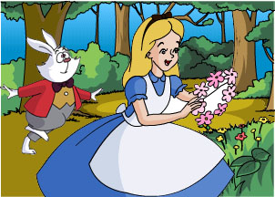
Suddenly a white rabbit with pink eyes ran by.
3.Why didn't Alice like her sister's book?
4.What happened next?
Because it had no pictures or conversations.
She saw a white rabbit with pink eyes run by her.

Slide 16
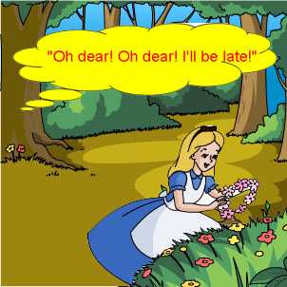
（没有奇怪的东西）
There was nothing strange about that. She heard the rabbit say, "Oh dear! Oh dear! I'll be late!“ and she didn't think it was strange .
_____________
5.What did the rabbit say?
The rabbit said, “Oh dear! Oh dear! I’ll be late!”

Slide 17
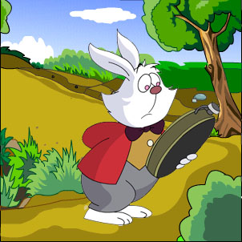
（从······中拿出······）
Then the rabbit took a watch out of its pocket and looked at it.
___ ______
6.What did the rabbit do with its watch?
It took it out of its pocket and looked at it.

Slide 18
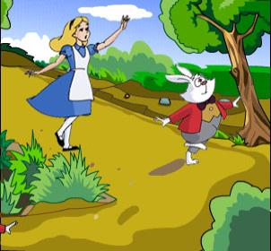
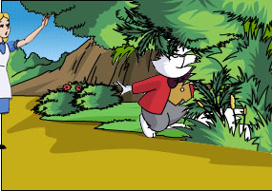
A rabbit with a pocket and a watch? Alice got up and ran across the field after it.
She saw it go down a large rabbit in the ground.
7.Why did Alice get up?
To run after the rabbit.
8.Where did the rabbit go?
It went across the field and down a large rabbit hole in the ground.

Slide 19
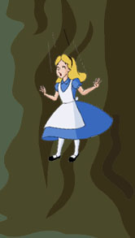
Then Alice went down after it but never thought about how she was going to get out again.
9.What did Alice do?
She went down after it.
10.How was she going to get out again?
She didn’t think about it.

Slide 20
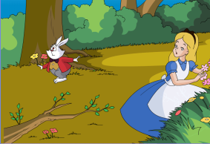
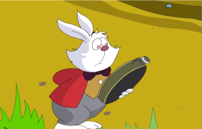
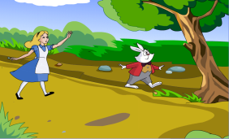
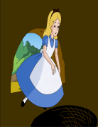
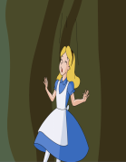
Retell
Retell the story
One day, Alice and her sister were sitting by the river.
Her sister was reading ,but Alice had nothing to do …
think of / suddenly/ pink/ run by
take out/ look at/ late
get up/ strange/ run across
a rabbit hole/ hedge/ go down

Slide 21
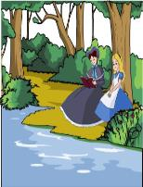
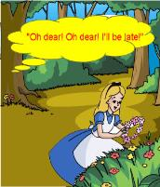
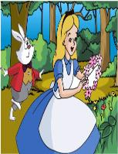
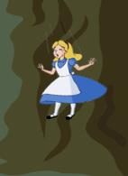
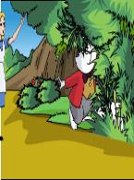
Retell
Read and number the pictures1-9,then repeat the story with One day…Then… and Finally.
1.
A B C D
6.
2.
5.
7.
3.
E F G H I
4.
9.
8.

Slide 22
Fill in the blanks
Alice and her sister were sitting 1) ______ the river. Her sister was 2)________ but Alice had 3) _______ to do. Suddenly a white rabbit 4) _____ pink eyes 5) _____ past her. Alice felt very 6) _______ when she saw the rabbit 7) ______ out a watch from its pocket. Alice ran quickly 8) ______ the field 9) _____ the rabbit. The rabbit went into a rabbit 10) _______and Alice followed.
by
reading
nothing
with
ran
strange
take
after
across
hole

Slide 23
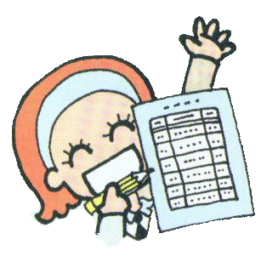
Match
Match the answers with the questions.
1. What did Alice find on a table?
2. What did Alice do with the key?
3. What did Alice find next?
4. What happened to Alice when she drank from the bottle?

Slide 24
Match
a) She became very small.
b) Alice found a small key on a table.
c) She found a bottle with the words
“DRINK ME” on it.
d) She opened a small door with the
key and saw a beautiful garden.
Keys: 1. ____ 2. ____ 3. ____ 4. ____
b d c a

Slide 25
Look for was / were doing sentences:
1. Alice was sitting with her sister by the river and her sister was reading a book.
2. … she was going to get out again.
3. She found she was falling down into a very, very deep hole.
4. She was falling for a long time.
5. While she was falling, she was thinking about her cat, Dinah.

Slide 26
Learning to learn
You may find books like Alice’s Adventures in Wonderland and Harry Potter very interesting but too difficult. Try to read simplified versions of the books you like.

Slide 27
Write what happened to Alice. Use the answers in Activity 5 to help you.
After Alice found a small key on a table, she opened a small door…

Slide 28
Possible answer:
After Alice found a small key on a table, she opened a small door with it and saw a beautiful garden. Next, she found a bottle with the words “DRINK ME” on it. Then, she drank from the bottle and became very small.

Slide 29
1.once or twice的意思是“偶尔，一两次”。
e.g. I read some books in library once or twice a week.
我一周去一两次图书馆看书。
2. “And what is a book for,” thought Alice, “without pictures or conversations?”
“没有插图也没有对话的书有什么用？”爱丽丝想。
What…for? 表示“有什么用，为什么？”
e.g. What did Tony go with me for?
托尼为什么和我一起去？

Slide 30
3.There was nothing strange about that.
形容词修饰不定代词时，应该后置，即不定代词后 跟形容词。
I have somthing to tell you.
我有事要告诉你们。
Can you find anything different ?
你找到不同的东西了吗？
4.She did not think it was strange.
她认为这不奇怪. （否定前移）
我想英语并不难。
I don’t think (that) English is easy.
老师认为我不聪明。
The teacher doesn’t think (that) I am clever.

Slide 31
5. She heard the rabbit say…….
She sew it go down a large rabbit hole.
see /watch/ hear/notice+ sb + do / doing
看见 /听见/ 注意到…做了(正做)某事
我看见老师上了车.
I saw the teacher get on the bus.
我听到有人正在隔壁房间唱歌.
I heard someone singing at the next room.

Slide 32
6. Suddenly she landed on some dry leaves…
突然，她落到了一些干树叶上……
land on “落到……上”
e.g. The plane landed on the beach because of a thick fog.
由于大雾飞机降落在海滩上了。
His kite landed on the playground at last.
他的风筝最后落到了操场上。

Slide 33
A. 单词拼写
1. How beautiful her ____ (粉红色的) dress is!
2. In autumn, the rice _____ (田地) look beautiful.
3. _________ (突然) he stood up and ran across the road.
4. The old man was standing with his hands in his _______ (口袋).
pink
fields
Suddenly
pockets

Slide 34
5. He goes to Hong Kong on business _____ (两次) a month.
6. That hole was very _____ (深).
B. 完成句子。
1. 我刚才看见了露西和莉莉，她们正在阅览室看书。
I saw Lucy and Lily just now. They
_________________ in the library.
twice
deep
were reading books

Slide 35
2. 他无事可做，感到很无聊。
He _______________ and felt so boring.
3. 猎人看见那只狼正在追赶一只兔子。
The hunter saw that wolf ____________ a rabbit.
4. 正当她往下掉的时候，她正在考虑她妈妈。
_____ she was falling, she ________________ her mother.
had nothing to do
running after
While
was thinking about

Slide 36
Past Continuous Tense: (过去进行时）的结构？
主+was / were + doing
1.Alice was sitting with her sister by the river.
2.It was running with a watch.
3.It was sitting in a tree and smiling at everyone.
4.He was sitting with the Mad Hatter and a mouse.
5.They were having a tea party.
6.She was playing a strange game.

Slide 37
过去进行时是指“过去的某一时间正在进行或发生的动作或事情”。
结构
“主语+was/were + 动ing+其它”
e.g. Alice was sitting with her sister by the river .

Slide 38
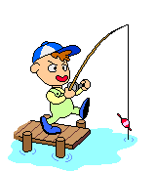
Practise : 主+was/ were + doing
They at 5 o’clock yesterday afternoon.
were dancing
dance
She football at 5 o’clock yesterday afternoon.
was playing
play football
He at 5 o’clock yesterday afternoon.
was fishing
fish

Slide 39
1. 过去进行时的各种句式:
肯定句: 主语+ was / were + 动词-ing形式。如:
I was reading at this time yesterday. 昨天这个时候我正在看书。
否定句:主语+ was / were + not + 动词-ing形式。如：
Grammar
I wasn’t reading at this time yesterday. 昨天这个时候我没在看书。

Slide 40
疑问句: (1)一般疑问句: was / were + 主语+ 动词-ing形式。肯定回答: Yes, 主语+ was / were.否定回答: No, 主语+ wasn’t / weren’t. 如：
—Were you reading at this time yesterday?
— 昨天这个时候你在看书吗？
— Yes, I was. / No, I wasn’t.
— 是的, 我在看。/ 不, 我没在看。

Slide 41
(2)特殊疑问句: 疑问词+ was / were + 主语+ 动词-ing形式。如：
What were you doing at this time yesterday?
昨天这个时候你在做什么？
What was he researching all day last Sunday?
上周日他一整天都在研究什么？

Slide 42
2. 过去进行时的用法基本用法:
(1)表示过去某一时刻或某一段时间内正在进行的动作, 常与时间状语at that time, at that moment, at this time yesterday, at ten o’clock yesterday等连用。如：
Were you playing basketball at four yesterday afternoon?
昨天下午四点你们在打篮球吗?

Slide 43
(2)表示在过去一段时间内持续进行的动作(有时也可以有间歇)。如：
We were watching TV from seven to nine last night.
昨天晚上七点到九点的时候我们在看电视。
She was singing from 7:00 to 7:30 last night.
她昨晚七点至七点半在唱歌。

Slide 44
特殊用法:
(1)常用于介绍故事的背景。如:
Once an Arab was traveling in the desert.
从前,有个阿拉伯人在沙漠中旅行。
(2)when引导的从句表示一个短暂的时间点,谓语动词用一般过去时, 主句用一般过去时或过去进行时； while引导的从句表示一段持续的时间, 主句为一般过去时, 从句谓语动词用过去进行时。如：

Slide 45
I was writing a letter when he came in.
当他进来时,我正在写信。
The telephone rang while she was washing.
当她正在洗衣服时, 电话响了。
(3)过去进行时常与always, continually等连用, 表示过去反复发生的行为动作, 带有赞美、厌烦等感情色彩。如：
He was continually asking her questions.
他一直在问她问题。

Slide 46
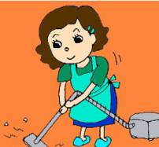
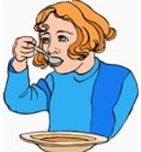
Grammar practice
Ask and answer.
What were you doing at 7 o’clock last night?
I was doing some housework.
I was having dinner.

Slide 47
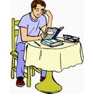
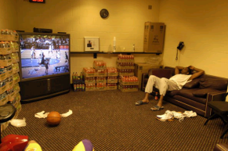
Grammar practice
What were you doing between 7o’clock and 9 o’clock yesterday?
I was doing my homework.
I was watching TV.

Slide 48
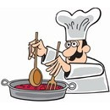
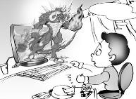
Grammar practice
What was your father doing when you
came back home yesterday?
He was cooking.
What was your brother doing when
you saw him half an hour ago?
He was playing computer games.

Slide 49
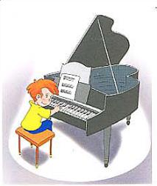
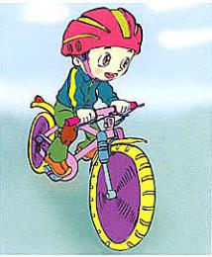
Grammar practice
What was Tom doing at that time last Sunday?
He was playing the piano.
How about David?
He was riding a bike.

Slide 50
Grammar practice
What were they doing at that time last week?
How about them?
They were having a picnic.
They were shopping.

Slide 51
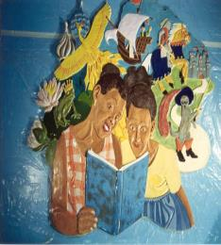
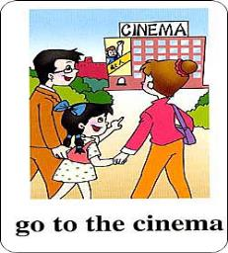
Grammar practice
What were they doing at 9 o’clock last night?
How about Tan Mei’s family?
They were going to the cinema.
They were reading.

