Slide 1
Unit7 It’s Tuesday 第4课时
陕旅版四年级上册
WWW.PPT818.COM

Slide 2
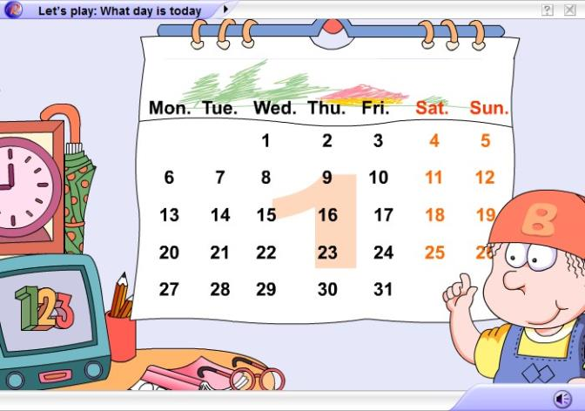
Say What day is today

Slide 3
Review
谈及自己与他人一周内的安排时用句型:
What day is it today?
今天星期几？
It’s+星期.
We have+科目+on+星期.

Slide 4
讨论每天的活动安排时,运用疑问句:
Is it…today?
Yes, it is.
What do you do on…?
I…
What does Liu Zhaoyang do on…?
He likes to…

Slide 5
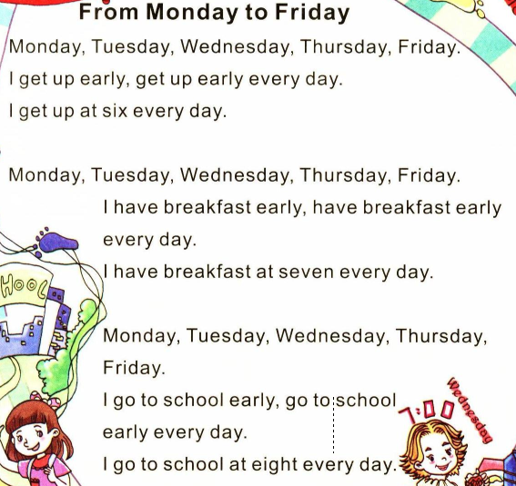
Let’s sing

Slide 6
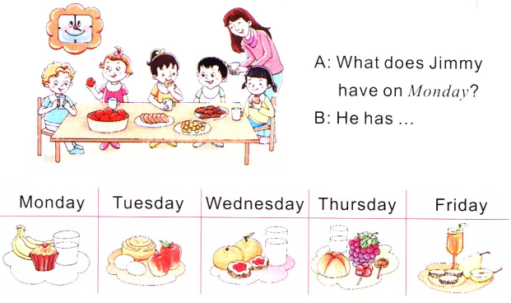
Talk about Jimmy’s afternoon tea

Slide 7
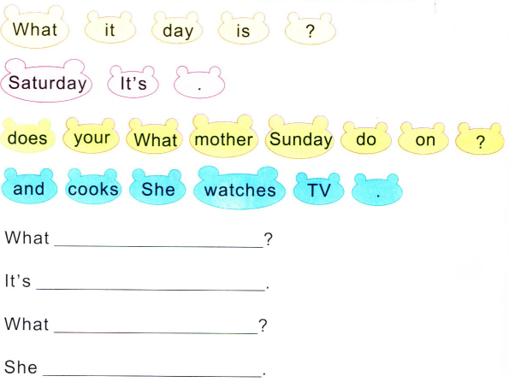
Put the words in order and write
day is it
Saturday
does your mother do on Sunday
watches TV and cooks

Slide 8
Good to know
新单词 缩写 中文含义
Monday Mon. 星期一
Tuesday Tue. 星期二
Wednesday Wed. 星期三
Thursday Thu. 星期四
Friday Fri. 星期五

