Slide 1
Unit2 There are forty students in our class.
人教精通版四年级下册
WWW.PPT818.COM

Slide 2
Warm-up
Let’s sing
（单击图片可播放动画）

Slide 3
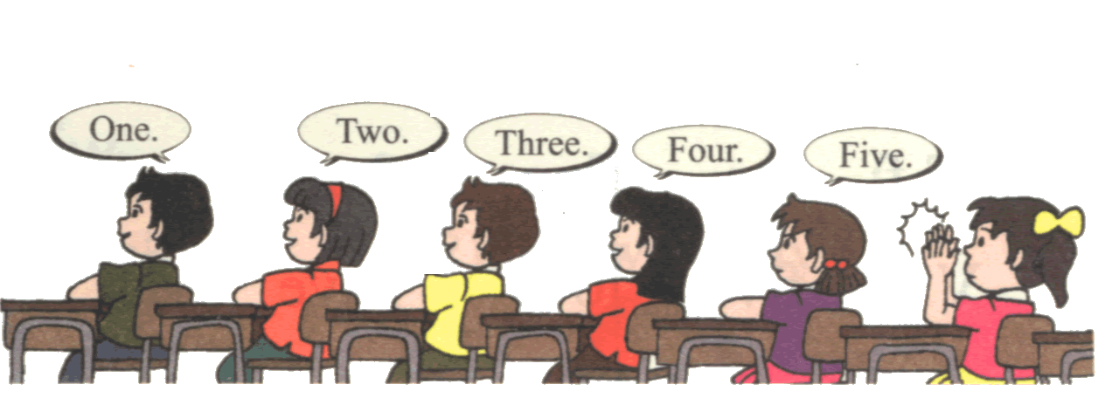
Lead-in
Game
数字接龙
one
two
three
…

Slide 4
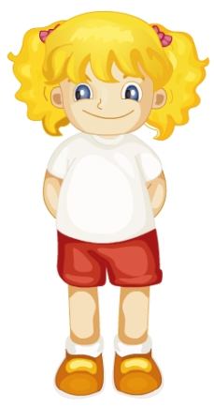
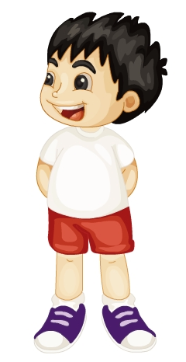
Presentation
Let’s learn
girl
boy

Slide 5
Presentation
Think and Say
How many girls are there in our class?
How many boys are there in our class?
…

Slide 6
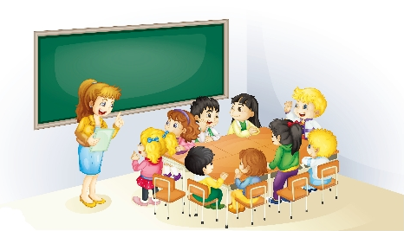
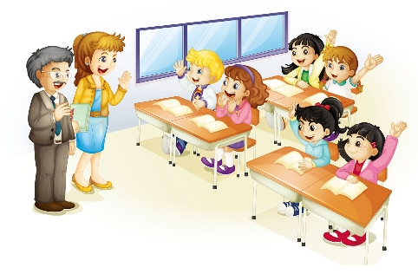
Presentation
Look and guess
Where are the children?
What does Miss Green teach?
What are they talking about?

Slide 7
Presentation
Listen and say
How many students are there in their class?
There are forty.

Slide 8
Presentation
Listen and say
How many boys are there in their class?
Thirty.
How many girls are there in their class?
Only ten girls.

Slide 9
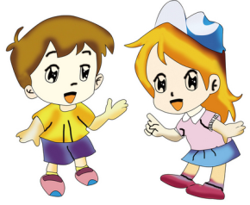
Practice
根据自己的情况，选择来做吧！
Role-play
Level1: 分角色朗读对话，注意模仿语音语调。
Level2: 四人一组，试着表演出来吧。

Slide 10
Presentation
Let’s learn
thirty

Slide 11
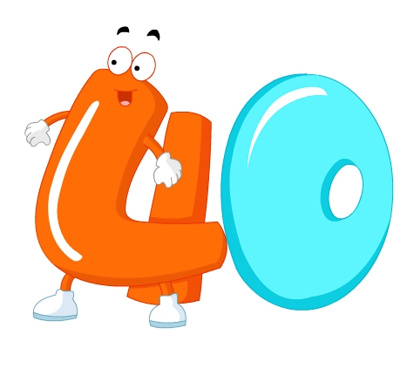
Presentation
Let’s learn
forty

Slide 12
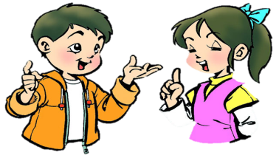
Practice
Ask and answer
Class 4, Grade 3
40 students
22 boys
18 girls
How many … are there in your class?
There are …

Slide 13
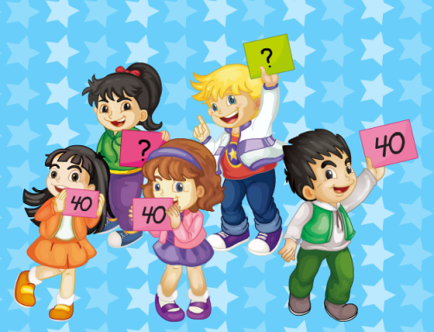
Practice
Let’s chant
（单击图片可播放动画）

Slide 14
Summary
1. 本课重点学习的单词是什么？
boy
girl
thirty
forty
2. 本课的重点句型是什么？
How many … are there in your class?
There are...

Slide 15
Homework
1. 跟读课文Just talk部分的录音，注意语音、语调。
2. 调查学校中任意两个班级的总人数和男女生人数，并制成一张表格。
3. 预习Lesson 9。
Close

