Slide 1
人教精通版六年级下册
Unit 3 We are going to travel.
WWW.PPT818.COM

Slide 2
>>Warm-up
Let’s sing

Slide 3
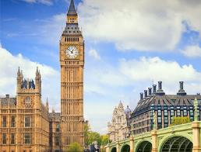
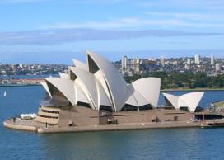
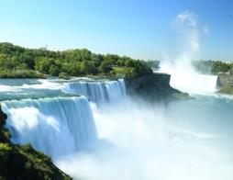
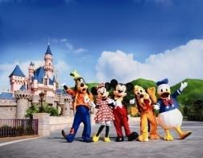
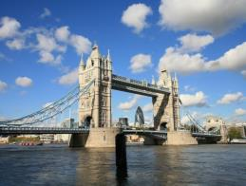
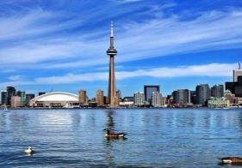
>>Lead-in
Big Ben
Sydney Opera House
Niagara Falls
Disneyland
Tower Bridge
CN Tower

Slide 4
>> Lead-in
Would you like to go to…?
Of course.

Slide 5
>>Presentation
Just practise

Slide 6
>>Practice
Britain
Canada
Australia
America
Big Ben
Tower Bridge
Niagara Falls
Sydney Opera House
CN Tower
Disneyland

Slide 7
>>Presentation
I want to see all my favourite places.
想
看见
最喜欢的
地方

Slide 8
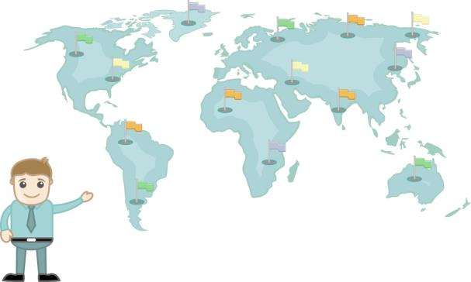
>>Practice
Would you like to go to…?
Yes, of course. I want to see all my favourite places.

Slide 9
>>Practice
Just write
want
想
see
看见
favourite
最喜欢的
place
位置；地点
I want to see all my favourite places.

Slide 10
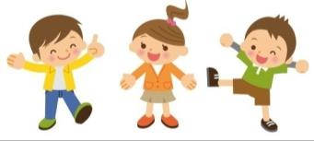
>>Practice
Group Work
Would you like to go to…?
Of course.
It’s very famous.
I want to see...
That’s great!
That’s amazing!

Slide 11
>> Presentation
Let’s chant

Slide 12
>>Summary
四会单词：
want
see
favourite
place
如何询问对方是否想去迪士尼？
---Would you like to go to Disneyland?
---Yes, of course.
如何表达“我想看到所有我最喜欢的地方”？
I want to see all my favourite places.

Slide 13
>>Homework
1. 观看课文动画，按照正确的语音、语调朗读课文。
2. 跟唱Let’s Sing部分。
3. 预习Revision。
close

