Slide 1
Unit 1 Lesson 1
We have Chinese.
WWW.PPT818.COM

Slide 2
 | Aims (学习目标) |  | 自我评价
 | talk about my school subjects.(能谈论自己的学校课程、表达喜好。)
 | talk about my day.(能流畅谈论自己的一天安排。)
 | talk about my school life. （能简单地谈论自己的学校生活。）
I can

Slide 3
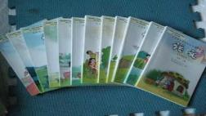
Listen and answer
1. What’s his name ?
Tom.
2. What are they talking about ?
Subjects.

Slide 4



Chinese
PE
English
subjects

Slide 5
What subject do we have this morning ?
We have …
Let’s guess!

Slide 6
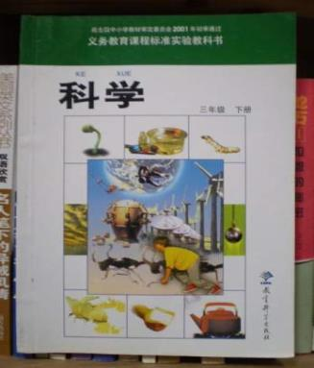
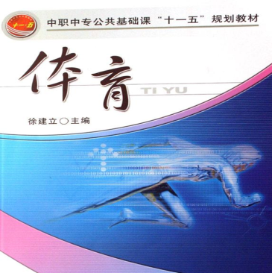
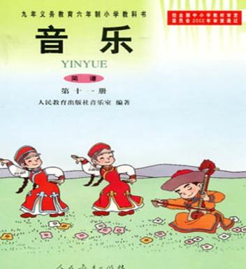

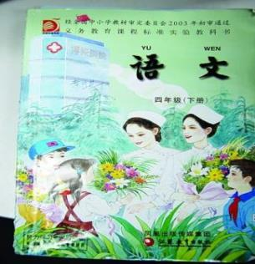
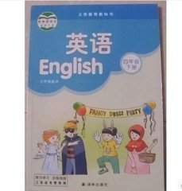

What subject is it ? (它是什么学科？)
Play a game
Have a guess
Write Aa, Bb,Cc.
Speak Chinese.
1 and 2 is 3.
Draw pictures.
Play football.
Sing and dance.
Watch leaves(叶子).

Slide 7
What do we learn today?
What subjects do we have this afternoon ?
——We have Chinese today.
PE.
English.
music.
art.
……

Slide 8
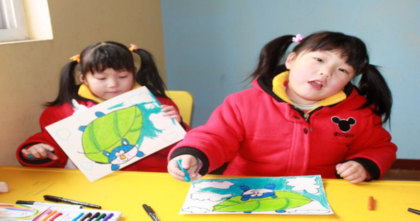
What subjects do we have this morning ?
We have art.

Slide 9
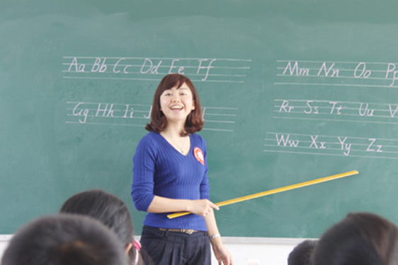
What subjects do we have this morning ?
We have English.

Slide 10
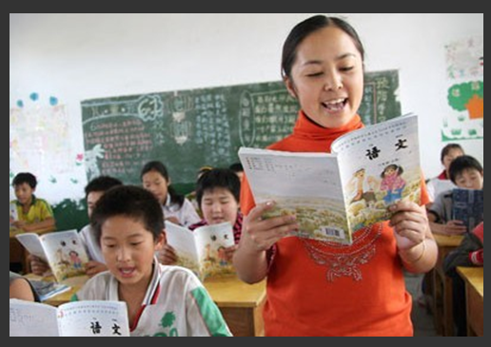
What subjects do we have this afternoon ?
We have Chinese.

Slide 11
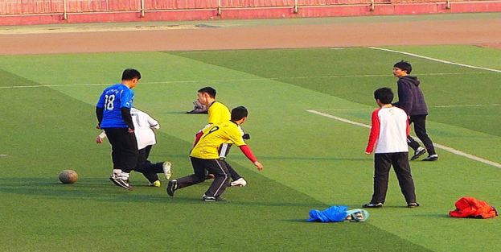
What subjects do we have this afternoon ?
We have PE.

Slide 12
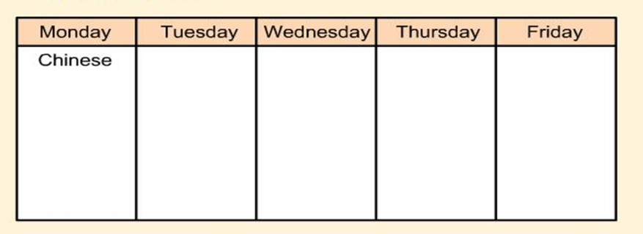
Design your own timetable.
（自己设计一个课程表，注意合理性。）
Tip: Do it quickly by yourself. (快速地独立完成)

Slide 13
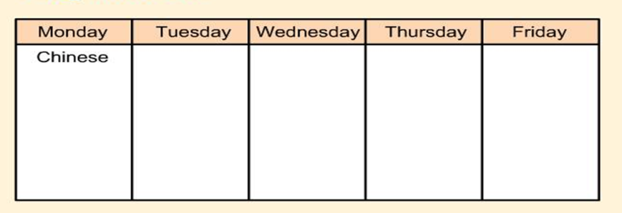
Ask and answer.
Eg: A: What lessons\subjects do you have on Monday
\on... \every day?
B: I have Chinese, …and…on Monday\on…\every day.
看着自己设计的课表，与同桌做对话。

Slide 14
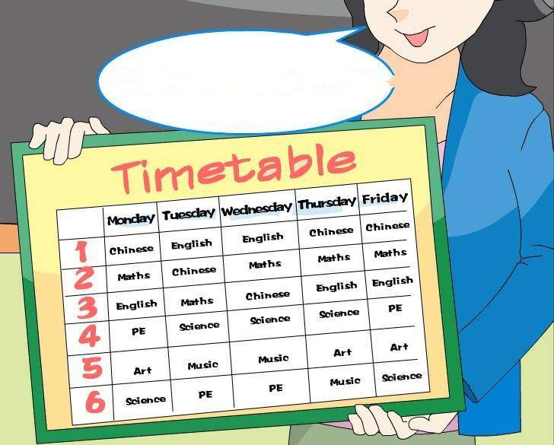
Our timetable
We have Chinese, maths, English and PE this morning.
Morning
Afternoon

Slide 15
Our timetable
We have art and science this afternoon.
Morning
Afternoon

