Slide 1
Unit 6 Topic 2
How about exploring Tian'anmen Square?
Section B
WWW.PPT818.COM

Slide 2
Review: word competition
receive
收到，得到
明信片
假期
忙着做
算出，制订出
期待着
explore
go camping
postcard
vacation / holiday
be busy doing
work out
look forward to
考查，探险
去野营

Slide 3
Review: Conversation
Make conversations to invite friends to do sth. together. The following expressions may help you.
May I invite you to…?
Would you like to …?
What about ….?
Shall we…?

Slide 4
Ask and answer
Where did you go during the National Day holiday?
What do people in Beijing usually do on that day?
What do you know about Tian’anmen Square?

Slide 5
New words
monument
n. 纪念碑
rostrum
n. 指挥台，主席台
announce
v. 宣布，宣告
meaningful
adj. 意味深长的
chairman
n. 主席
mean→ meaning →meaningful
memorial
adj. 纪念的，悼念的
found
v. 创办，建立

Slide 6
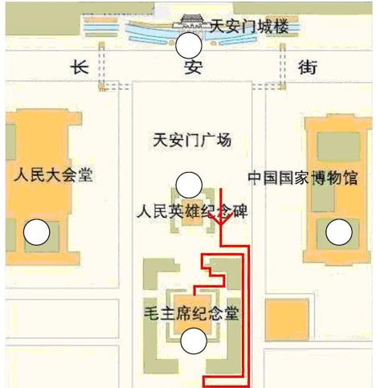
3a
Match the names with the buildings on the map. Then read the direction words and the name of each great building.
B
A. Monument to the People’s Heroes
B. Tian’anmen Rostrum
A
C. Chairman Mao Memorial Hall
D
E
D. Great Hall of the People
E. National Museum
C

Slide 7
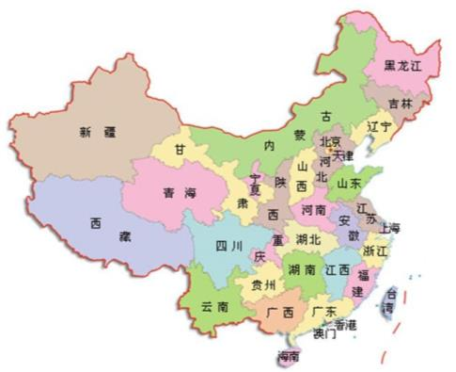
North
Northwest
Northeast
★
West
East
Southwest
Southeast
South
Beijing is in the north of China.
Taiwan is to the southeast of Fujian.
Shangdong is on the northeast of Henan.

Slide 8
in the +方位名词 + of …
指某一范围之内的地区
to the +方位名词 + of …
The use of “in”, “on” and “to”
指互不接壤并互不管辖的两个地区
on the +方位名词 + of …
指相互接壤但互不管辖的两个地区
Make more sentences with the map.

Slide 9
3b
Fill in the blanks with the correct direction words in 3a. Then read the sentences aloud.
The Tian’anmen Rostrum is in the_________ of Tian’anmen Square.
The Monument to the People’s Heroes is in the __________ of Tian’anmen Square.
The Great Hall of the People is to the _________ of the Monument to the People’s Heroes, and the National Museum is to the __________ of it.
The Chairman Mao Memorial Hall lies to the ____________ of the Great Hall of the People while it lies to the _________ of the National Museum.
north
south
west
east
southeast
southwest

Slide 10
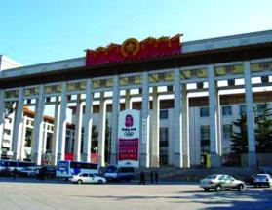
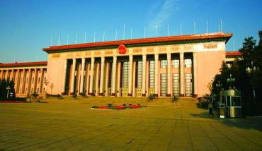
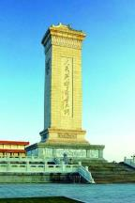
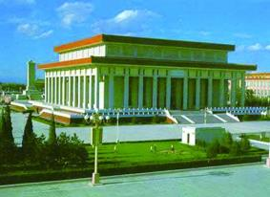
2
A.Listen and number the pictures.
3
2
Great Buildings in Tian'anmen Square.
National Museum
Great Hall of the People
October, 1959
September, 1959
_________________
___________________
1
4
Monument to the People’s Heroes
Chairman Mao Memorial Hall
April, 1958
May, 1977
____________
____________
B. Listen again and write down the time when people built these buildings.

Slide 11
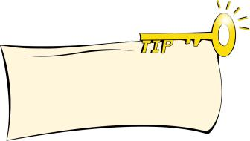
1b
Listen to 1a and underline the information about Tian’anmen Square. Then complete the table with key words.
Key points of a topic will help you to express better.
Location |  | Width
Area |  | Great buildings
Length |  | Meaning
in the centre of Beijing city
500m
the Monument to the People’s Heroes, Tian’anmen Rostrum
440 000m²
quite meaningful to all Chinese people
880m

Slide 12
Fill in the blanks according to 1a.
Tian’anmen Square is in the _______ of Beijing City. It’s the _______ square in the world. It covers _______ square meters. It’s ______ meters long from north to south and _____ meters wide from east to west.
There are many _______ _______there, such as the Great Hall of the People, the Monument to the People’s Heroes, and so on.
It will take Kangkang and his friends about _________ to ride there.
center
largest
440 000
880
500
great buildings
1.5 hours

Slide 13
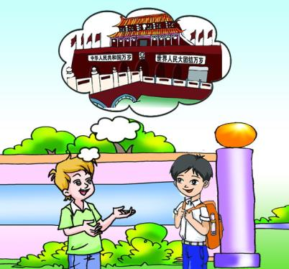
Work in pairs and use your own words to introduce Tian’anmen Square.
center, largest, 440 000 m² , 880 m, 500 m, one million,

Slide 14
Translation
Exercise
1. 从这到天安门有多远？
How far is it from here to Tian’anmen Square?
2. 我迫不及待地想去看它。
I can’t wait to see it.
3. 天安门广场的面积有44万平方米,能容纳100万人。
Tian’anmen Square covers 440 000 square meters. It can hold 1,000,000 people.
4. 它南北长880米。
It’s 880 meters long from north to south.
5. 日本位于中国的东面。
Japan lies / is to the east of China.

Slide 15
Read the pairs of words and pay attention to the sounds of the underlined letters. Then listen and try to imitate.
4a
thing — sing think — sink
thick — sick mouth — mouse

Slide 16
Read the sentences, paying attention to the liaison and intonation. Then listen and try to imitate.
4b
While Jane was singing, I was reading a book.
When John came in, Lily was writing a letter.
By the way, how far is it from here to the center of Beijing City?
In the south of the square, we can see a monument.

Slide 17
Summary
We learn
New words and phrases:
north, east, west, wait
Directions and positions:
in / on / to the east of…, in the center of…,
Phonetics, liaison and intonation:

Slide 18
Summary
We can
Describe directions and positions:
It’s in the center of Beijing City.
In the north of the square, we can see…
Describe the area, length and width:
It covers 440 000 square meters.
It’ 880 meters long ….
It’s 500 meters wide ….

Slide 19
Project
Use the map of China to introduce the positions of the provinces with the structure “in / on / to the … of …” . You can begin it like this:
Beijing is the capital of China. It’s in the north of China.

Slide 20
Homework
Review the key points in Section B.
Talk about the positions of the provinces of China by using the map.
Preview Section C.

Slide 21
The end.
Thanks!

