Slide 1
Unit 3 Asking the way
五年级(下)
第1课时
WWW.PPT818.COM

Slide 2
Think and say
回忆一下杨玲是怎样问路的？
How do I get to your home?

Slide 3
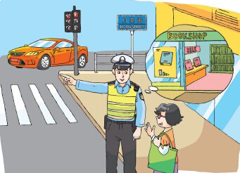
Think and say
How do I get to the bookshop?

Slide 4
How to ask the way?
How do I get to …?
我们还可以用其他方法问路吗？
Where’s…?
Can you show me the way to…?
Can you tell me the way to…?
Do you know the way to…?

Slide 5
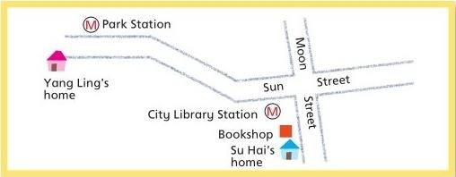
Try to say
How does Yang Ling get to Su Hai's home?

Slide 6
游戏介绍
今天下午苏海和杨玲一起去Fruit Town寻找一张
Map , map！
Where are you?
让我们一起加油吧！惊喜等着你哦！

Slide 7
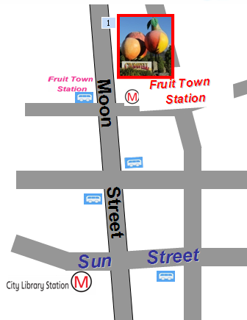
Try to say

Slide 8
Try to say
I can take the …
I get on the … at … and get off the … at …
选择一种你喜欢的出行方式，
和同桌讨论去水果小镇的路线。
11
Fruit Town Station
Fruit Town Station
City Library Station
11
Sun Station
Su Hai’s home

Slide 9
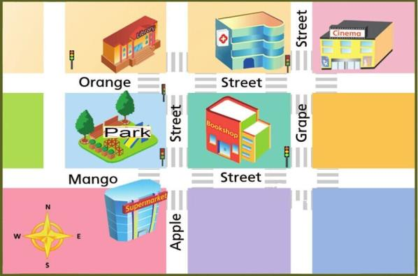
Try to tell
Fruit Town

Slide 10
Try to tell
Fruit Town

Slide 11
四人一小组，讨论路线，
绘制路线图，然后向同学介绍。
Try to tell
四人可以选择同一地点，分配好任务。四人也可选择不同地点，分别绘制路线，不同的路线用不同颜色的笔画。

Slide 12
参考句型
I think the map is in the…
Go along…
Walk along…
Turn…at…
The…is… /You can see the…is…
…

Slide 13
四人一小组，讨论路线，
绘制路线图，然后向同学介绍
Try to tell

Slide 14
How to ask and show the way?
These expressions are very useful.
这些交际用语很有用。
问路和指路的用语不止这些，你可以在课后多查一些资料，了解更多有关问路和指路的表达方式。

Slide 15
Homework
1. Talk with your parents about how to ask and show the way in English.
和父母交流如何用英语指路和问路。
2. Write down the way from your school to your home.
写一写从学校到你家的路线。

