Slide 1
Unit 7 Abilities Grammar 1
WWW.PPT818.COM

Slide 2
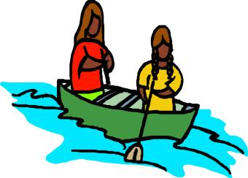
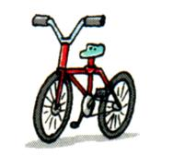
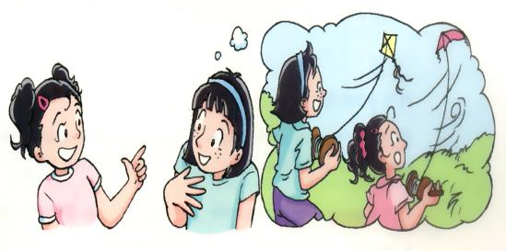
Do you know these sports?

Slide 3
row a boat
I could not row a boat at five. Now I can .

Slide 4
ride a bike
...could not ... now ...can...

Slide 5
play badminton
...could not ... now ...can...

Slide 6
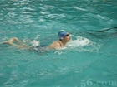
swim/ have a swim
...could not ... now ...can...

Slide 7
fly a kite/ kites
...could not ... now ...can...

Slide 8
Grammar
Using “can”/ “could” to talk about ability
we use “can” to say that we are able to do something now.
we use “could” to say that we were able to do something in the past.
e.g. I can (cannot /can’t /can not ) swim. What about you?
He could (couldn’t /could not) dance in the past. What about you ?

Slide 9
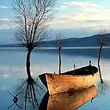
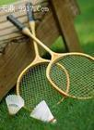
What can they do ?/ What could they not do?
 | Sandy | Simon | Millie | Daniel& Peter | Amy
last year | × | × | × | × | ×
this year | √ | √ | √ | √ | √
Last year, Sandy _________.Now she _______. .... Simon...

Slide 10
Ask and answer the questions
 | Sandy | Simon | Millie | Daniel& Peter | Amy
last year | × | × | × | × | ×
this year | √ | √ | √ | √ | √
Can Sandy row a boat now? Yes, she can Could Sandy row a boat last year? No, she couldn't.

Slide 11
2 "can " "could " possiblity
When we want to express something is possible, we use can/could
can/could ---- present
(the possibility: can>could)

Slide 12
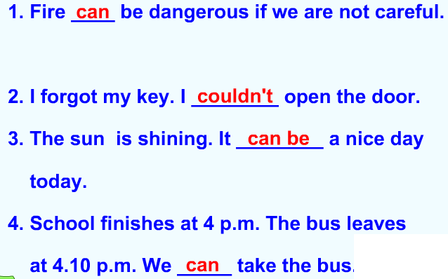
2 "can " "could " ------- possibility

Slide 14
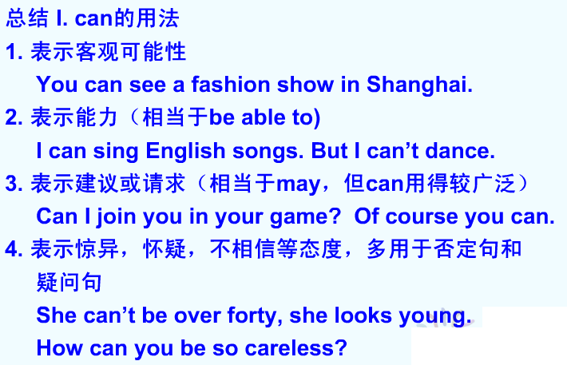

Slide 15
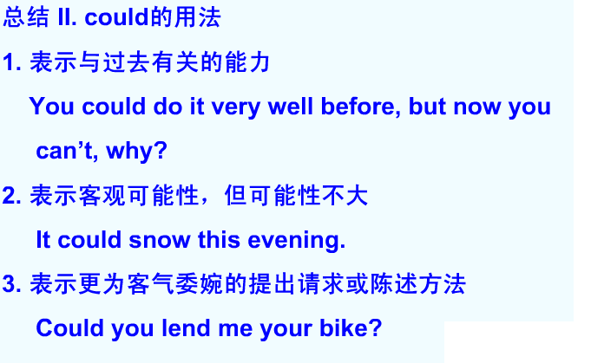

Slide 16
注意
当委婉表达 “请求” “要求”时，用could。
而回答时，肯定用can.否定语气一般要婉转，有时可说明不能的原因。如：
--Could you send this letter for me?
--Yes, I can./sorry, I’m busy now.

Slide 17
Exercises: Fill in them with"could/could not "
"can/ can not".
1 It is snowing in Canada. We ______go skiing there. 2 The swimming pool does not open today. We ________ go swimming.
3 We ___________ fly kites yesterday because it rained.
4 We _______ play badminton last Friday because we had our badminton rackets.
5 We ________ play football because Simon forget to bring a football.
can
can not
could not
could
can not

Slide 18
Take turns to ask and answer questions using “can” or “could”.Try to make dialogues in pairs.
1.____ you speak Japanese ?
2._______ you play the piano last year?
3._______ you cook?
4._______ you use a computer when you were 3?
5._______ you ride a bicycle when you were very younger?
6._______ you understand English TV programmes in 2000?
Can
Could
Can
Could
Could
Could

Slide 19
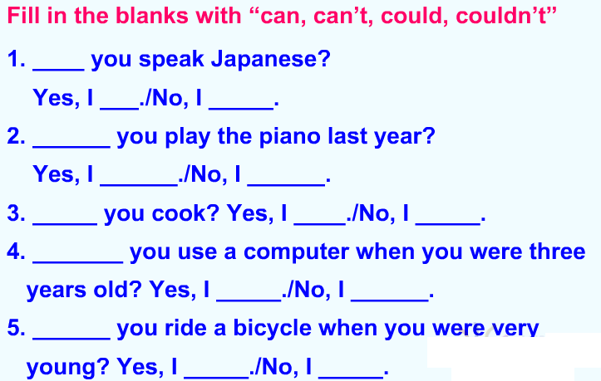

Slide 20
Homework:
1 Recite new phrases.
2 Learn to use "can/could " to show "ability"/ "possibility".
3 Pay attention to the sentence change.

Slide 21
Goodbye!

