Slide 1
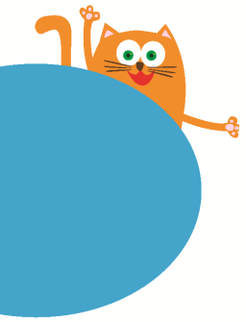
Small animals
11
第二课时
WWW.PPT818.COM

Slide 2
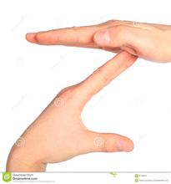
Make Z with your body

Slide 3
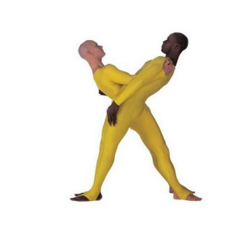
Make X with your body

Slide 4
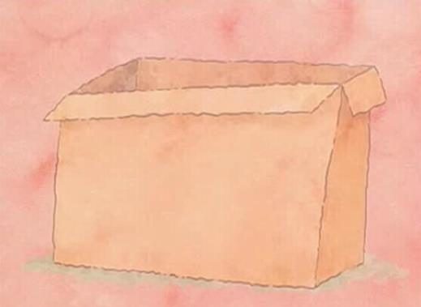
What's in the box?
It's thin.
Its tail is long.
Its ears are big.
Its eyes are big.
It's brown.
It's...
Its tail is...
Its ears are...
Its eyes are...
It's...(color)

Slide 5
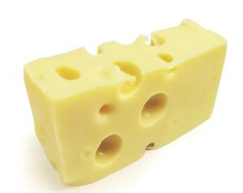
a yellow cheese

Slide 6
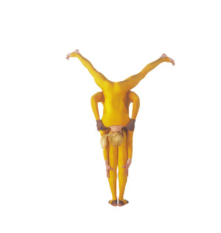
Make Y with your body

Slide 7
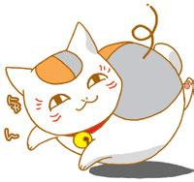
What's in the box?
It's fat.
Its tail is long.
Its eyes are big.
Its ears are big.
It's white.
It's...
Its tail is...
Its eyes are...
Its ears are...
It's...(color)

Slide 8
A small mouse

Slide 9
Why?
What's in the box?
Nothing！

Slide 10
Small animals in the magic zoo
In the magic ， there is a .
Here comes a small mouse.It's .Its tail is .Its ears are .He says "What's in the box?Oh, there is a cheese."
Here comes a cat.It's . Its tail is .Its eyes are .He says "What's in the box?Oh, there is a mouse."
Here comes a boy.He says"What's in the box.Nothing!" Why?
zoo
box
thin
long
big
yellow
fat
long
big

Slide 11
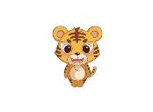
Make your story
In the magic zoo, there is a box.
Here comes a small .
It's .Its tail is .Its ears are .He says "What's in the box?Oh, there is a yellow ."
Here comes a .It's .
Its tail is . Its eyes are .He says "What's in the box?Oh, there is a ."
Here comes a boy. "What's in the box.Nothing! "Why?
cat
mouse
dog
rabbit
fox
yak
tiger
zebra
cheese
apple
yogurt

Slide 12
Homework
1. Share your story with your parents.
2. Workbook P67

